Slide 1

Credit Unions:
Supporting members and
developing communities

Slide 2
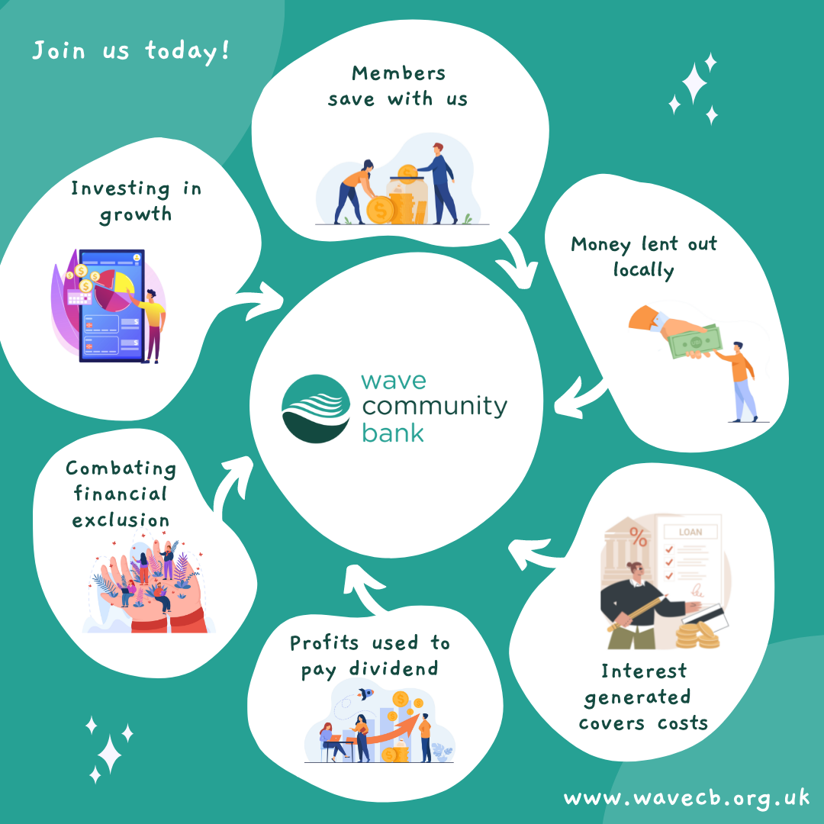
Wave Community Bank
Credit union – not-for-profit savings and loans co-operative owned and run by its members focussed on financial inclusion. A truly community owned organisation with no fat cats.
Anyone living or working in Kent, Medway, East Sussex, Brighton & Hove, and the London Borough of Bexley, plus Unite in the South East Region can join us.
Established in 2000 and merged with Kent Savers Credit Union February 2024
14,600+ members
£6.9m assets, savings £5.8m, loans £4.3m
Authorised and regulated by the PRA and the FCA
Volunteer Board of Directors
Staff and volunteer run – 4 of current staff team started as volunteers
Notes:
Prudential Regulation Authority and FCA

Slide 3


Our Services
Savings accounts including:
  Share accounts
  PrizeSaver – monthly prize draws for £5000
  Wave Save – money management tool to reach savings goals
  Christmas Savings account – locked to 1st Nov
Savings protected by FSCS
Ethical loans £500 - £35,000 – all with a savings element
We lend for all sorts of reasons helping local people to access affordable credit
Workplace Savings schemes with local employers
Collaborative working with local authorities, NHS Trust and charities

Slide 4

Community Group accounts
Community groups can have a business account with us – foodbanks, small charities, CICs etc
Need a constitution and two signatories
Can receive grants into these accounts
Remember this is a savings account not a current account
Download and complete a business membership application from our website

Slide 5

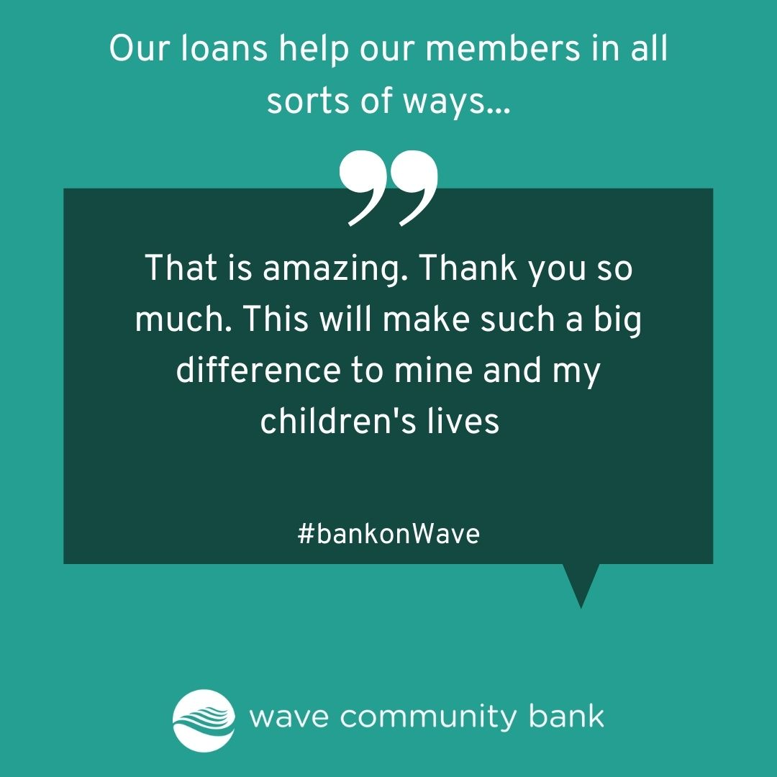
Affordable loans for members
Issuing 2200+ loans a year
975 Family saver loans issued in a year – repaid using child benefit.
1600 Loans under £1k - saving borrowers £231k interest compared to other lenders
We look at affordability as the priority
All borrowers save as part of their loan repayment
(loan data from 1/10/24 to 30/9/24)

Slide 6
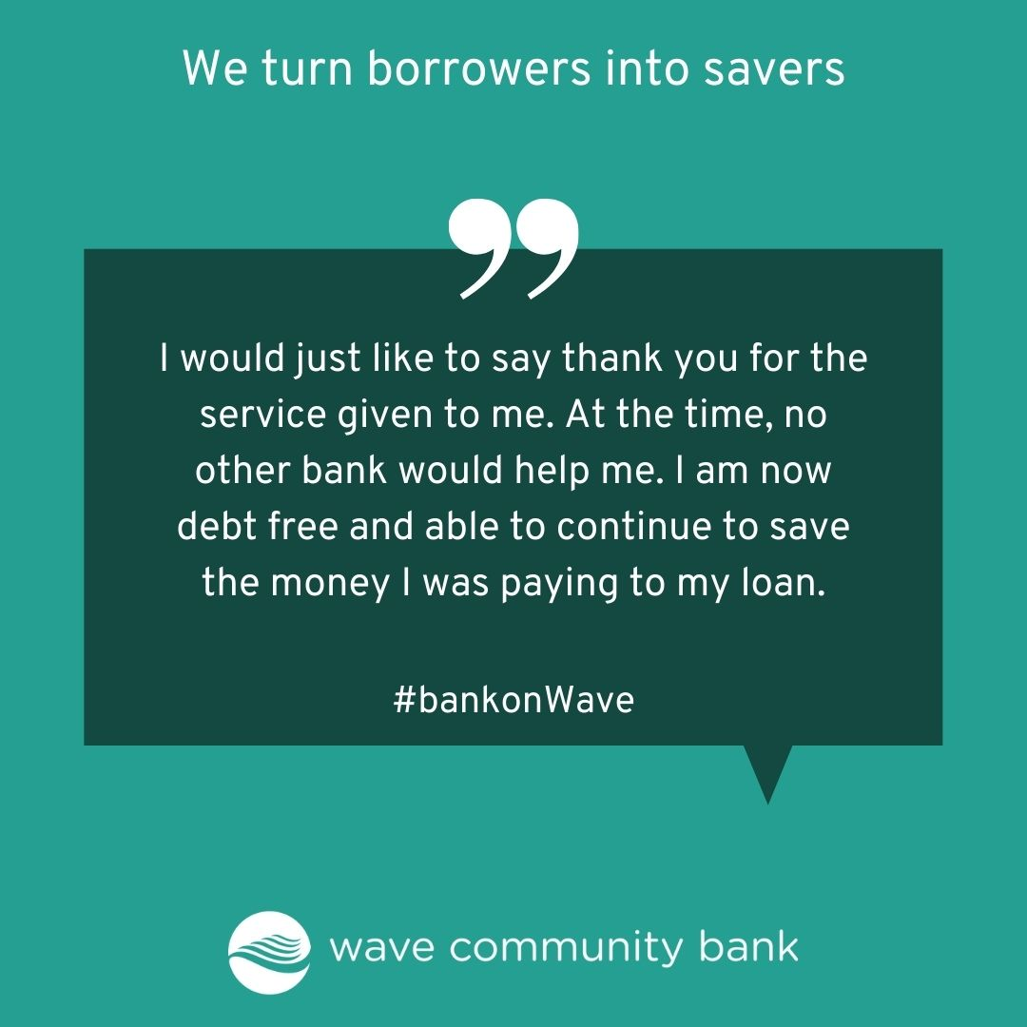
Who are our members?
We have to members in all sorts of circumstances…
  Employed
  Unemployed / benefit recipients
  Single parents
  Retired
  Students
  Young people (under 16s)
  ‘unbanked’ - Street homeless
  People in vulnerable circumstances – migrants, refugees, people with SEND, people with non-standard ID
  Community Groups – organisations, associations, foodbanks
  Members join us for all sorts of reasons – our ethical roots, co-operative principles, financial inclusion work and for some there is no other financial service that will help them.

Slide 7
The Kent members we serve
6000+ members in Kent
60% of members are female
Average age of members = 38
44% of loan applications are from unemployed people
Credit unions are for EVERYONE

Slide 8
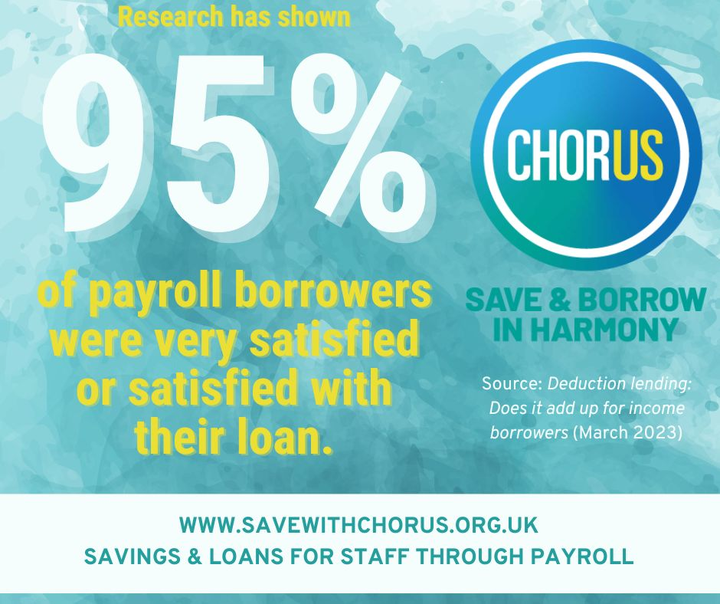
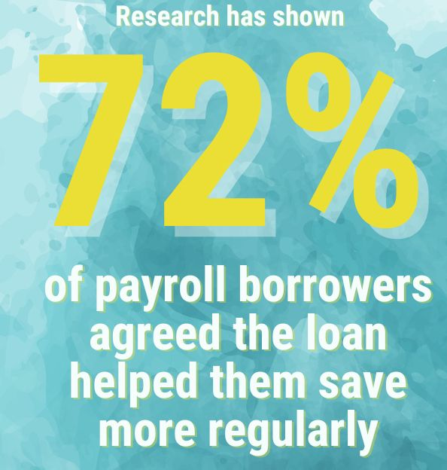
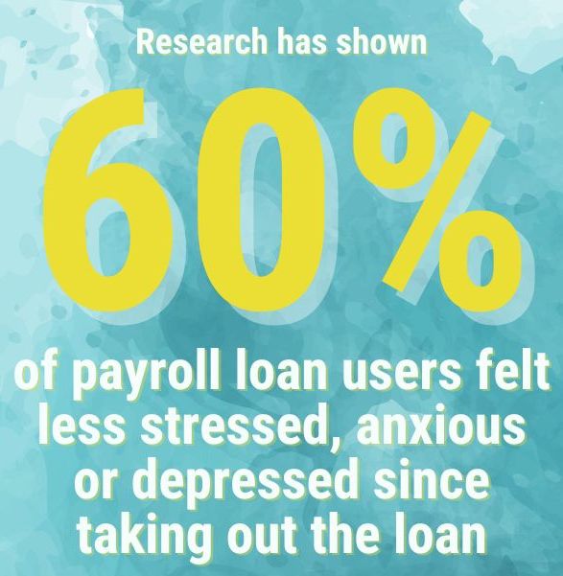
Our Workplace Saving Scheme
Partnerships with Employers to offer payroll deduction savings and loans
  Free staff benefit for employers that is simple and easy to run
  Higher loan application approval level with payroll employees
  Support for low paid workers
  Help staff build financial resilience through savings
  Access to financial education resources and money management support – visits and budgeting sessions
  High levels of satisfaction
  Over £1.2m lent to workers repaying through payroll
Source: Deduction Lending March 2023

Slide 9











Chorus Workplace Savings Scheme
WCB has partners across Kent and East Sussex including
  Local authorities – KCC, MBC, ABC, BHCC, ESCC, LDC, EBC, RDC
  NHS Trusts and Public Services – University Hospitals Sussex, East Sussex Healthcare and Sussex Community NHS Trusts and East Sussex Fire and Rescue
  Transport - Brighton & Hove Buses, Metrobus, The Big Lemon, Community Transport Brighton & Hove
  Charities – BHT Sussex, Marlets Hospice, Amaze, 3VA, Grace Eyre, Warming Up the Homeless, Havens Community Hub
  Private businesses – Let’s Do Business, Michelmersh Bricks, NSl Services, Martello
  Education establishments – University of Brighton, Varndean School

Slide 10
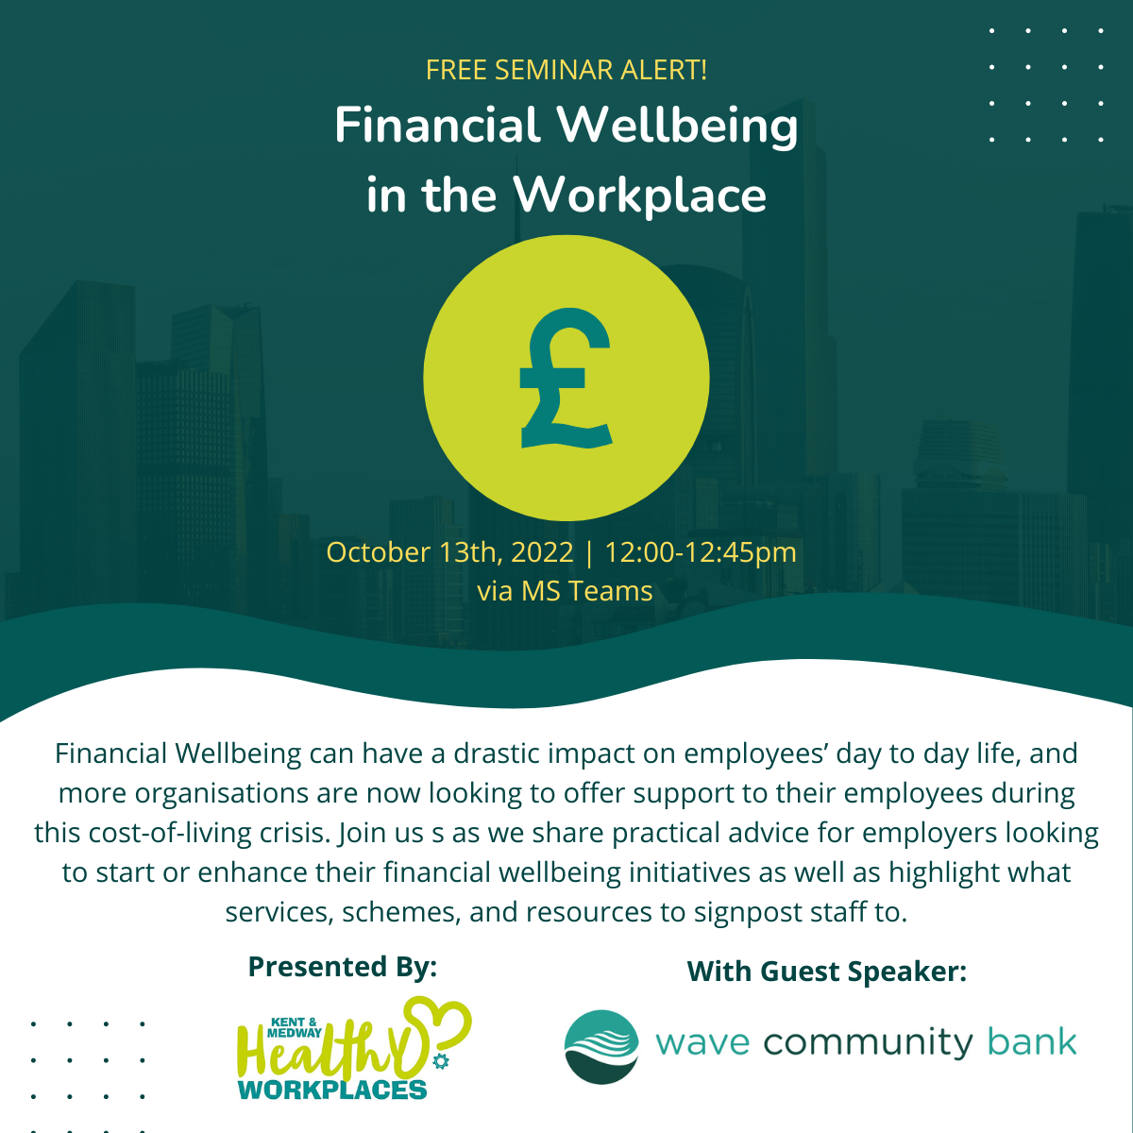

Workplace wellbeing initiatives
We’ve been working with Healthy Workplaces in Kent & Medway
Webinars for employers and workplace wellbeing champions
Blog posts and news letter articles on their online channels
Webinar with Money and Pensions Service for employers looking at the benefits of payroll schemes with credit unions - recording available

Slide 11

What are we doing to help our members?
Financial education has always been part of our social mission but more important than ever now
Helping our members to manage money better to improve affordability and build savings
  Financial Wellbeing webinars – improving credit scores, Tackling debt and Surviving the cost of living crisis
  Wave Money Guide – free resource to help with budgeting and attitudes to money
  MoneyHelper – MaPS content on our website.
  Benefits calculator – free to use and anonymous to find out what you are entitled to
  Signposting – when people need advice or help – tailored decline emails depending on the reason with signposting
  Money Guiders – MaPS staff training

Slide 12
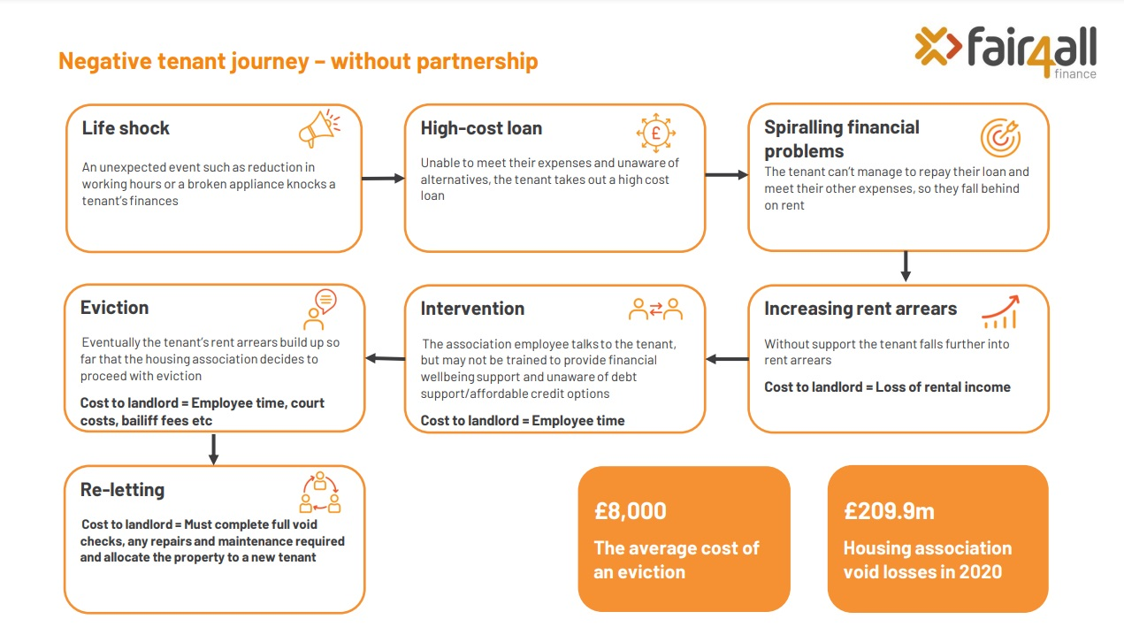
Notes:
Rise of BNPL products

Slide 13
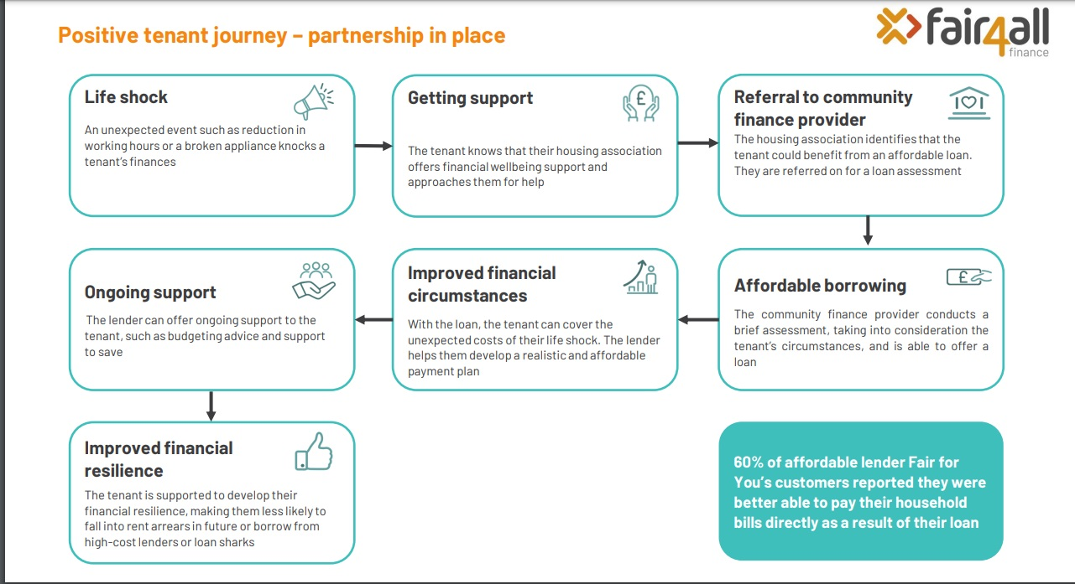

Slide 14
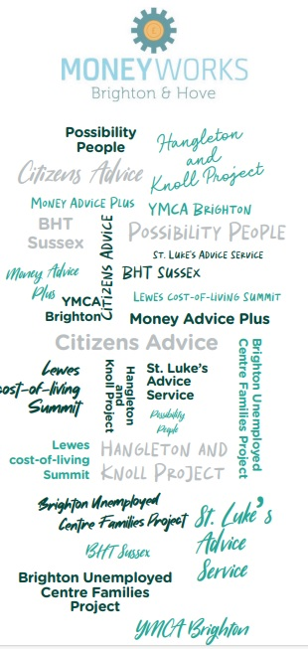
Community outreach and engagement
  Long history of community outreach and engagement collaborating with the VCSE sector
  ReferKent – actively engage with VCSE in Kent
  Moneyworks in Brighton & Hove – multi-agency collaborative working with Citizens Advice, Money Advice Plus and many other community support groups in the city
  ESCC’s Multi-agency Financial Inclusion Steering Group
  South East Financial Capability Forum

Slide 15
Innovation & partnership working
  Loans schemes with local councils including Maidstone
  Deposit Guarantee Scheme with BHCC helping over 1000 people into private rented accommodation
  More projects in the pipeline watch this space!

Slide 16
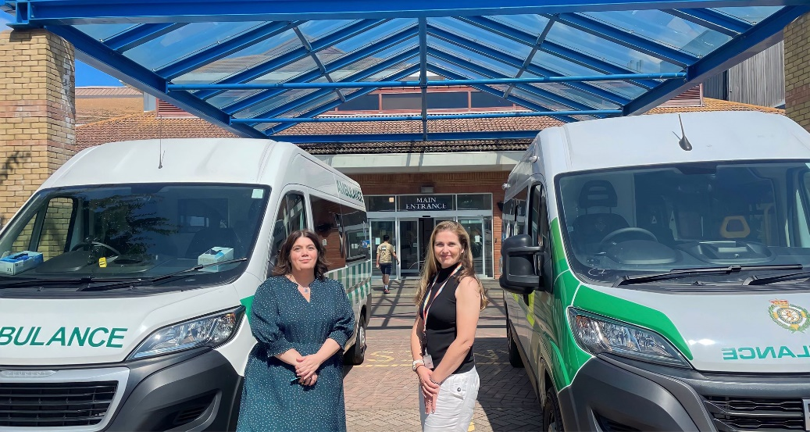




Innovation & partnership working
  Financial Wellbeing Support Officer based in University Hospitals Sussex NHS Trust – supporting staff of one of the largest NHS Trusts in England with financial wellbeing
  0% interest charity loans schemes with 4 charities – to help homeless people into accommodation and for refugees and immigrants with no recourse to public funds

Slide 17
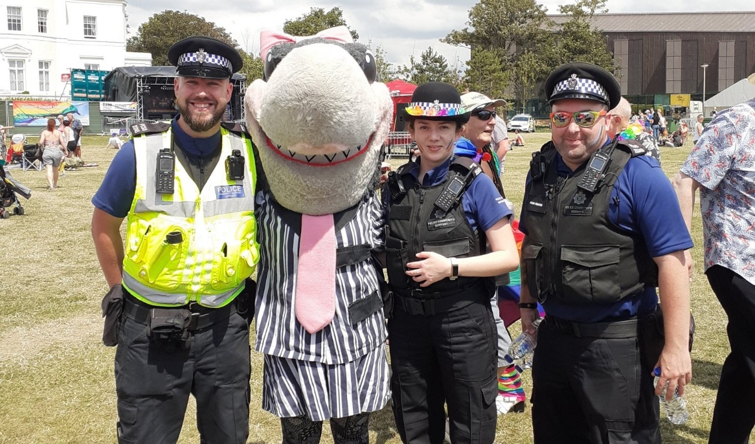
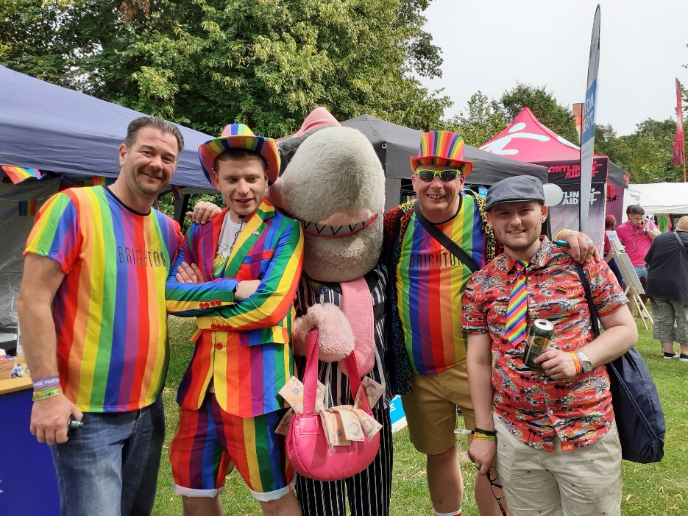

Stop Loan Sharks Campaign Partner
1.08 million people could be borrowing from illegal money lenders – increase of 700,000 on previous estimate (Centre for Social Justice: Swimming with Sharks)
Partner organisation with the Illegal Money Lending Team (England) promoting the Stop Loan Sharks Campaign
Stop Loan Sharks tour of Pride events
School visits to educate kids on the dangers of loan sharks
Savings bonus promotions sponsored by the IMLT with POCA money

Slide 18
Any questions?
Jennifer.Sutton@wavecb.org.uk info@wavecb.org.uk www.wavecb.org.uk
0300 303 3188 (Mon – Fri 9.30am – 1pm)

