Slide 1


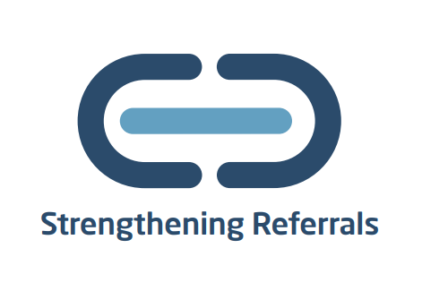


ReferKent
Making referrals simple, easy and secure
Notes:
ReferKent was launched in 2022, its an online referrals system that aimed to mitigate the action of signposting. It was recognised during the pandemic that people were often signposted to support, however the support wouldn’t always come to fruition, perhaps because they didn’t have the confidence in reaching out, or were passed between organisations. And from a professional perspective its not always clear if that person was actually getting the onward support following the signposting. The system aims to make referrals simple safe and secure between a network of organisations who onboard to the system.

Slide 2


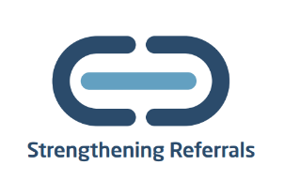

ReferKent
Making referrals safe, easy and secure!
Many people seeking support were subjected to signposting, often from one organisation to another. This left them feeling deflated and falling further into hardship. ReferKent takes the pressure off the individual to reach out.
www.kent.gov.uk/referkent
Notes:
At first the organisations that the team targeted were to help provide advice and guidance in relation to financial hardship, but we have since expanded to accommodate many different types of advice and support services. Having mental health services onboard has been one of the priorities as we all know that money worries and mental health often interlink and so now we have a number of mental health services onboard.

Slide 3



















































































































Notes:
Receiving Logos

Slide 4
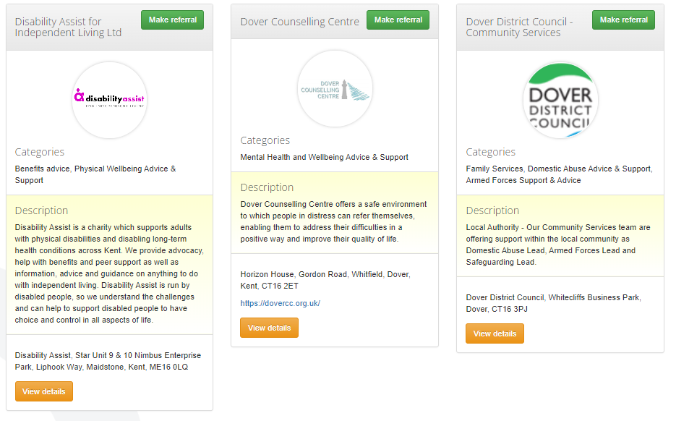

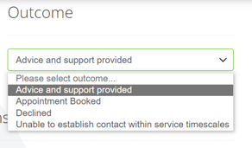
ReferKent

Slide 5



Promotion
Newsletter
Created from scratch every month
Contains information on projects, updates, helpful information across Kent
Dedicated sections to FH team
Spotlight Sessions
Monthly sessions
Highlighting organisations on ReferKent and the work they do
Allows people to learn about an organisation they might not know is on ReferKent
Networking Forum
Drop in session
First Tuesday of every month at 10:30am
Chance to speak with other professionals about projects that can be referred to
YouTube https://www.youtube.com/@ReferKent/videos
LinkedIn https://www.linkedin.com/showcase/99104717/admin/feed/posts/
Notes:
Also part of the RK package:
These are accessible to everyone, not just those onboard.
In order to sign up, we ask for service level agreement and data sharing agreement, which can be accessed by filling out our EOI form, or emailing the RK inbox.

Slide 6
Money Guiders
Feeling confident in giving money guidance
20 hours online learning
City and Guilds accreditation
Access to an online hub
Free to access
Book for an online information/enrolment session here:
Join the Money Guiders Programme (office.com)
For more information email referkent@kent.gov.uk
Notes:
We are also promoting ‘Money Guiders’ Course, which is aimed at professionals who might have informal conversations about money, in order to build their knowledge and confidence in having these conversations.
The course is 20 hours and you receive a City and Guilds Accrediation at the end. Again this is free to access, If you would like to join our waiting list, please contact us

Slide 7



Money Adviser Network (MAN) - Solution
Benefits
Provides a single point of entry to a panel of MaPS funded debt advice agencies
The MAN is available to residents of England (Government sponsored debt advice is a devolved matter)
The referral system directs customers to an agency with capacity to help immediately. The system can also arrange for a scheduled call back to the client from a debt advice agency
A key challenge is to ensure people who are financially struggling take action sooner rather than later. Therefore, creditors referring into the system helps to facilitate engagement with key support.
The Money Adviser Network (MAN) is a free, government sponsored partnership opportunity for creditors in the public and private sector. It simplifies how creditors (or government) refer customers in financial difficulty to free regulated debt advice.
Referral to
Online debt self-help tool
Immediate call-back from a Debt Advice Agency
Scheduled call-back from a
Debt Advice Agency
Notes:
The Financial Hardship Team have also been working in partnership with Money and Pensions Services, we have a system where professionals can make referrals for immediate, free debt advice. The call back can be instant, or a request can be made for a scheduled call back. The referral is quick and simple.
Organisations such as debt free London and step change are involved in this Govt sponsored programme.

Slide 8
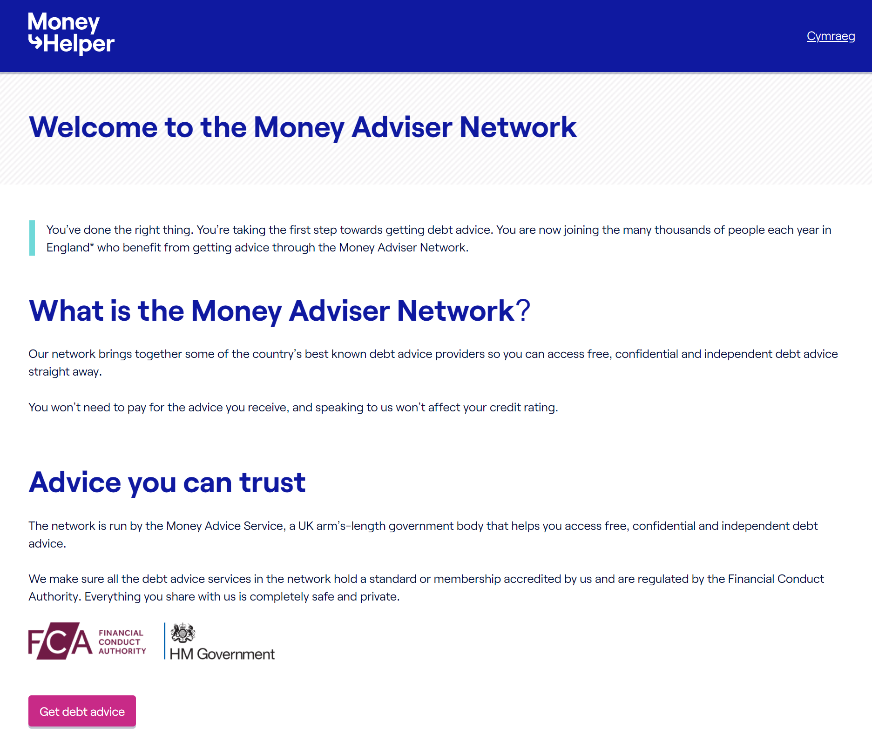
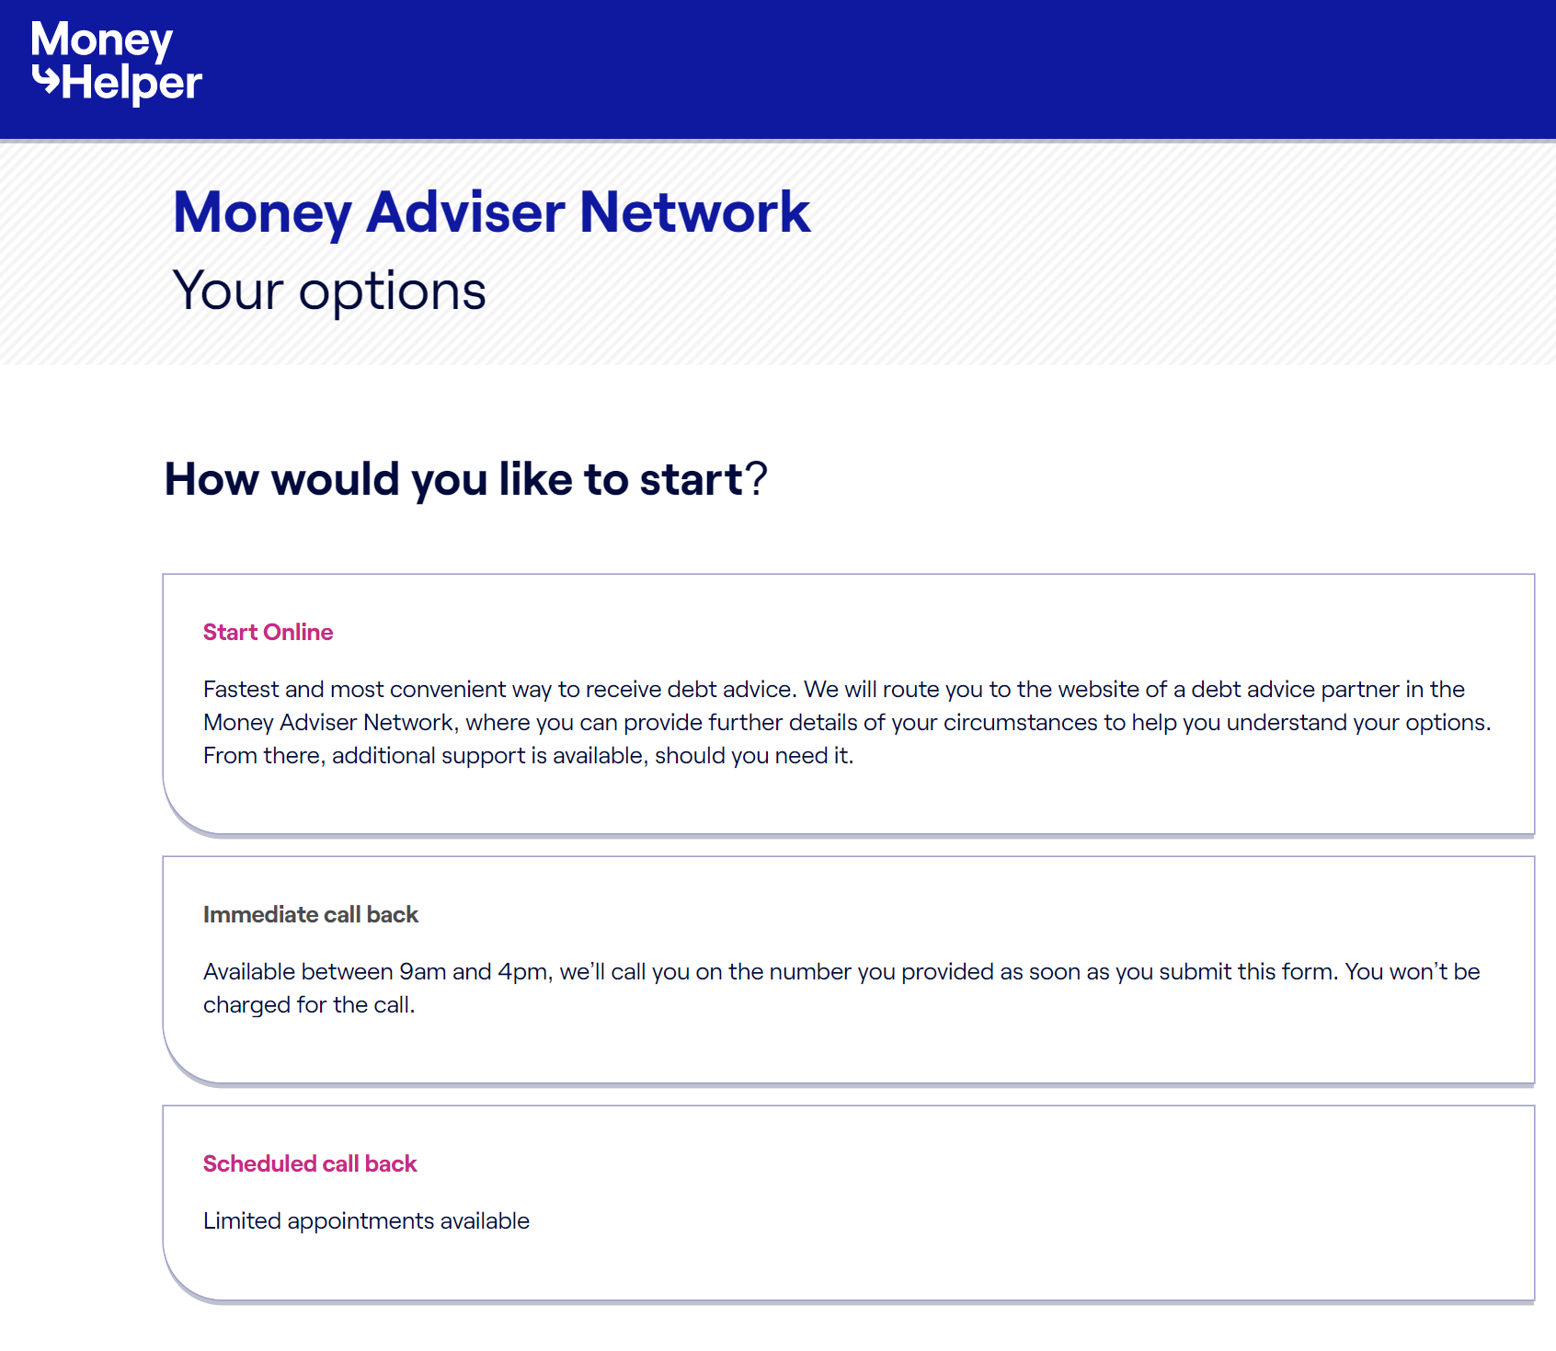
Money Adviser Network – customer self referral form
Customers can self serve and request an immediate or scheduled call back from a debt adviser
Or can opt to ‘self-help via on-line debt advice tools
Suitable for all customer communication channels (Websites, letters text messaging)
Notes:
There is also a self-referral option, through Money Helper, which the is the customer facing website. This website also has tools such as online benefits checkers and budgeting tools.

Slide 9


What is the Vulnerability Registration Service (VRS)?
Hosts a data base of vulnerable people, alerting organisations to customers or potential customers in vulnerable circumstances.
The VRS provides customer insight to help decision-making, customer support and delivery of the right outcomes.
Holds and easily accessible, unique dataset drawn from disparate sources from many different sectors.
For more information see: www.vulnerabilityregistrationservice.co.uk

Slide 10


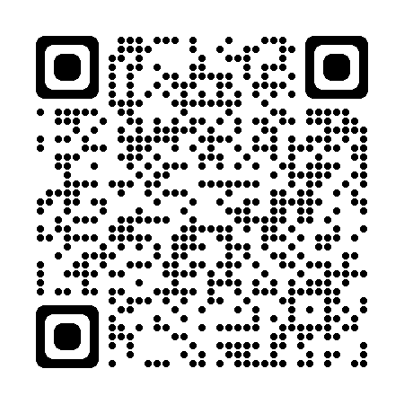
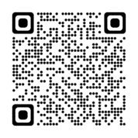

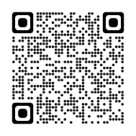

Money worries support by phone, video call, or at a kiosk
CALL
0808 175 6406
Mon—Fri
9am—5pm
Household income under £40,000
Savings less then £1,000
Other eligibility may apply
*Urgent Help & Support, inc. voucher
*Benefits Checker
*Advice on reducing energy bills

Slide 11






Digital Kent is working to improve digital inclusion and capabilities in Kent

Slide 12
Q&A
To onboard e-mail: ReferKent@kent.gov.uk
or click Join ReferKent as an Agency (office.com)

