Slide 1


Slide 2
About Us
Founded in 2006 by Tom Andrews, PU was established to ‘create a kinder world’ championing the movement of arts and creativity to elicit and support positive health and wellbeing, create deeper social connections, and encourage experimentation.
Underpinned by research, PU’s work evidenced that the arts could create the conditions for kindness to flourish.
From Kindness to Care….
Over the years the world changed, and the organisation and our practice responded. Kindness became Care and Care became Radical Care in a shift which recognises the complexity of the social, political, environmental and economic challenges we face
‘Instead of only acting as a force for self-preservation, care is about the survival of marginal communities because it is intimately connected to modern radical politics and activism. As Maria Puig de la Bellacasa notes, caring is “an ethically and politically charged practice.”
(Hobart and Kneese 2020)
Notes:
Who we are:
People United is an arts charity based in Canterbury. Our focus is co-designing care-centred art with local communities. Currently that includes collaborations with service users from organisations like Age UK and Kent Refugee Action Network - I can show some examples of what those projects look like shortly.
We were founded in 2006, and since then we’ve built a body of evidence showing how and why creativity can grow empathy, develop deeper connections and strengthen people’s belief that they can make change happen.
Our tried and tested methodology has defined components, such as research and deep listening, co-creation, working slowly, taking risks, sharing and celebrating, and building in legacy - all underpinned by taking care, paying attention and nurturing relationships throughout.
Our previous work has been on the mediators that connect creativity and kindness – however, we have taken a shift in recent years to more radical kindness (kindness that is strong, systemic and transformational) and then in 2022 shifting to focus on care.
We reviewed our values at this time, while kindness and creativity were central already, we were excited and hopeful to add the others: to be collaborative, inclusive, and brave. We began to ask bigger questions about power and to us that comes up as considering how we collaborate, and the art community framing of ‘co-design’. We are actively thinking of what care-centred practice means to us as we move forward.

Slide 3
Created as an authentic and living, breathing alternative to a formal vision, mission and values statement, these positions outline the way we work and the difference we want to make. As the world around us changes, so may our 10 Positions.
We are an arts organisation: We believe that everyone is an artist. That’s why we want to make art with you, not for you.
Our work is human-centred: Our work is relational. We recognise the importance of being vulnerable and the effect that may have on the communities we work with.
When appropriate we work with trauma conscious artists.
We make intentional choices: We pride ourselves on making bold, brave decisions about how we work and are not led by funding priorities or trends.
We lead/participate in strategic conversations: These conversations lead to partnerships, understanding, and build foundations for effective and lasting collaboration.
We learn and change: As a learning organisation we aim to create, acquire and transfer knowledge, enabling us to think holistically and systemically. Reflection and sharing within the creative sector and beyond are central to our practice.
About Us
Notes:
Who we are:
People United is an arts charity based in Canterbury. Our focus is co-designing care-centred art with local communities. Currently that includes collaborations with service users from organisations like Age UK and Kent Refugee Action Network - I can show some examples of what those projects look like shortly.
We were founded in 2006, and since then we’ve built a body of evidence showing how and why creativity can grow empathy, develop deeper connections and strengthen people’s belief that they can make change happen.
Our tried and tested methodology has defined components, such as research and deep listening, co-creation, working slowly, taking risks, sharing and celebrating, and building in legacy - all underpinned by taking care, paying attention and nurturing relationships throughout.
Our previous work has been on the mediators that connect creativity and kindness – however, we have taken a shift in recent years to more radical kindness (kindness that is strong, systemic and transformational) and then in 2022 shifting to focus on care.
We reviewed our values at this time, while kindness and creativity were central already, we were excited and hopeful to add the others: to be collaborative, inclusive, and brave. We began to ask bigger questions about power and to us that comes up as considering how we collaborate, and the art community framing of ‘co-design’. We are actively thinking of what care-centred practice means to us as we move forward.

Slide 4
About Us
We establish trust through slow relationship-building, working in solidarity with our local communities: We work with communities who are most affected by inequality, recognising power imbalances and, using our co-design methodology, strive for a more equal platform.
We are mindful of our place and impact in the world: We make collaborative art where our communities are (from people’s homes to public spaces), working with what’s already there.
We acknowledge there is a climate crisis: We want to do more than produce policies; we are actively creating programmes and practice which lead to a net zero future.
We embrace the unknown: We stay curious and brave, creating space for self-expression and a place to be more honest, joyful and celebratory.
We are building a positive legacy: What we leave behind matters; we have an ongoing commitment to create positive and lasting impact through the ‘ripple effect’ and cross sector working.
Notes:
Who we are:
People United is an arts charity based in Canterbury. Our focus is co-designing care-centred art with local communities. Currently that includes collaborations with service users from organisations like Age UK and Kent Refugee Action Network - I can show some examples of what those projects look like shortly.
We were founded in 2006, and since then we’ve built a body of evidence showing how and why creativity can grow empathy, develop deeper connections and strengthen people’s belief that they can make change happen.
Our tried and tested methodology has defined components, such as research and deep listening, co-creation, working slowly, taking risks, sharing and celebrating, and building in legacy - all underpinned by taking care, paying attention and nurturing relationships throughout.
Our previous work has been on the mediators that connect creativity and kindness – however, we have taken a shift in recent years to more radical kindness (kindness that is strong, systemic and transformational) and then in 2022 shifting to focus on care.
We reviewed our values at this time, while kindness and creativity were central already, we were excited and hopeful to add the others: to be collaborative, inclusive, and brave. We began to ask bigger questions about power and to us that comes up as considering how we collaborate, and the art community framing of ‘co-design’. We are actively thinking of what care-centred practice means to us as we move forward.

Slide 5
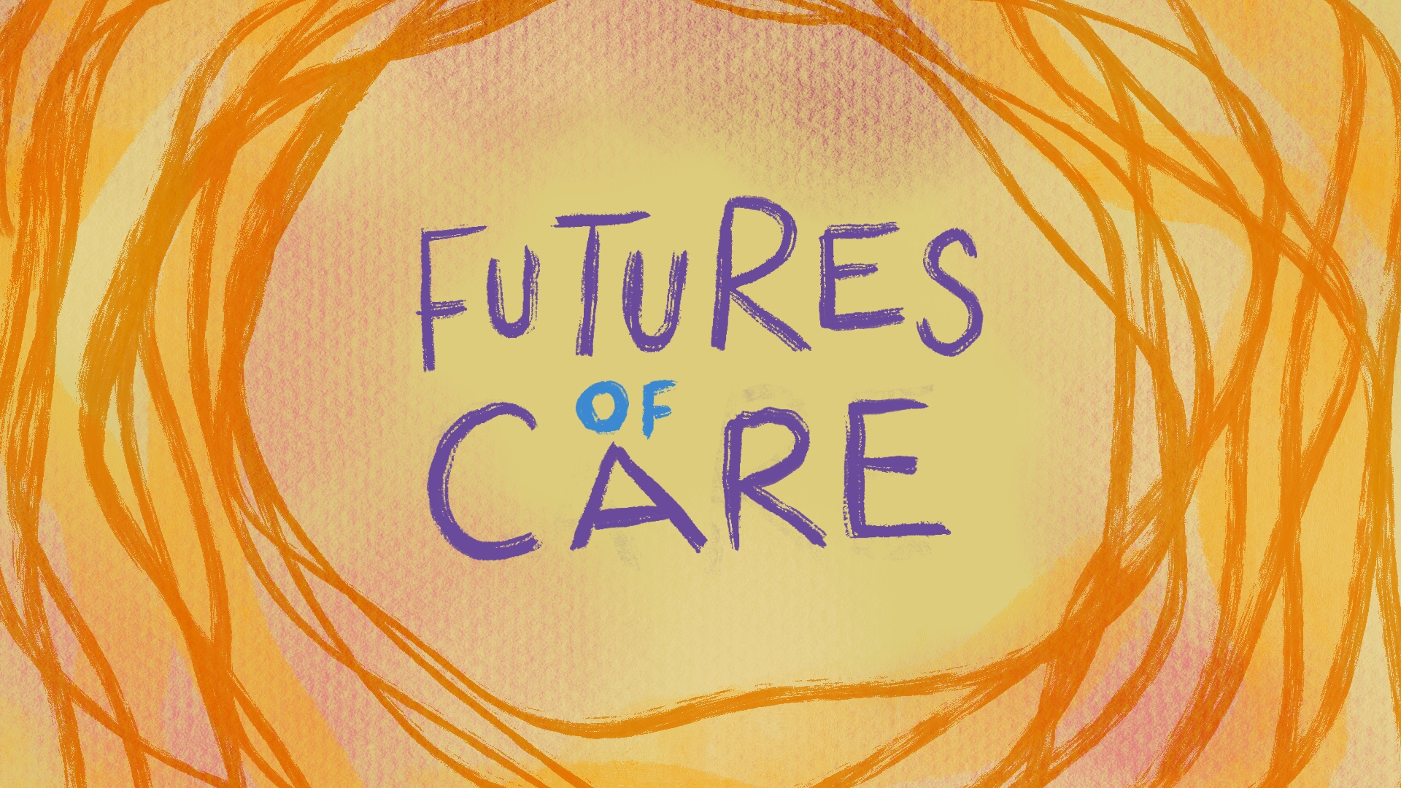
Our Projects
Each of our projects is a shared endeavour which shapes the change we want to see in the world. Our creative practice centres Radical Care and the lived experience of our communities, enabling us to question the status quo, reimagine it and create alternative scenarios. We understand the messiness and complexity of care and believe that it is in this place that change happens.
Notes:
Futures of Care:
Futures of Care is our collaborative, multi-arts programme exploring radical care, taking place across East Kent and online. Our programme started in 2021, partnering with Creative Estuary, Kent Refugee Action Network, Pie Factory Music, Dover Smart Project, The Beany and others to examine what taking care of ourselves and each other means in today’s changing world.
This time last year we ran our first care lab which was really powerful and brought up three main artist provocations:
- How do we create care-centred work in productivity-centred systems?
- How do we centre care collaborations between artists and communities?
- How we create the conditions for building and sustaining care-centred collaborations?
These are the kind of questions we are motivated by in our ongoing projects, I’d like to share two with you now.

Slide 6
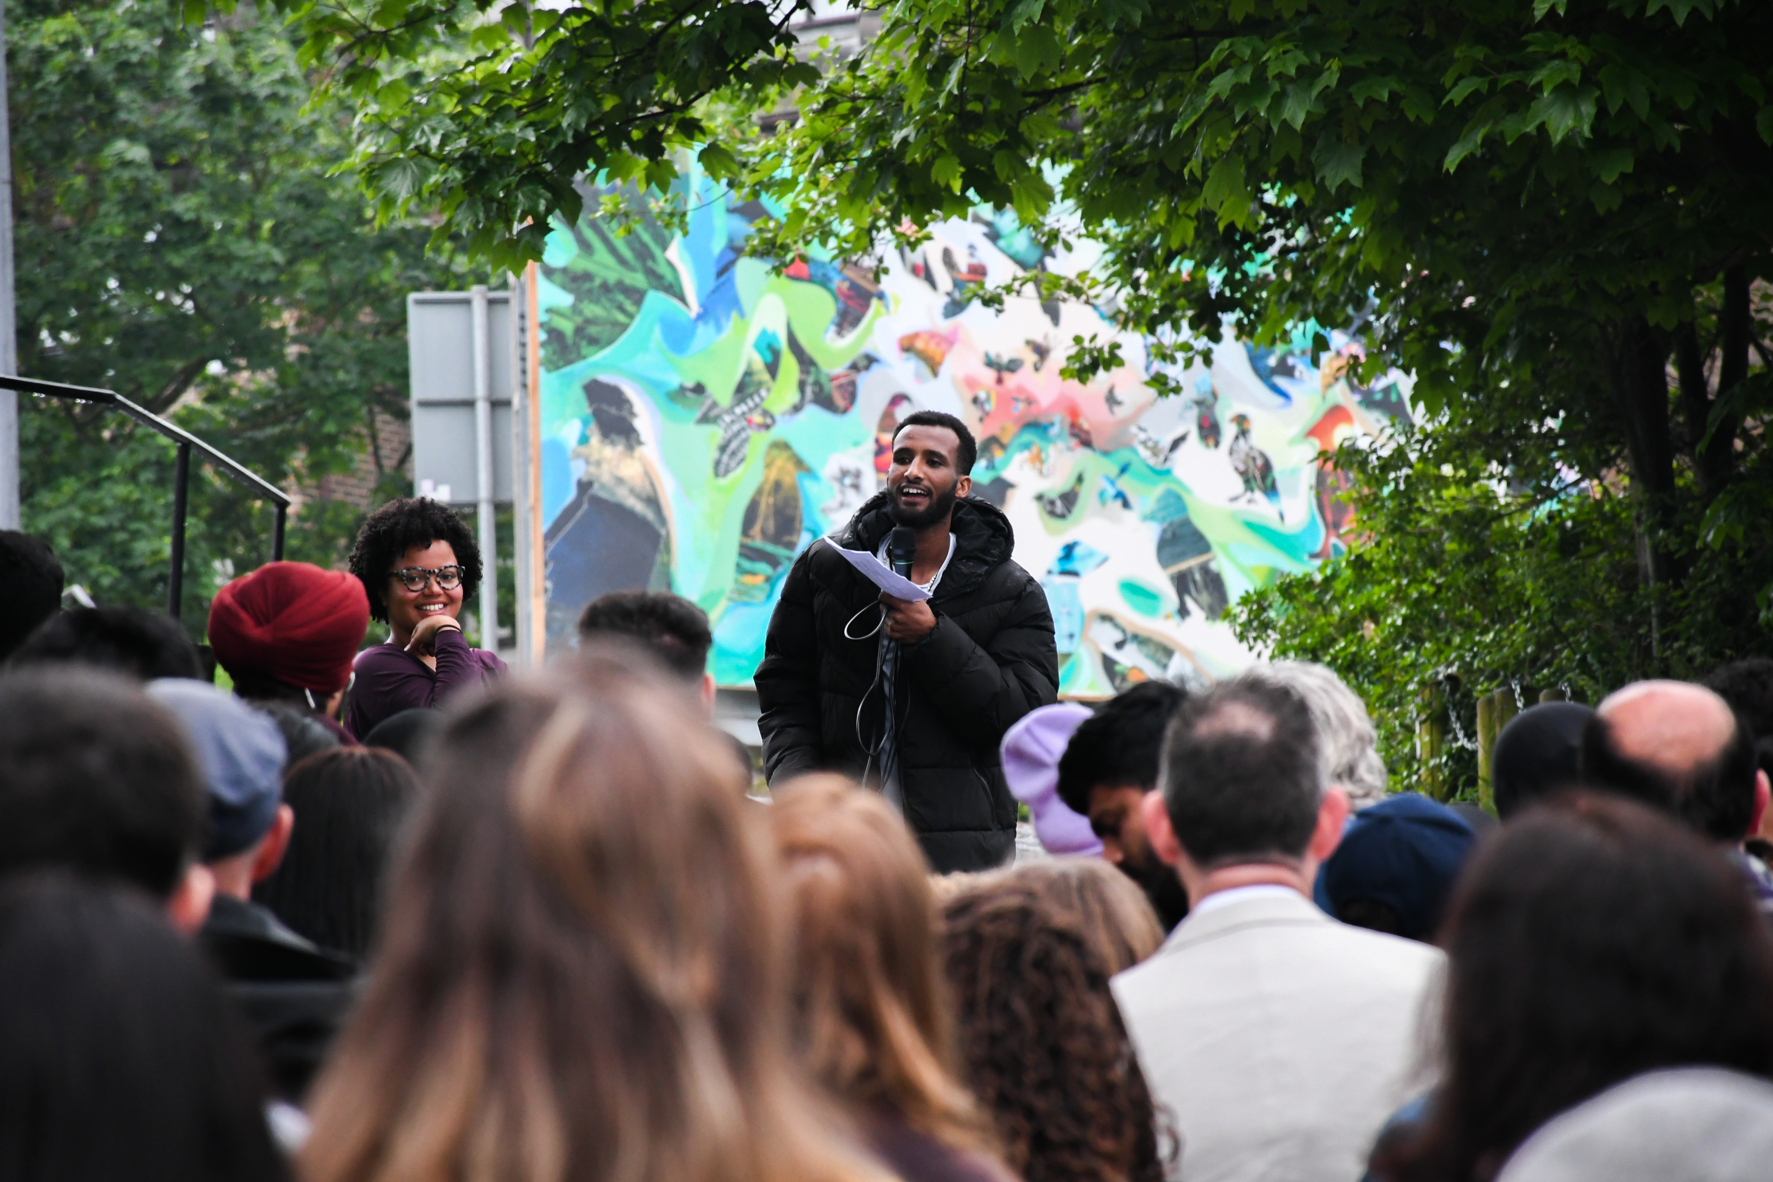
The Studio
A long-term collaboration between People United and Kent Refugee Action Network (KRAN).
Notes:
Sea of the Unseeable:
Another project within ‘Futures of Care’ was Sea of the Unseeable. In 2022 we started working with young refugees and asylum seekers being supported by Kent Refugee Action Network – all of them had arrived as unaccompanied minors and were living in or leaving the care system. Their dream was to make a beautiful piece of art in a public art space, driven by their own ideas and giving them voice.
Luwam, one of the young producers shared: “My hope is that this artwork helps people understand what refugees and asylum seekers go through in order to find safety. On the waves you can see our ideas of what care looks like for us, here and now, as we try to move forwards as part of this place.”
This piece was hung in library atrium in the Beany for 7 months and was seen by over 200,00 people. Last week it was moved to Canterbury Christ Church, it is in their library within Augustine House if anyone wants to see it.
The partnership we have with KRAN is growing and next year we will be launching a co-production house – stay tuned.

Slide 7
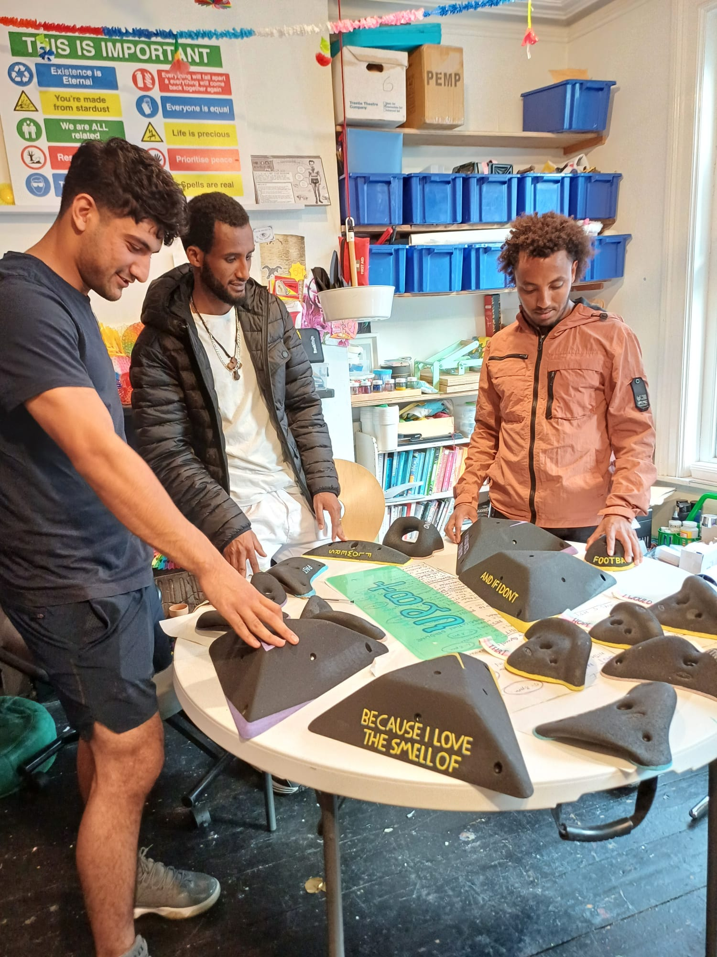
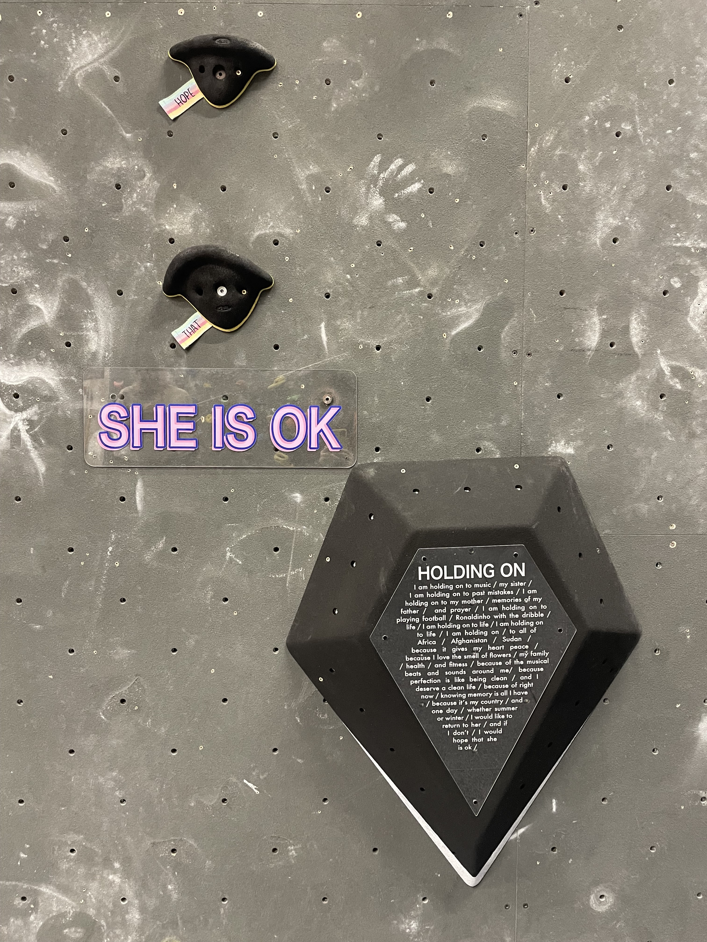
The Studio
Notes:
Sea of the Unseeable:
Another project within ‘Futures of Care’ was Sea of the Unseeable. In 2022 we started working with young refugees and asylum seekers being supported by Kent Refugee Action Network – all of them had arrived as unaccompanied minors and were living in or leaving the care system. Their dream was to make a beautiful piece of art in a public art space, driven by their own ideas and giving them voice.
Luwam, one of the young producers shared: “My hope is that this artwork helps people understand what refugees and asylum seekers go through in order to find safety. On the waves you can see our ideas of what care looks like for us, here and now, as we try to move forwards as part of this place.”
This piece was hung in library atrium in the Beany for 7 months and was seen by over 200,00 people. Last week it was moved to Canterbury Christ Church, it is in their library within Augustine House if anyone wants to see it.
The partnership we have with KRAN is growing and next year we will be launching a co-production house – stay tuned.

Slide 8
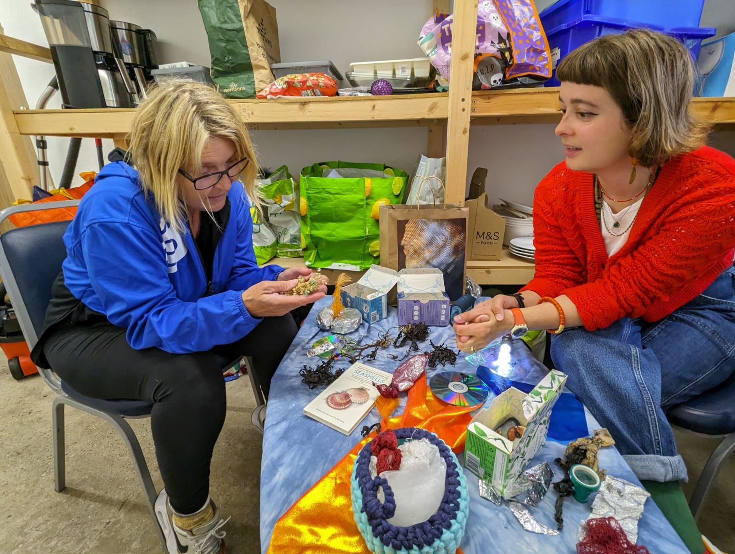
Radical Gifting
Artists meet collaborators to co-create sensory objects that bring the East Kent coast to those who can't access it.
Notes:
Radical Gifting:
Radical Gifting is an ongoing project for us in which artists meet participant-collaborators in their homes to co-create sensory objects that bring the East Kent coast to those who can't access it.
We commissioned three socially engaged artists who you can see at our coastal immersion session, intended to connect with each other and gather inspiration. They then met the collaborators who were socially isolated individuals, in their homes, to co-design objects that would evoke an immersive experience of the coast, as you see Maggie and Jan here. The arts designed objects that could be created by other community members, as you see in progress at one of Porchlight’s weekly Open Door sessions. Then we packaged them up in the office, here is a lovely team shot of us, and the stage in progress is delivering these boxes to 20 socially isolated people across East Kent, with support from our partners at Age UK.

Slide 9
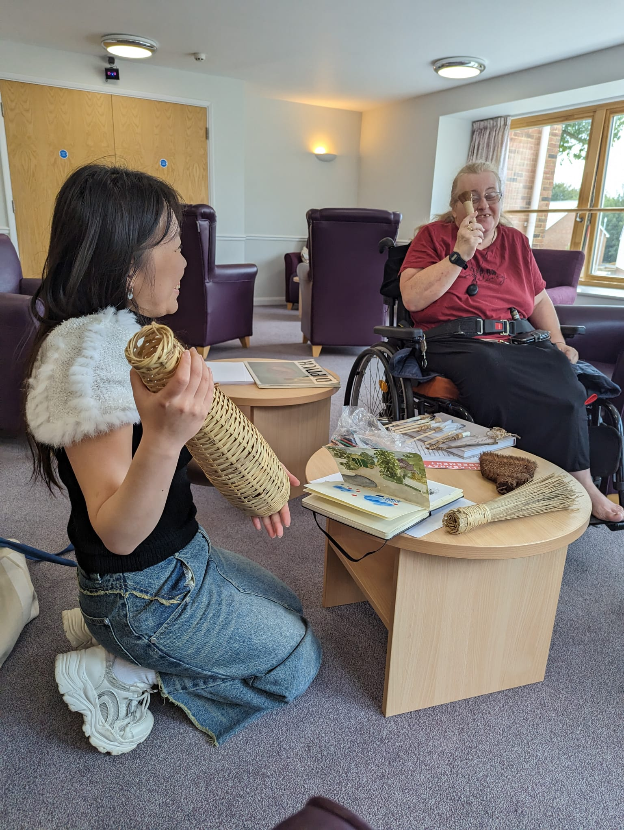
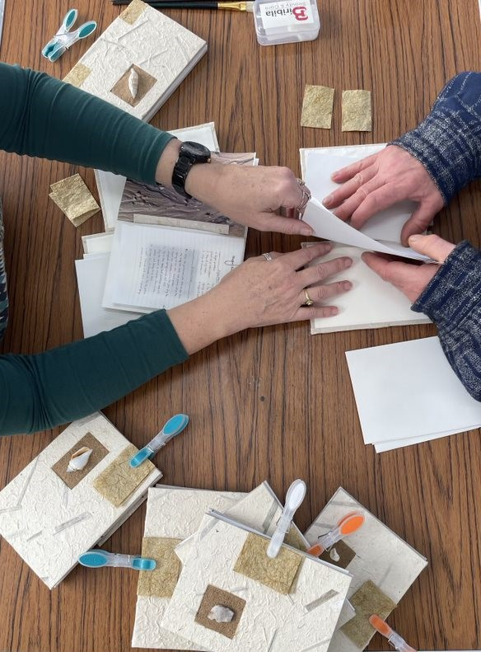
Radical Gifting
Notes:
Radical Gifting:
Radical Gifting is an ongoing project for us in which artists meet participant-collaborators in their homes to co-create sensory objects that bring the East Kent coast to those who can't access it.
We commissioned three socially engaged artists who you can see at our coastal immersion session, intended to connect with each other and gather inspiration. They then met the collaborators who were socially isolated individuals, in their homes, to co-design objects that would evoke an immersive experience of the coast, as you see Maggie and Jan here. The arts designed objects that could be created by other community members, as you see in progress at one of Porchlight’s weekly Open Door sessions. Then we packaged them up in the office, here is a lovely team shot of us, and the stage in progress is delivering these boxes to 20 socially isolated people across East Kent, with support from our partners at Age UK.

Slide 10

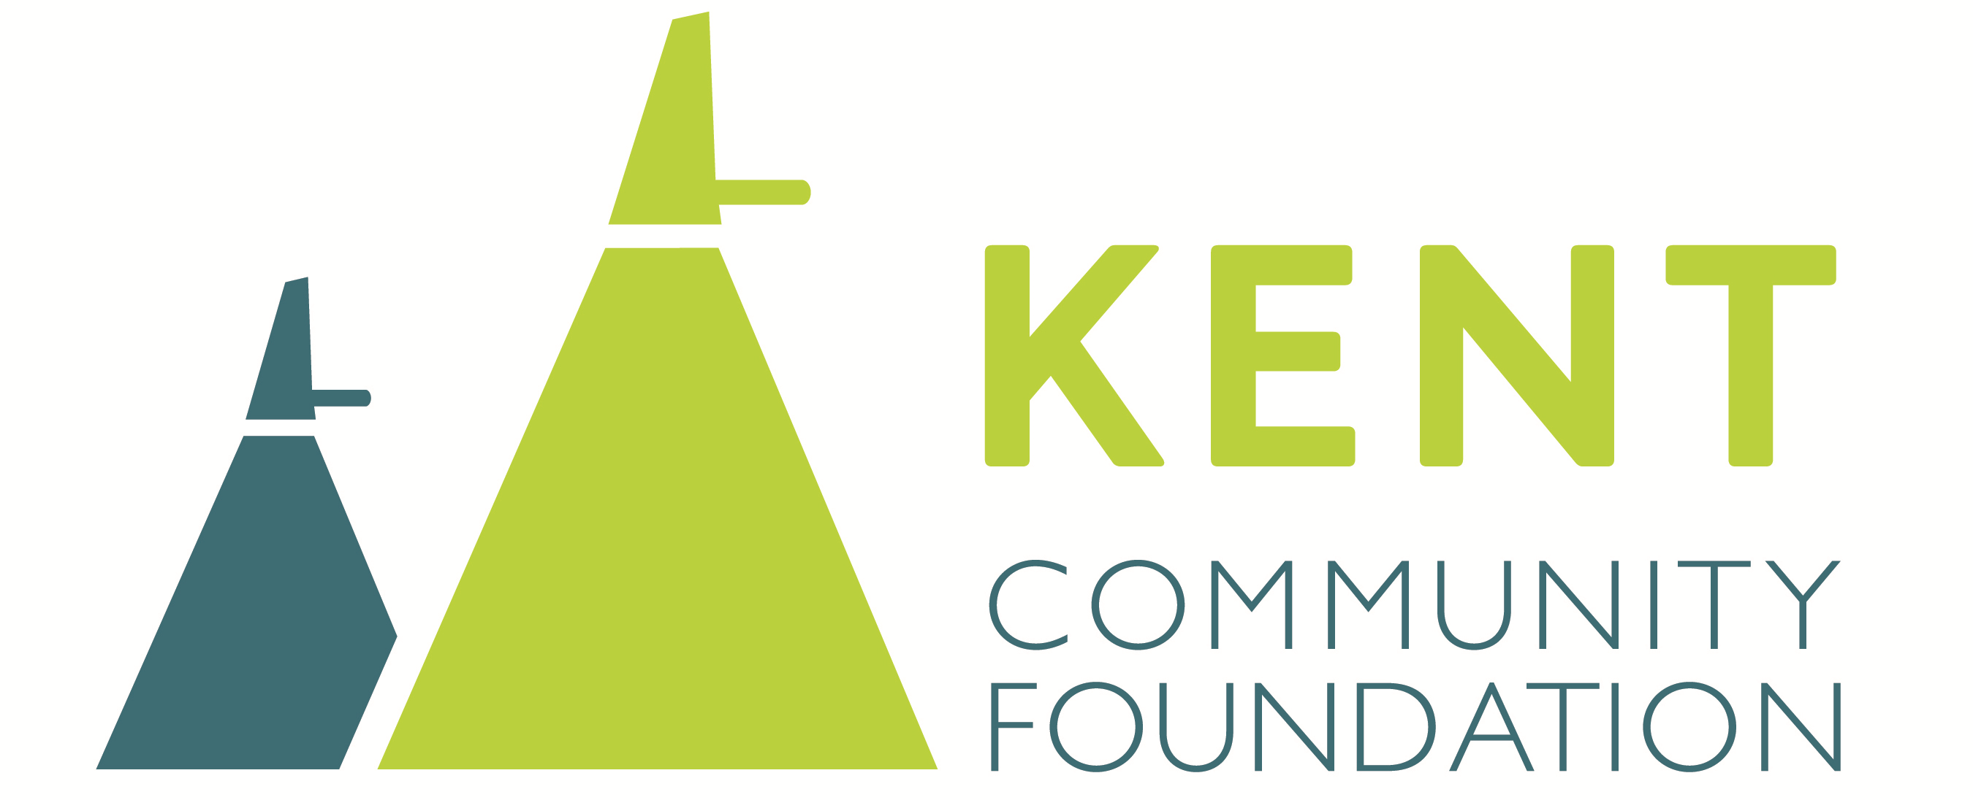


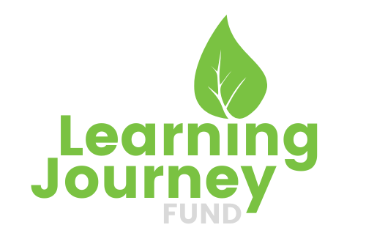
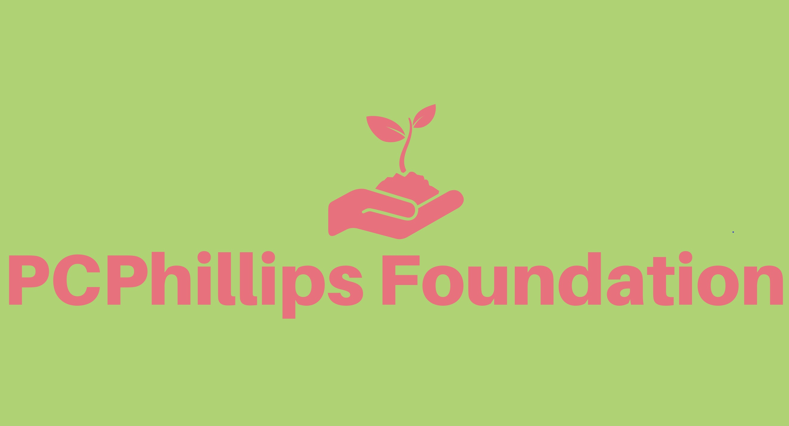
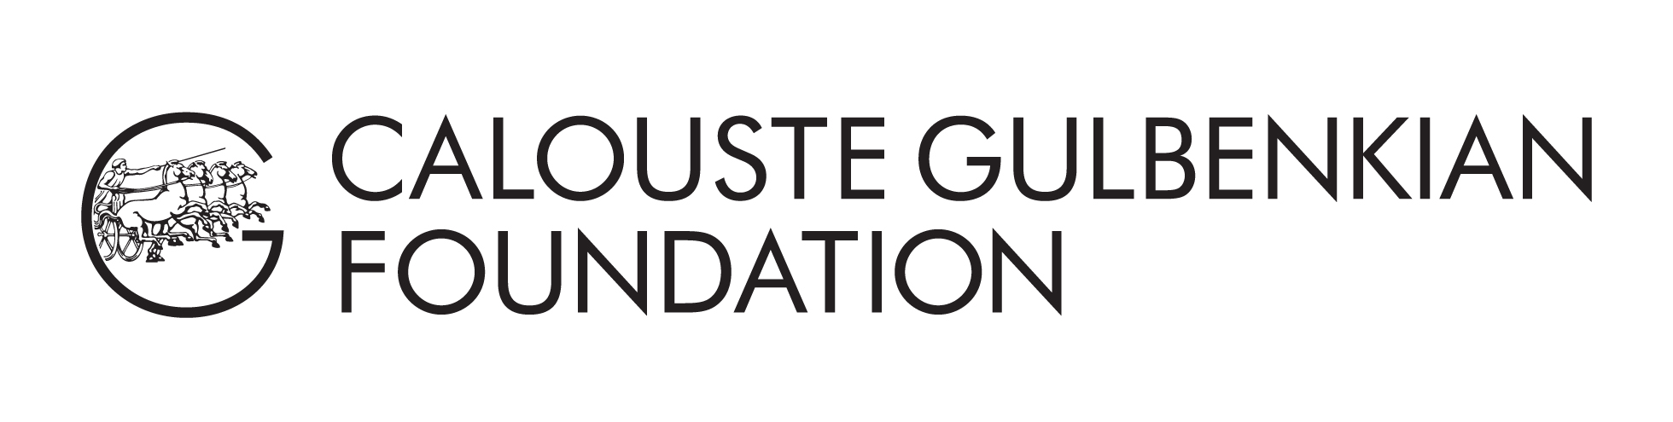
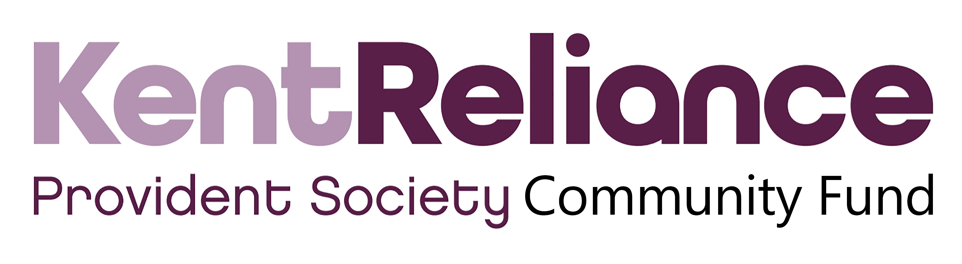


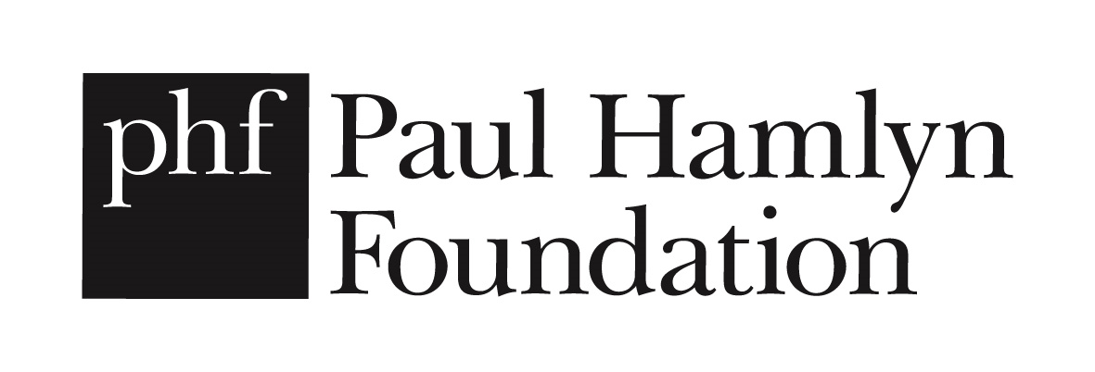
Our Partners
Notes:
Partners:
I hope this has given you a snapshot into the kind of work we do and the collaborations we are passionate. In the year ahead we are looking for embedded relationships we can develop long term – partnerships over time (not one off).

Slide 11
Thanks for listening!
Contact: erin@peopleunited.org.uk
Or visit our website: www.peopleunited.org.uk

