Slide 1


Founded in 2008 to present Hurried Steps
New Shoes Theatre is registered as a Co Ltd by Guarantee and a Charity.
This presentation is about our revival of Hurried Steps for International Women’s Day March 2025

Slide 2


Slide 3
    Hurried Steps is a hard hitting, powerful text written from accounts given to the writer by Amnesty International and she has since added stories taken from newspaper articles

Slide 4
    Hurried Steps is presented simply. There's a choice of 10 powerful stories from all over the world, based on real Amnesty testimonies & newspaper cuttings.
    Organisations can choose which stories are performed.

Slide 5
The hour long play is performed in a stark context; five actors stand without visual distractions as they recount stories about violence against women and girls.
Hurried Steps

Slide 6
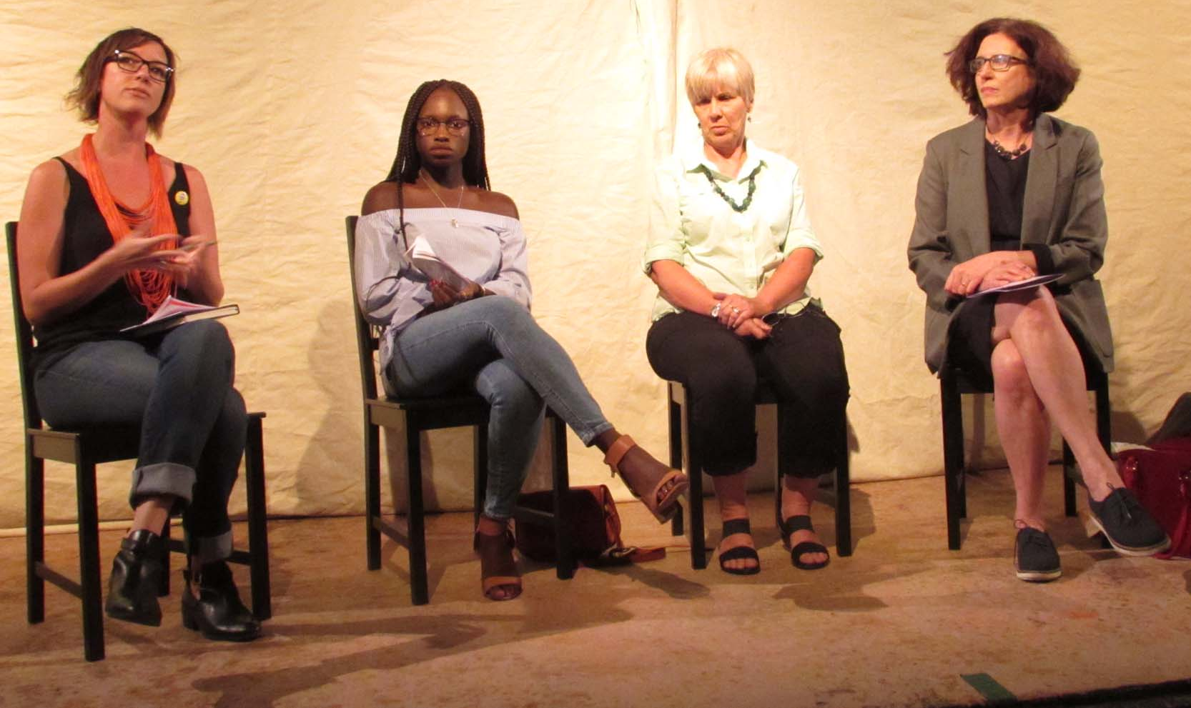
Panels
All performances must be followed by a discussion panel. They have included advocates/representatives from many different organisations

Slide 7
    Hurried Steps only needs two days rehearsal and can be performed in any space.

Slide 8
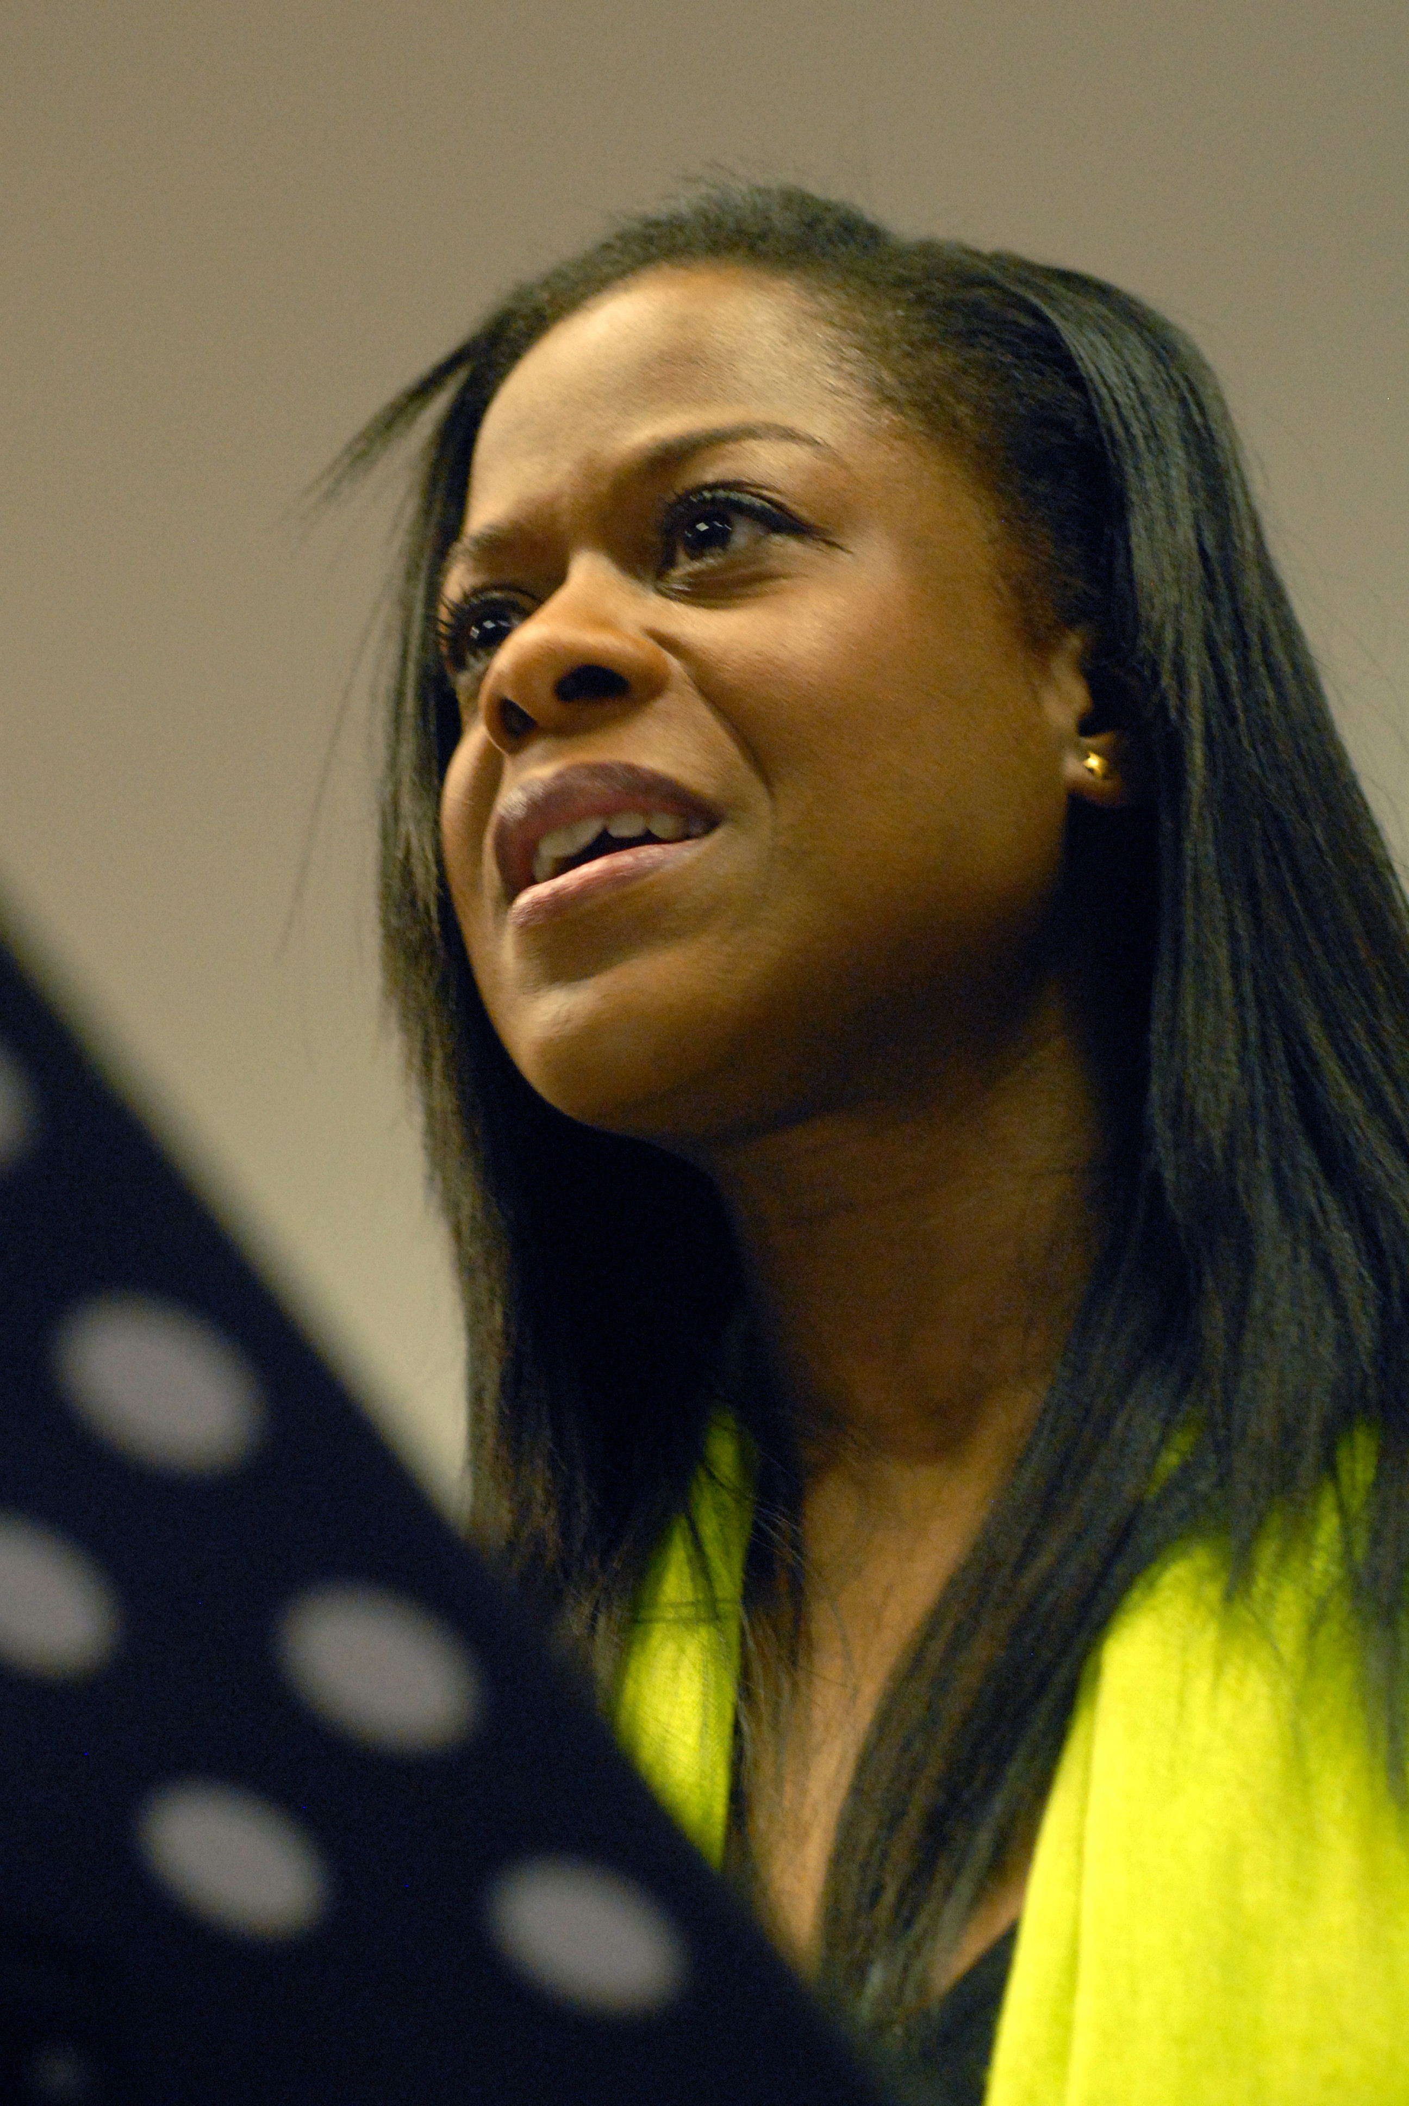
Viollca story
- Sex trafficking and modern day slavery

Slide 9
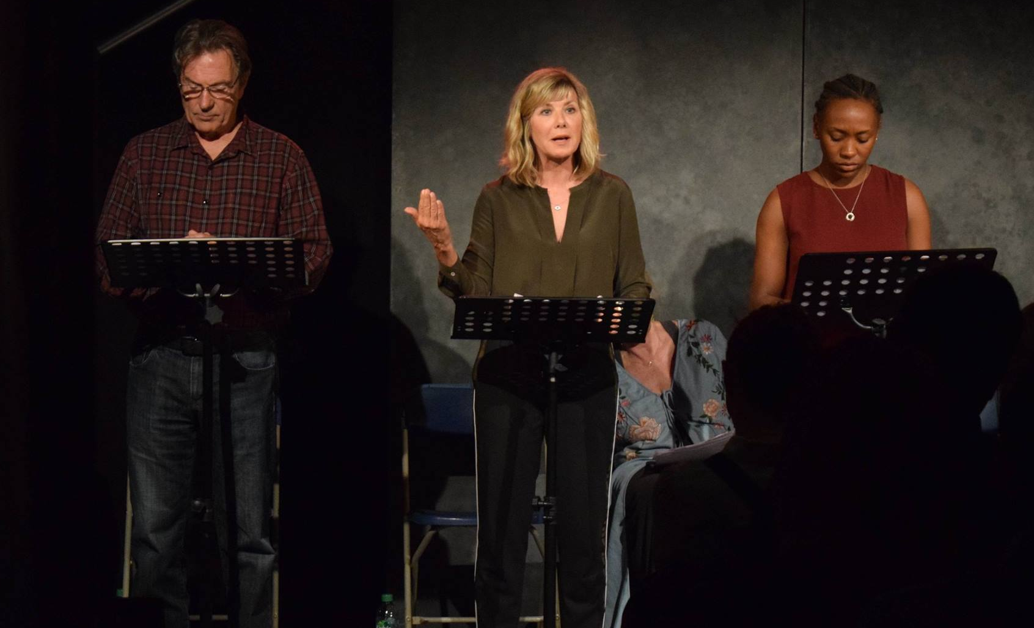
Teresa and Marguerite stories
- Coercive control/domestic abuse & no police intervention

Slide 10
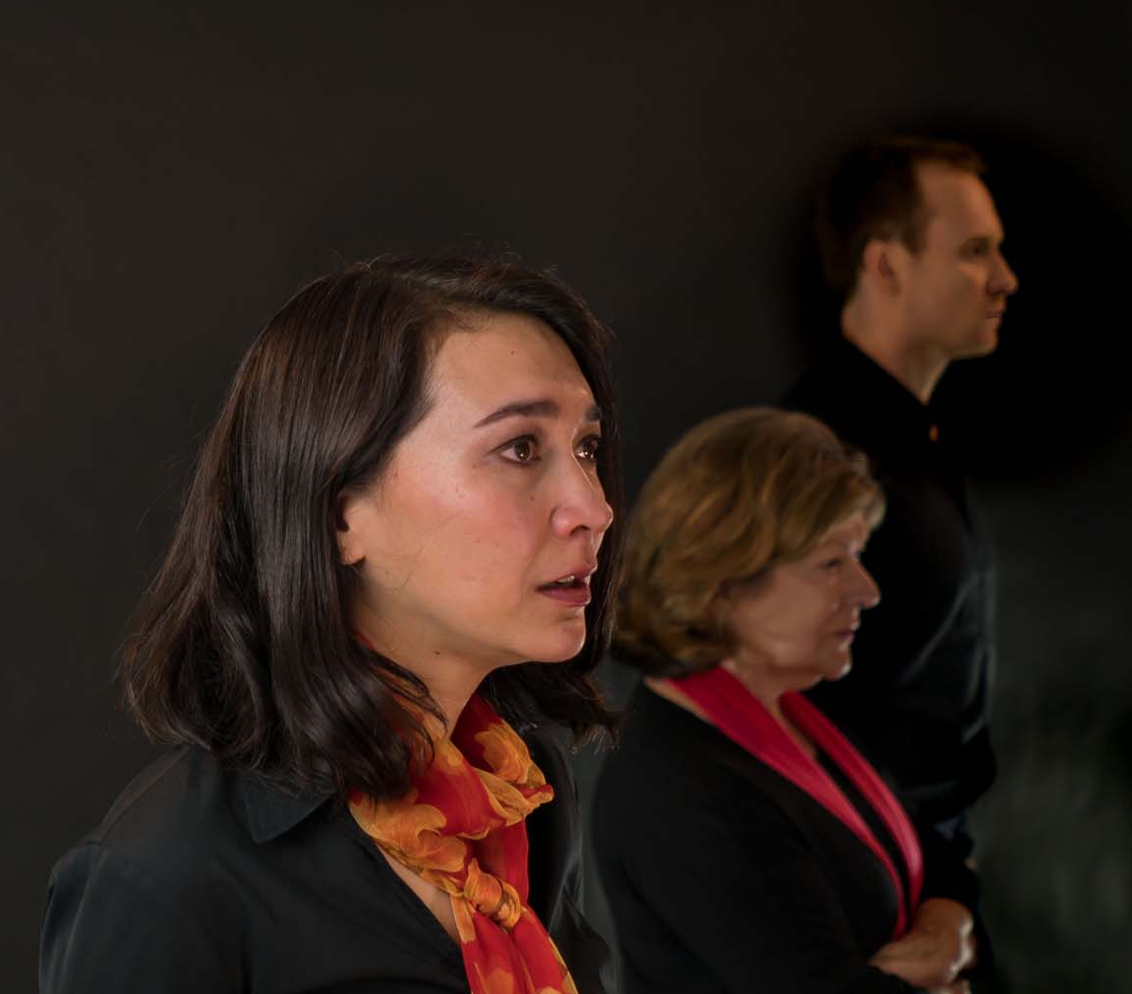
Kubra Story
- Female genital mutilation/cutting (FGM/C)

Slide 11
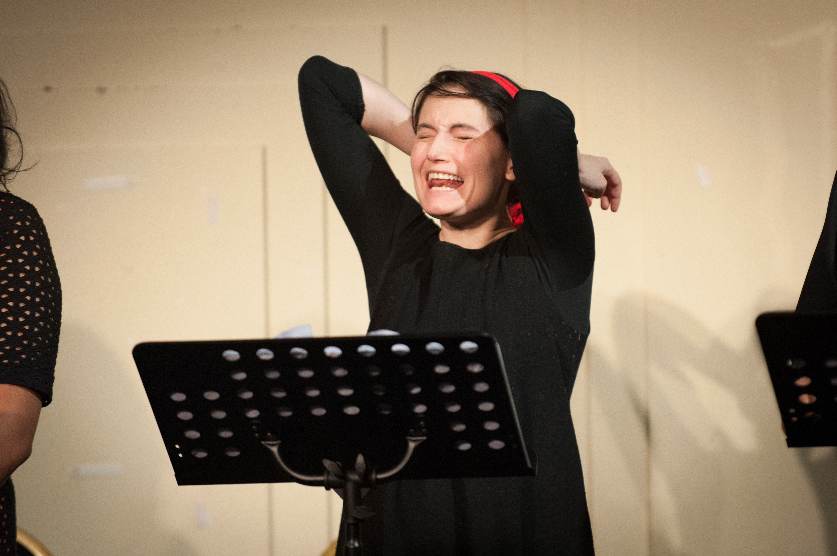
Carmelina Story
- Expoitation and Rape

Slide 12
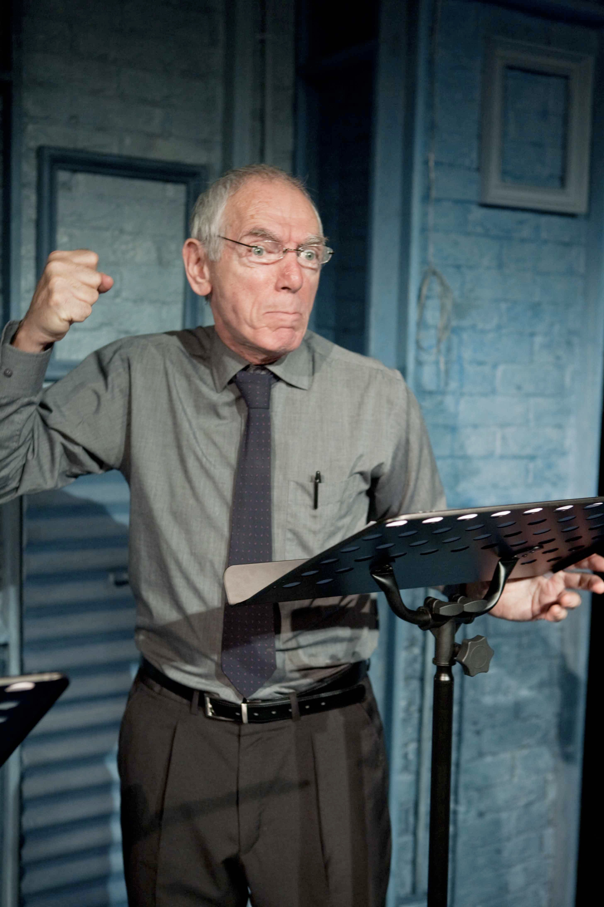
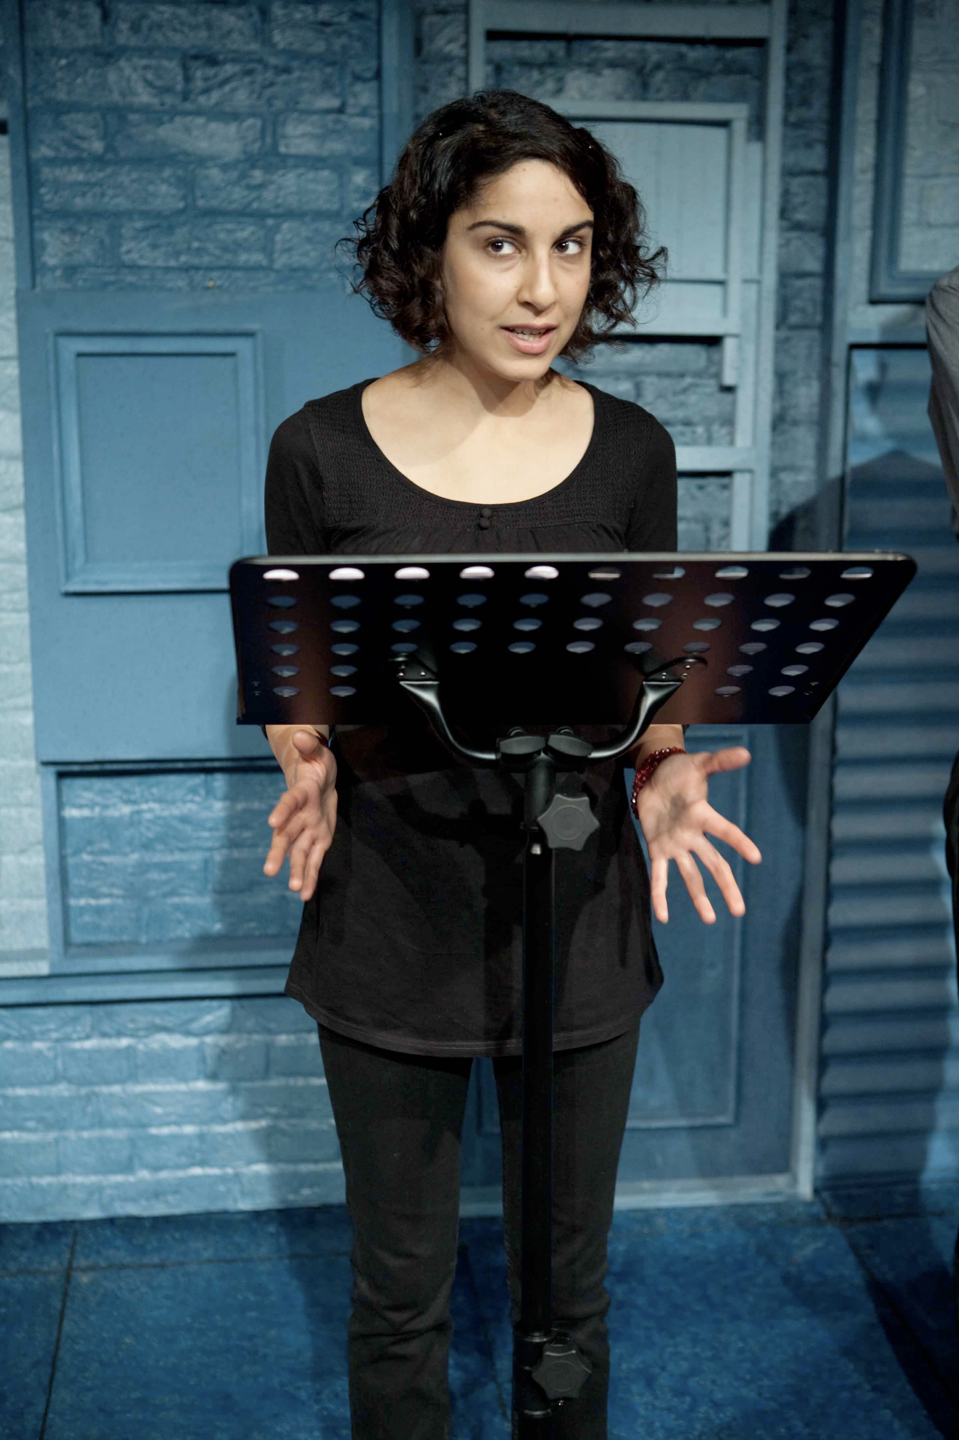
Amina and Aisha stories
- Honour based violence

Slide 13
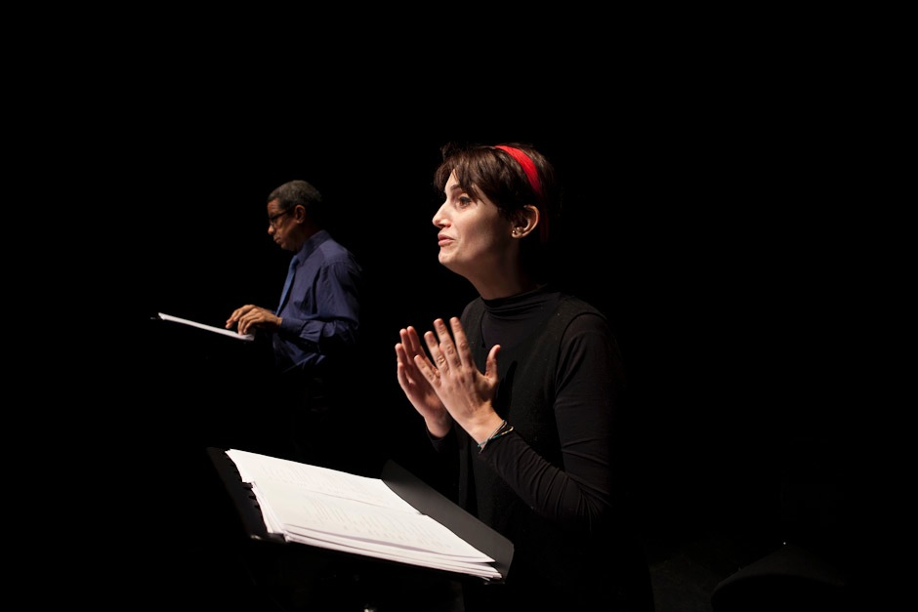
Civita story
- Rape as a weapon of war.

Slide 14
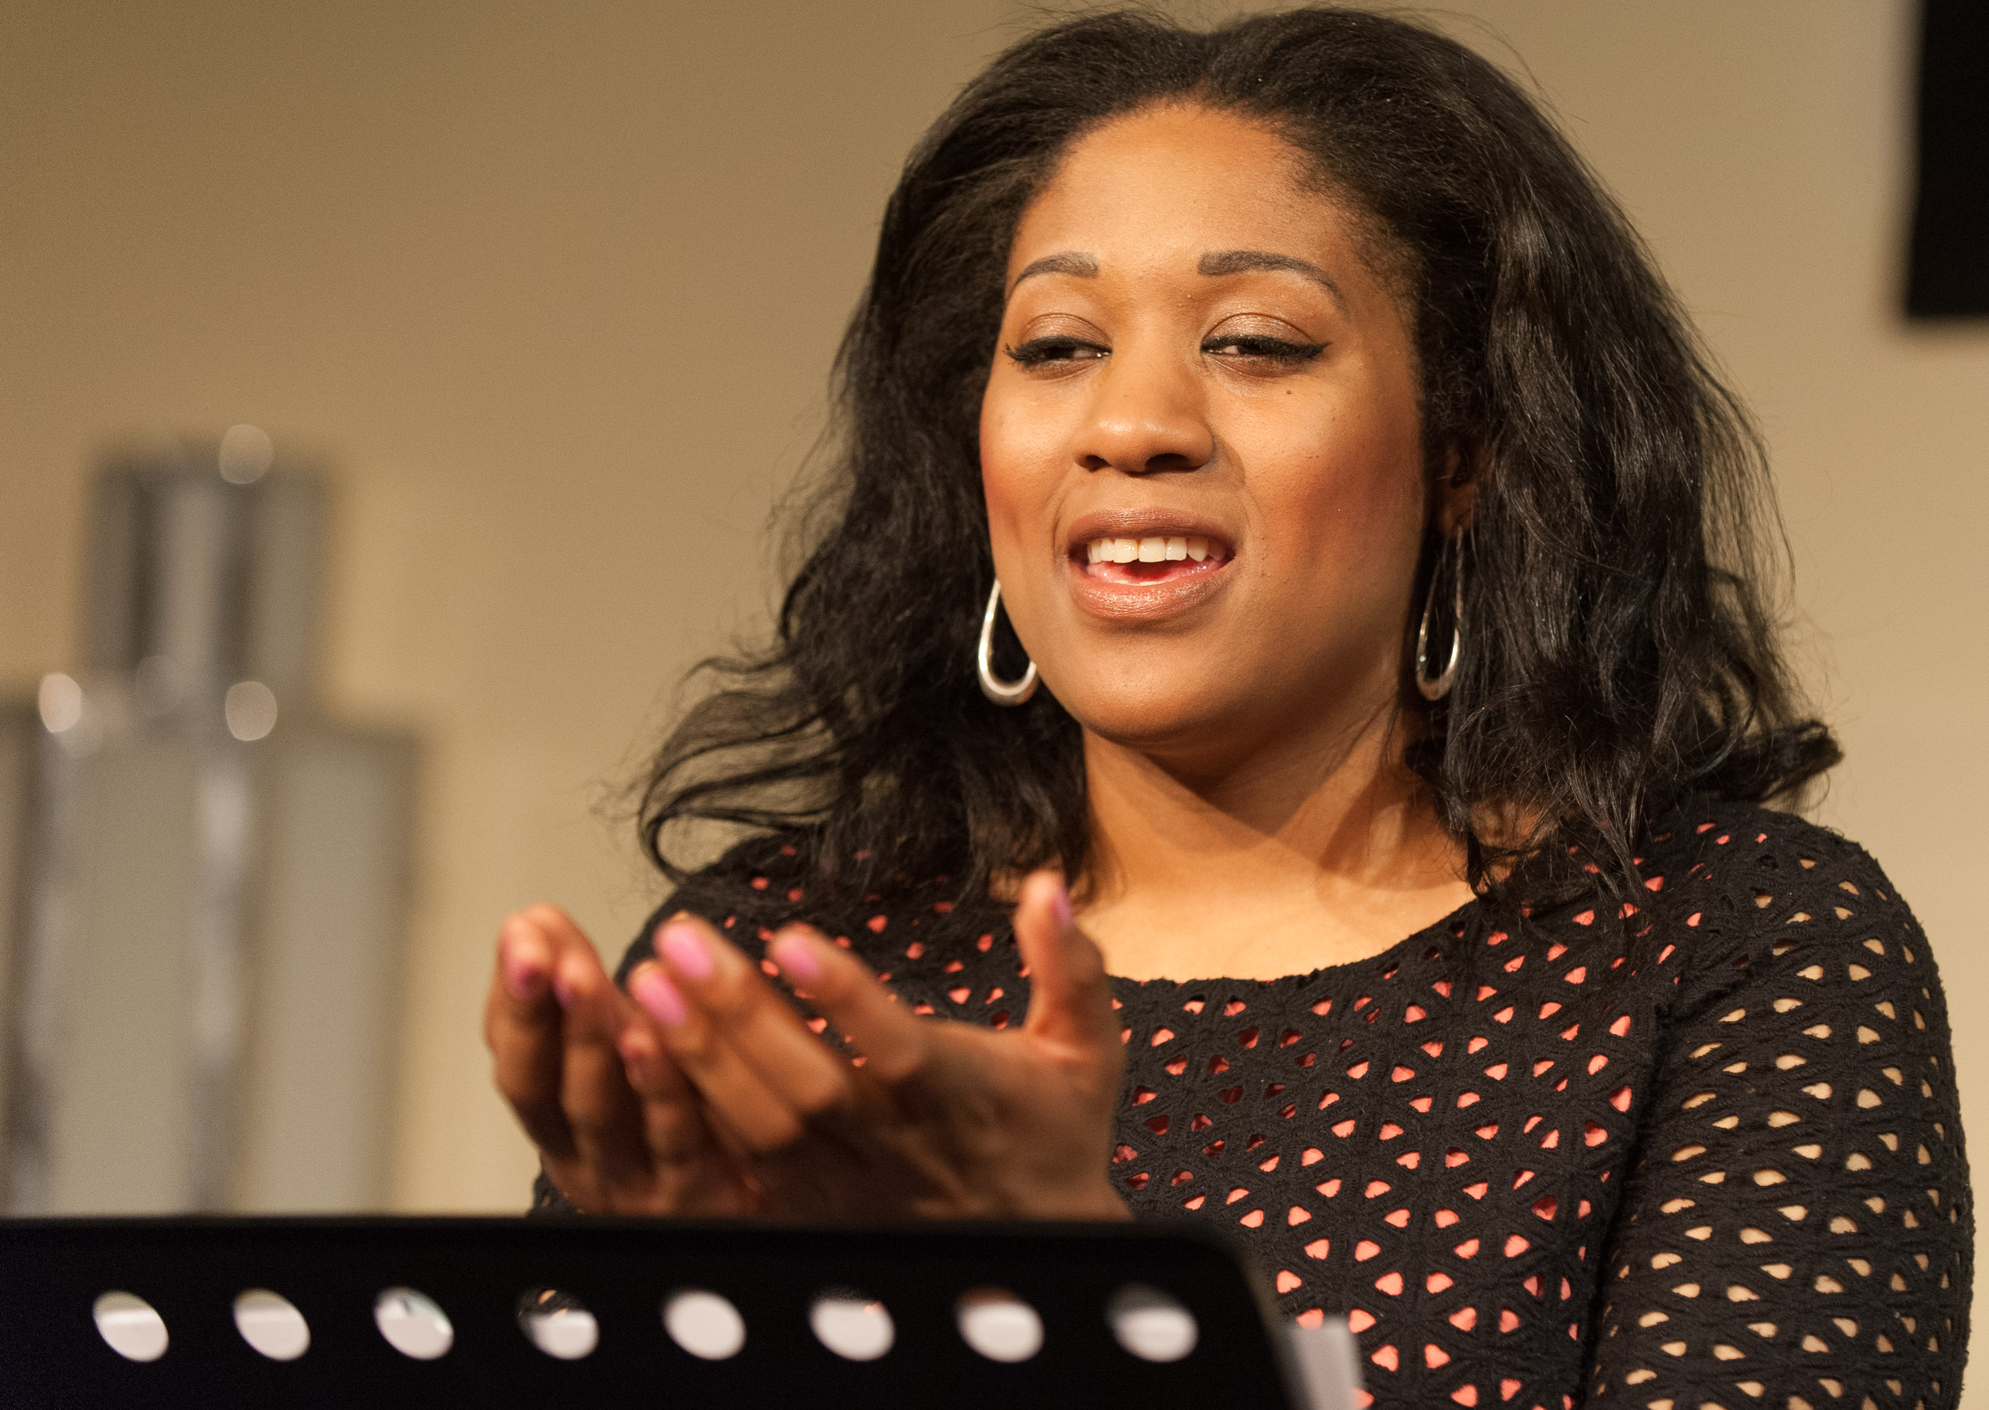
Organisations can
Organise for New Shoes Theatre actors to present Hurried Steps stories of your choosing and collaborate with us to invite panel members

Slide 15
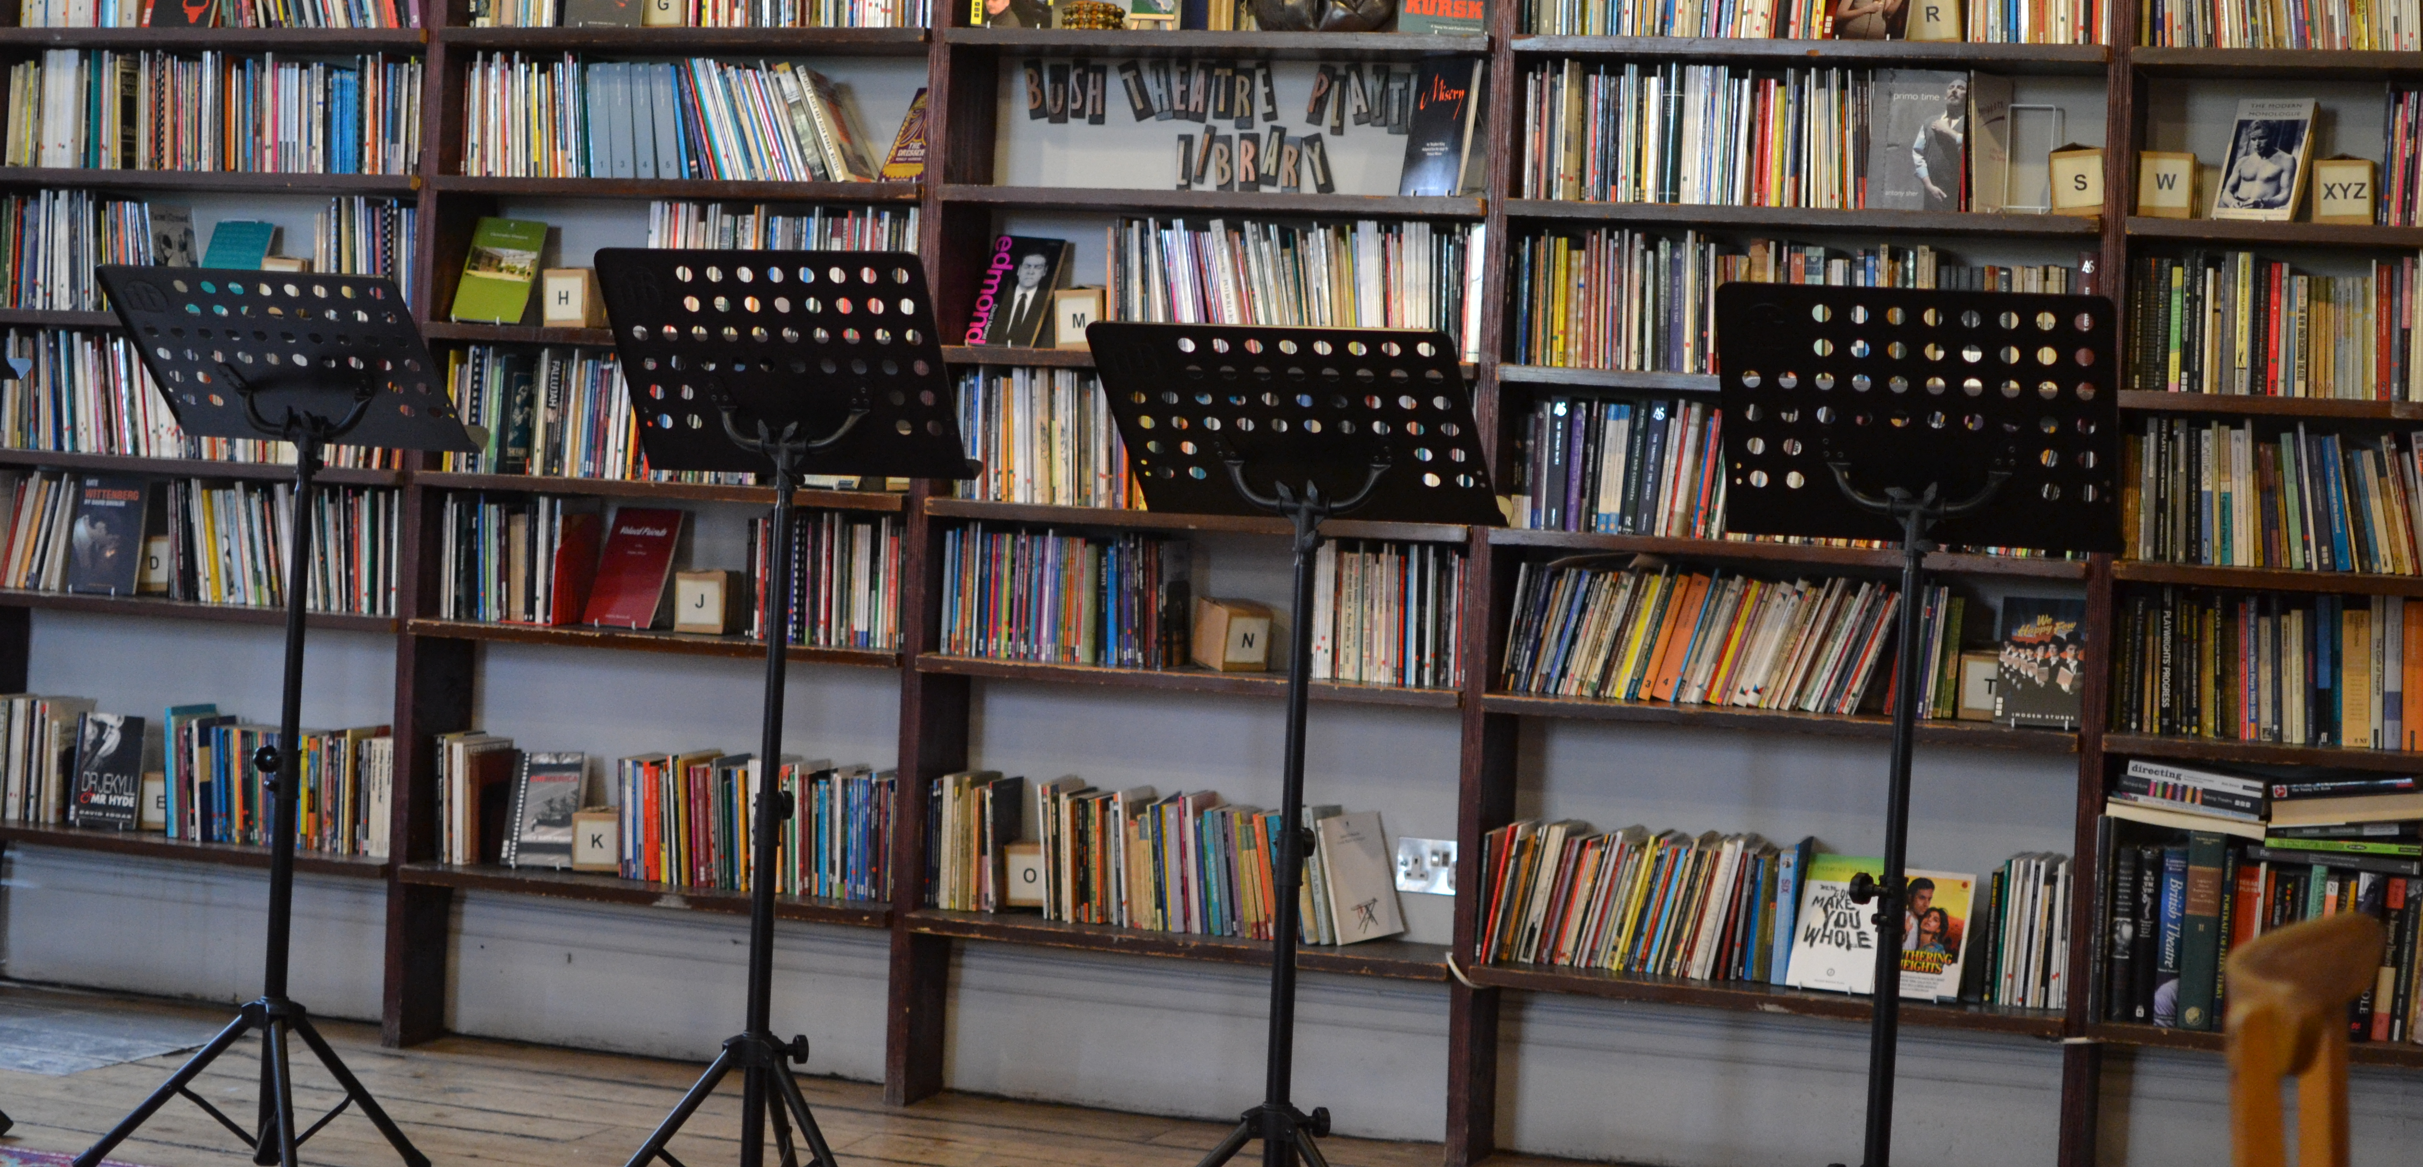
Organisations can
2. Groups can organise their own performance with their own community members performing
- New Shoes Theatre would obtain the permissions from the playwright & translator.
-We could also lend music stands.
-There has to be a panel discussion afterwards.

Slide 16
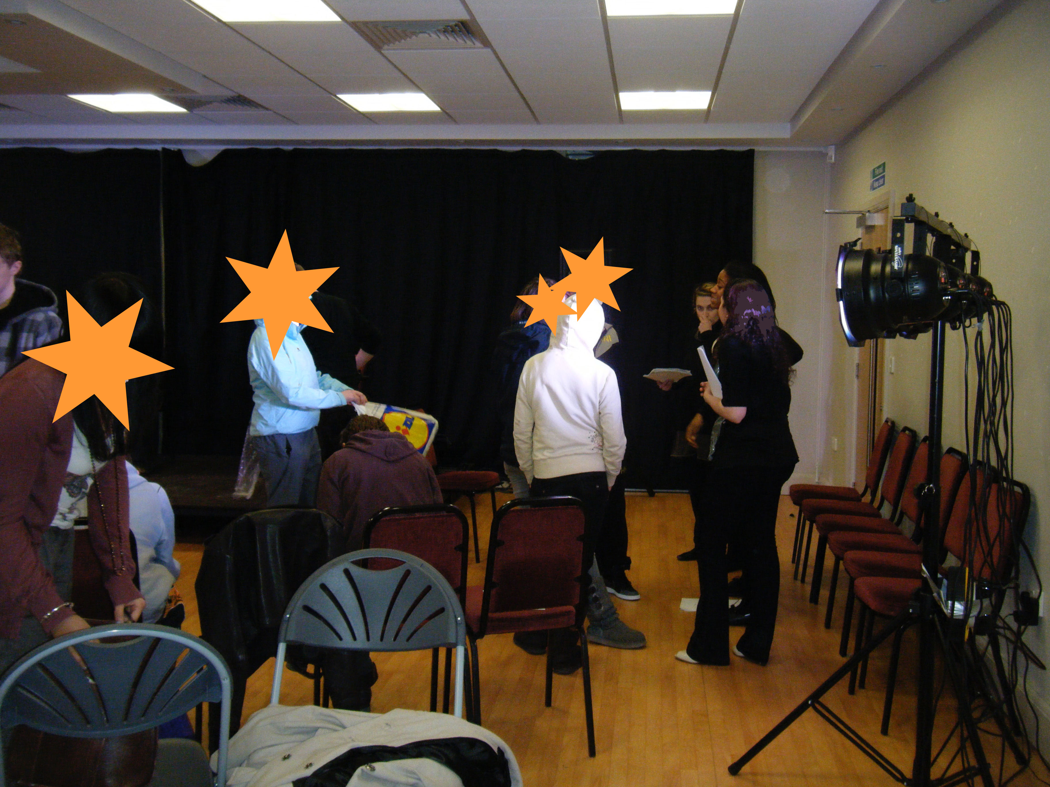
Organisations can
3. Host workshops: There is a Hurried Steps themed workshop devised for young people. We use the fairytale and not Hurried Steps stories as a structure for this workshop
Cinderella Answers Back

Slide 17
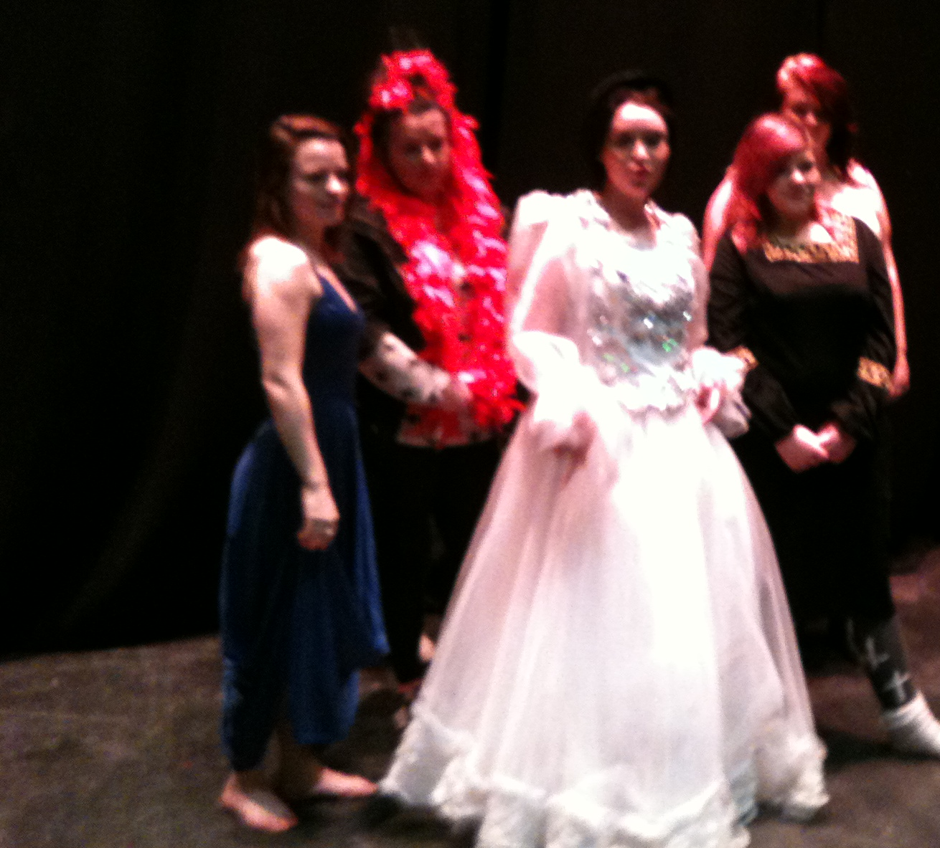
Cinderella Answers Back

Slide 18
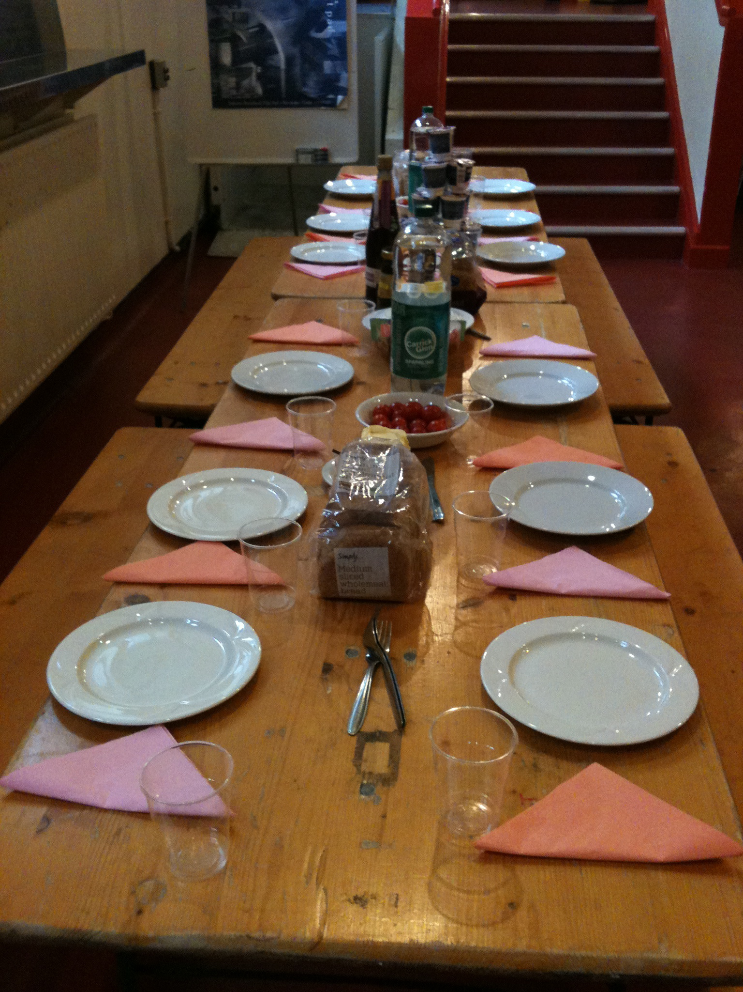
Cinderella Answers Back
For longer workshops we discuss ideas during ‘family’ meals

Slide 19
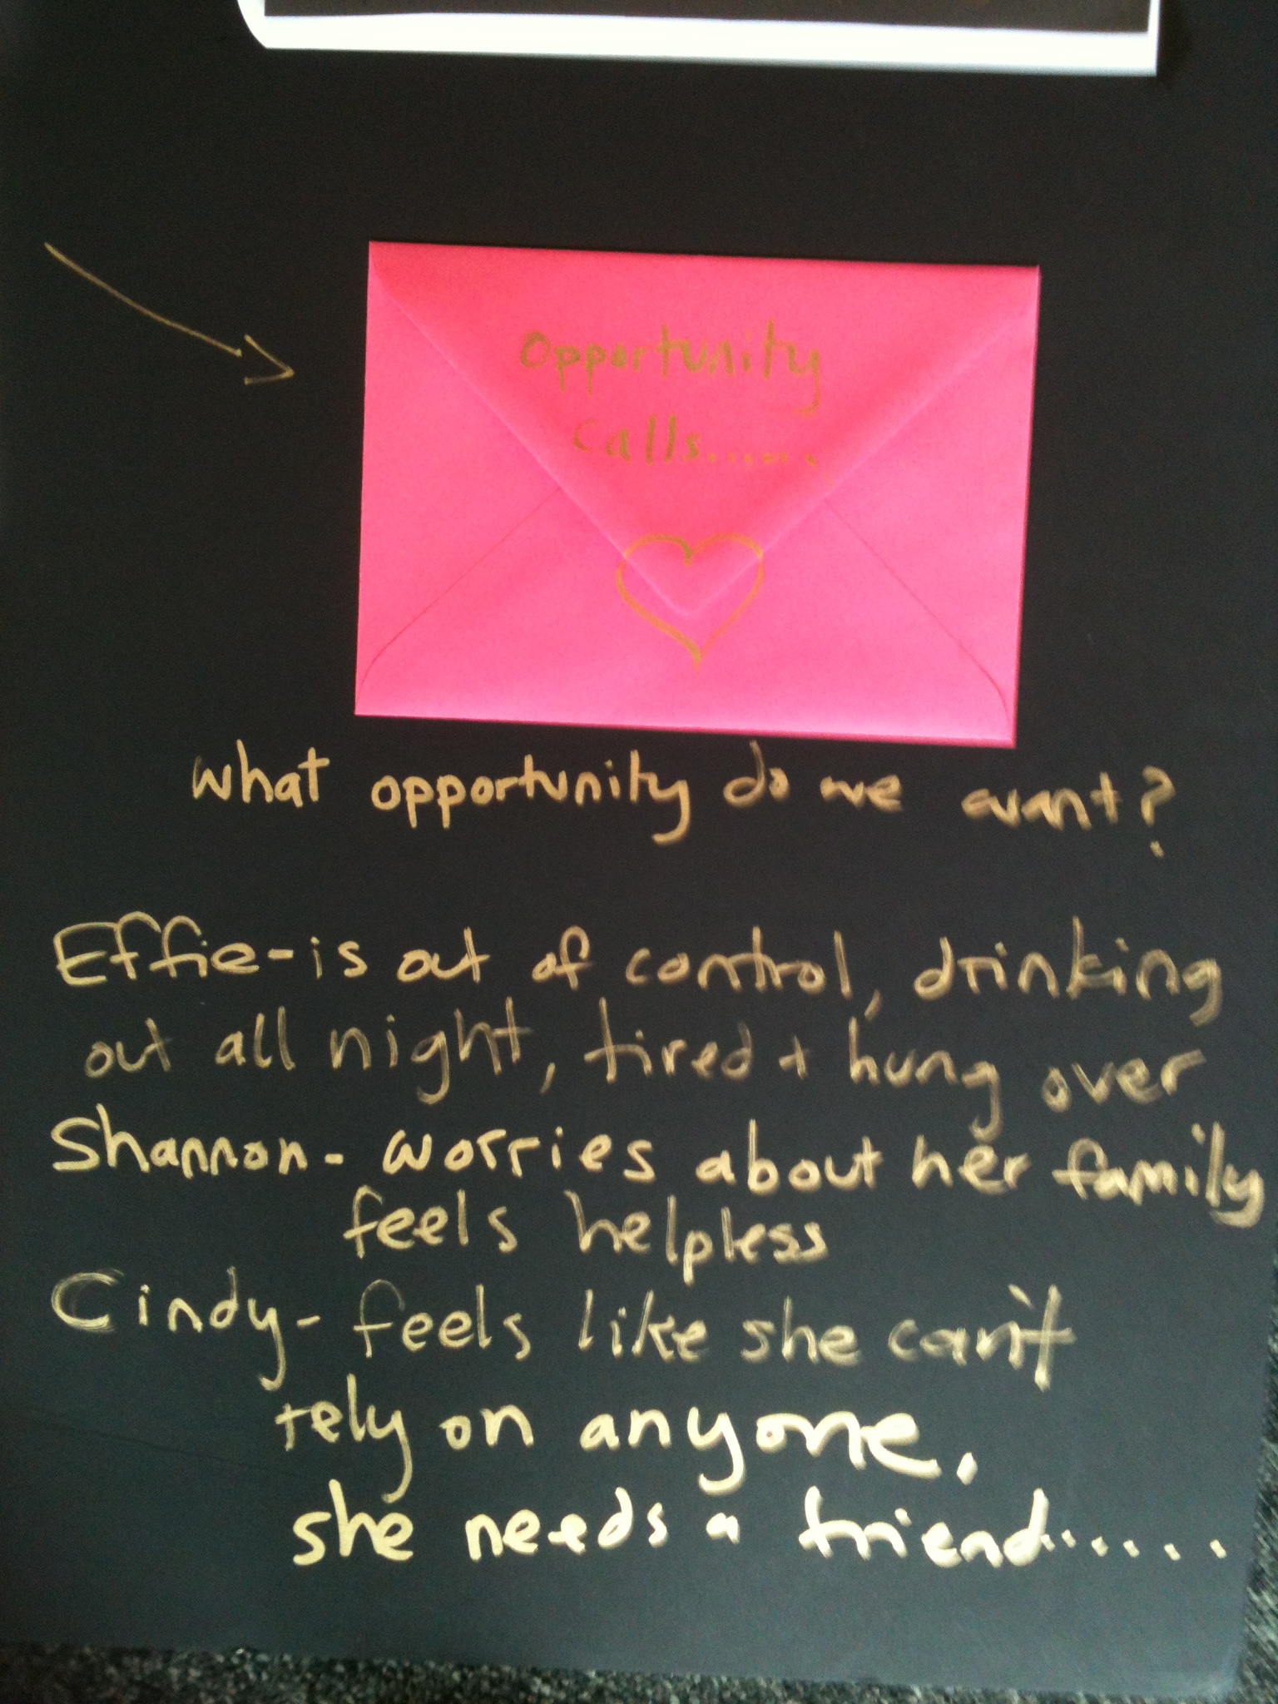
Cinderella Answers Back

Slide 20
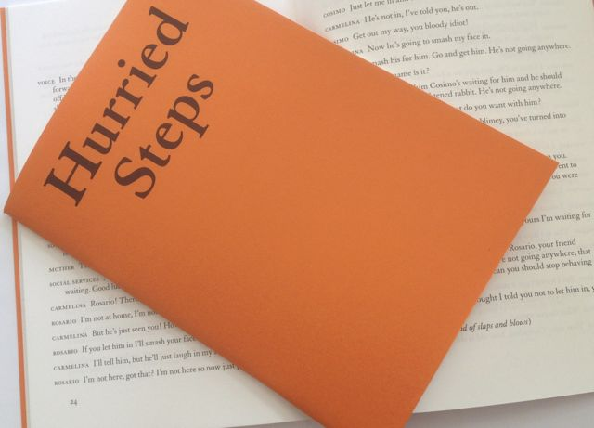
Book
Hurried Steps is available to read you are welcome to take a copy
(Trigger warnings - powerful descriptions of violence and control)

Slide 21
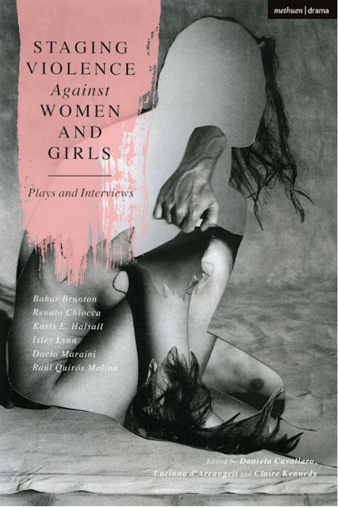
Book
The Kubra FGM/C story is published by Bloomsbury (Trigger warning - powerful description of violence)

Slide 22

www.hurriedsteps.org
Contact Nicolette Kay
admin@newshoestheatre.org.uk
www.newshoestheatre.org.uk

