Slide 1
Charity Mentors Kent & Medway
Justin Byrd – Charity Co-ordinator
18th July 2024

Slide 2
Vision and Mission
Our Vision is for there to be vibrant charities and not-for-profit social organisations throughout Kent and Medway, producing excellent outcomes led by confident leaders with clear strategic purpose.
Our Mission is to provide these leaders with FREE, high-quality mentoring and support for strategic thinking, so that they are empowered to improve the resilience, efficiency, and social impact of their organisations.

Slide 3
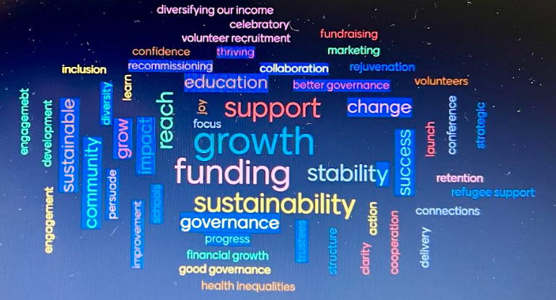
What are your hopes / aspirations for the year ahead?

Slide 4
Why be mentored?
Running a charity or social enterprise can be a challenging and sometimes lonely job
The management of day-to-day issues often leaves little time to step back and think about strategic direction and how best to get there
An independent external Mentor can add value to your thinking, enabling you to gain new perspectives.

Slide 5
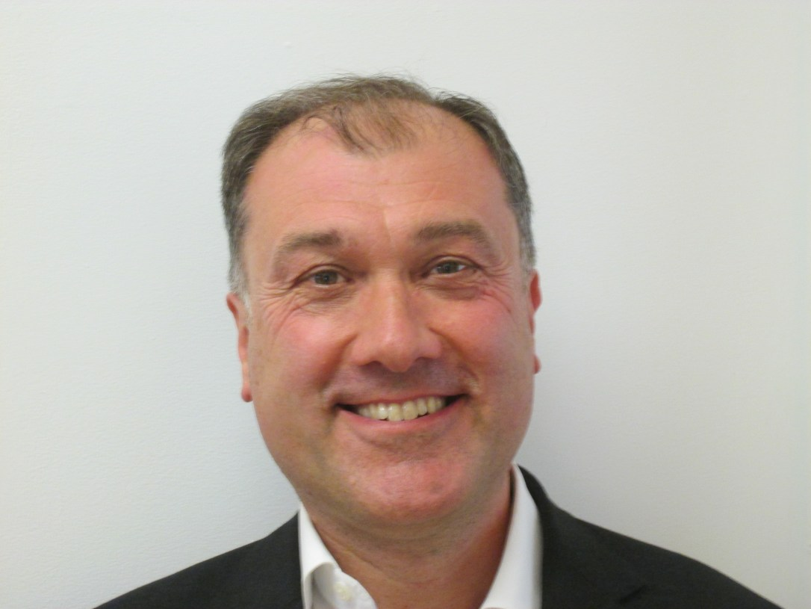
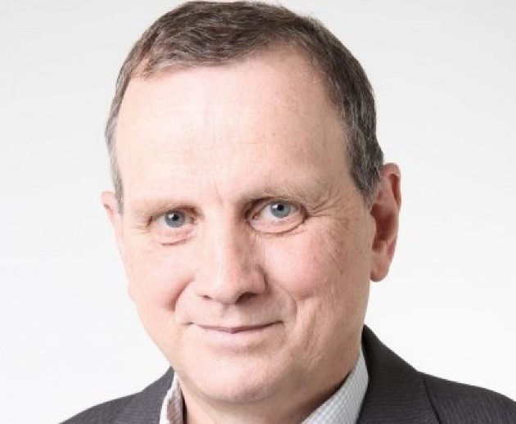
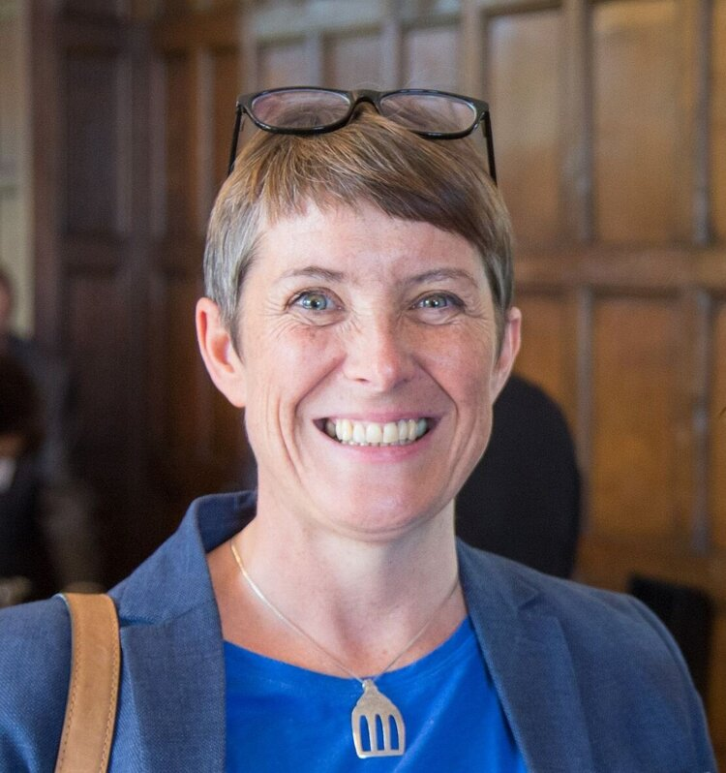
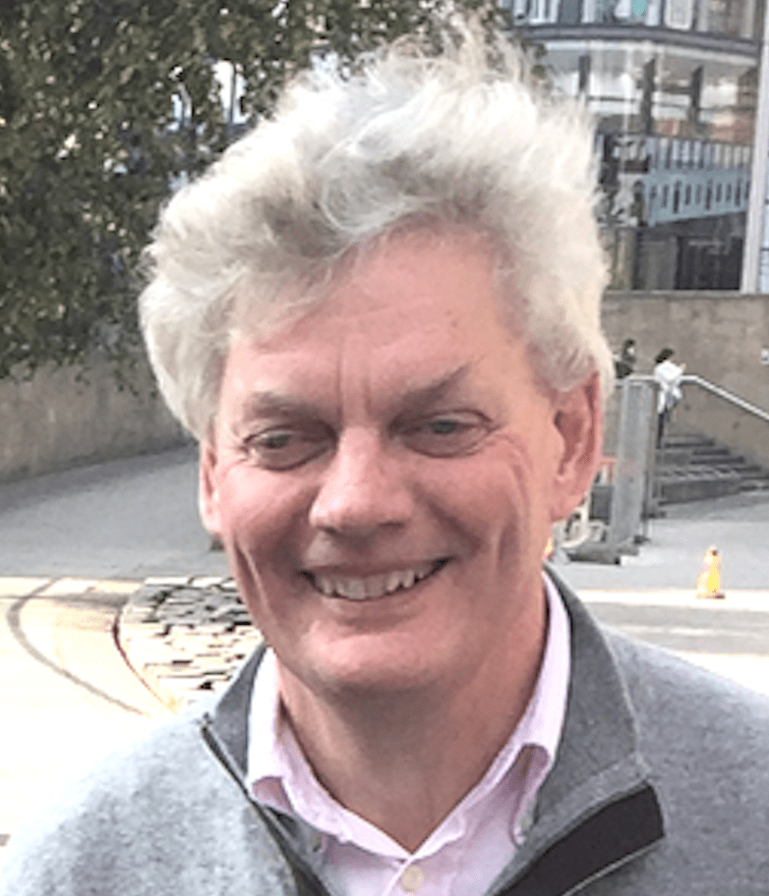
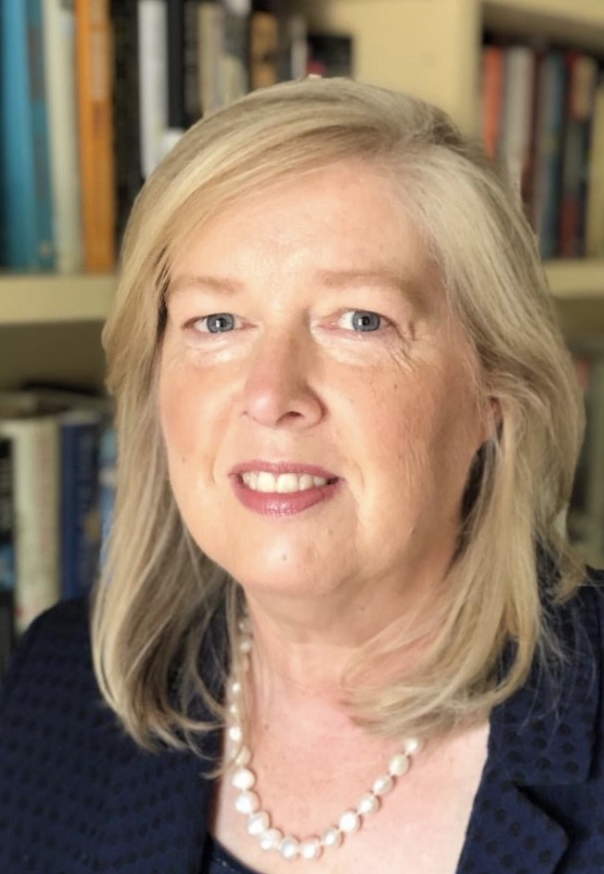
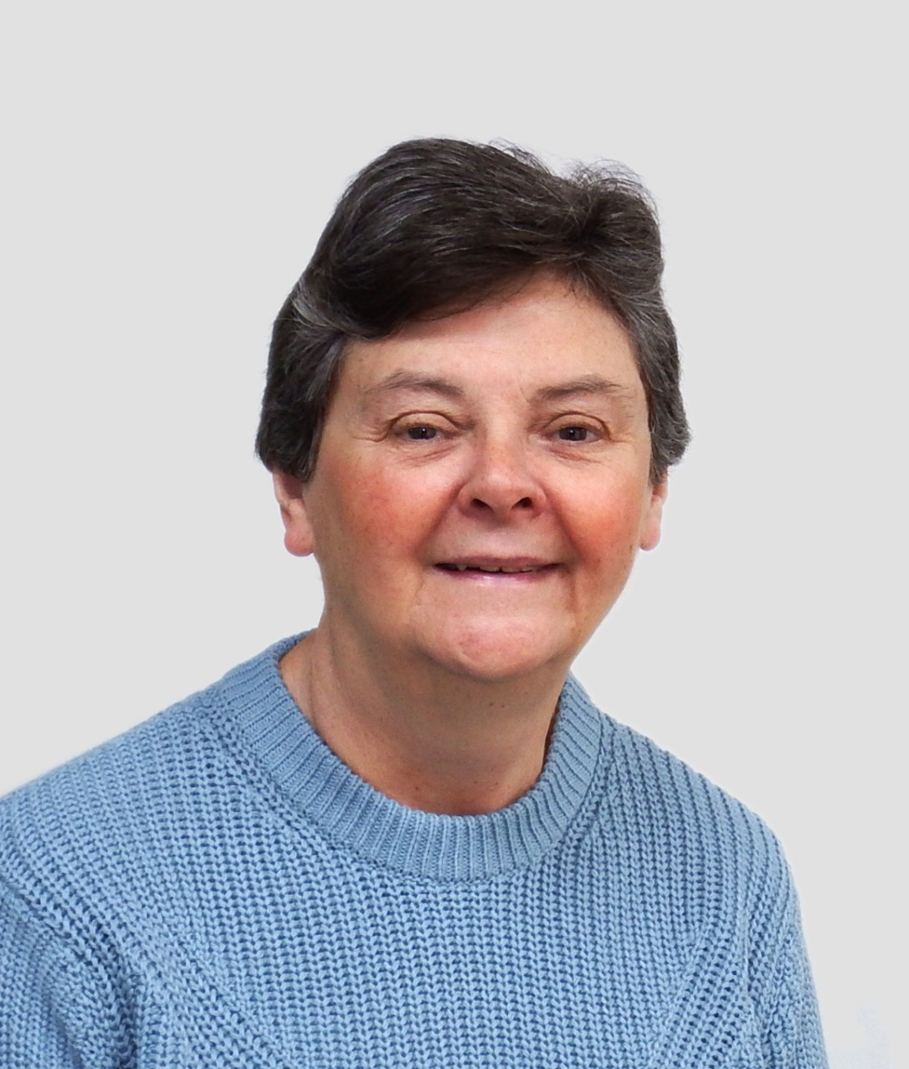
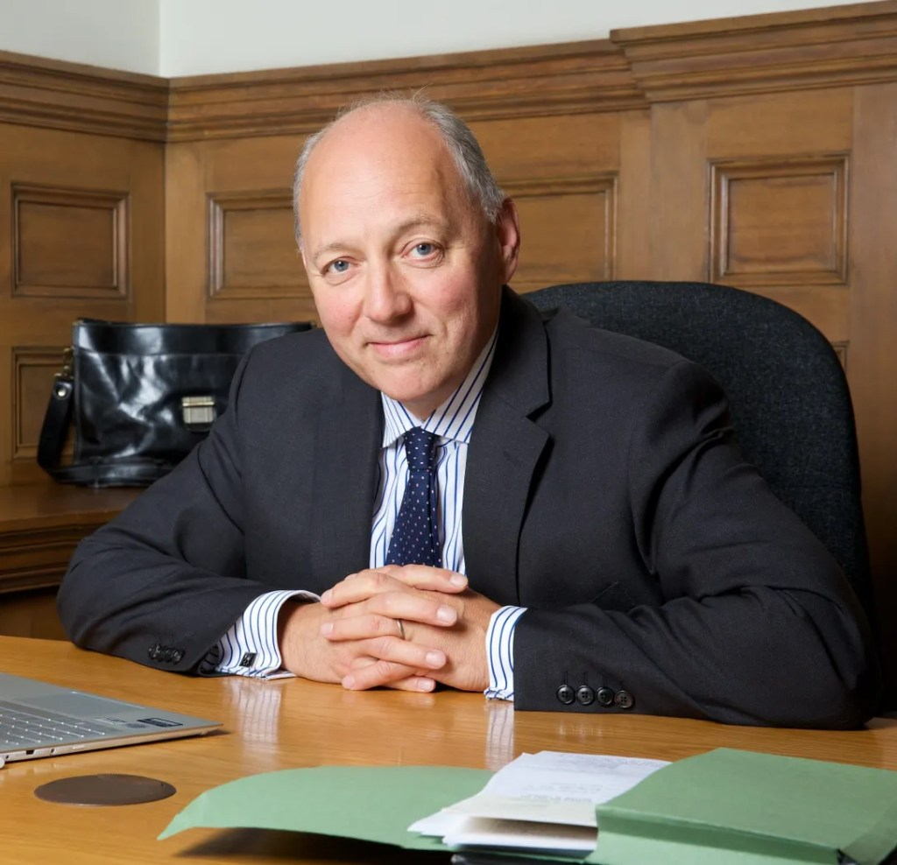
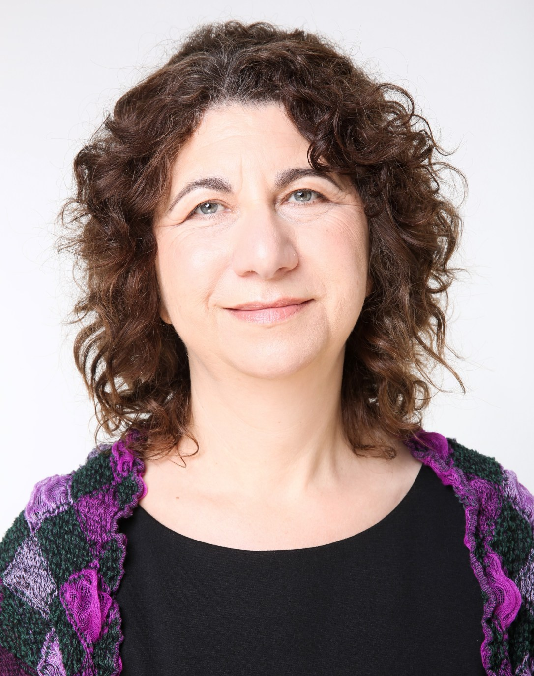
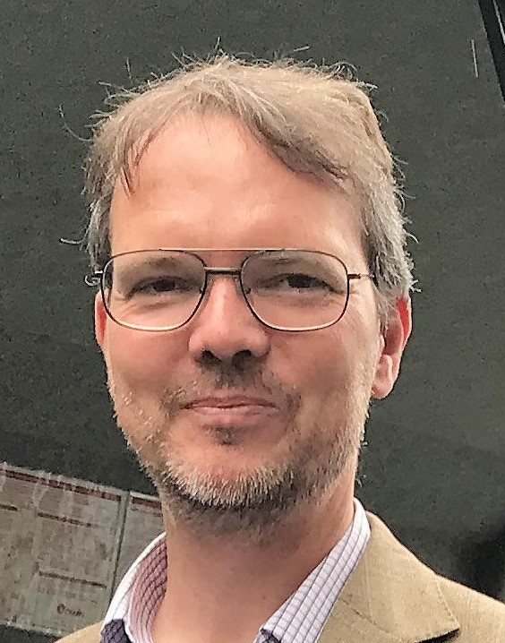
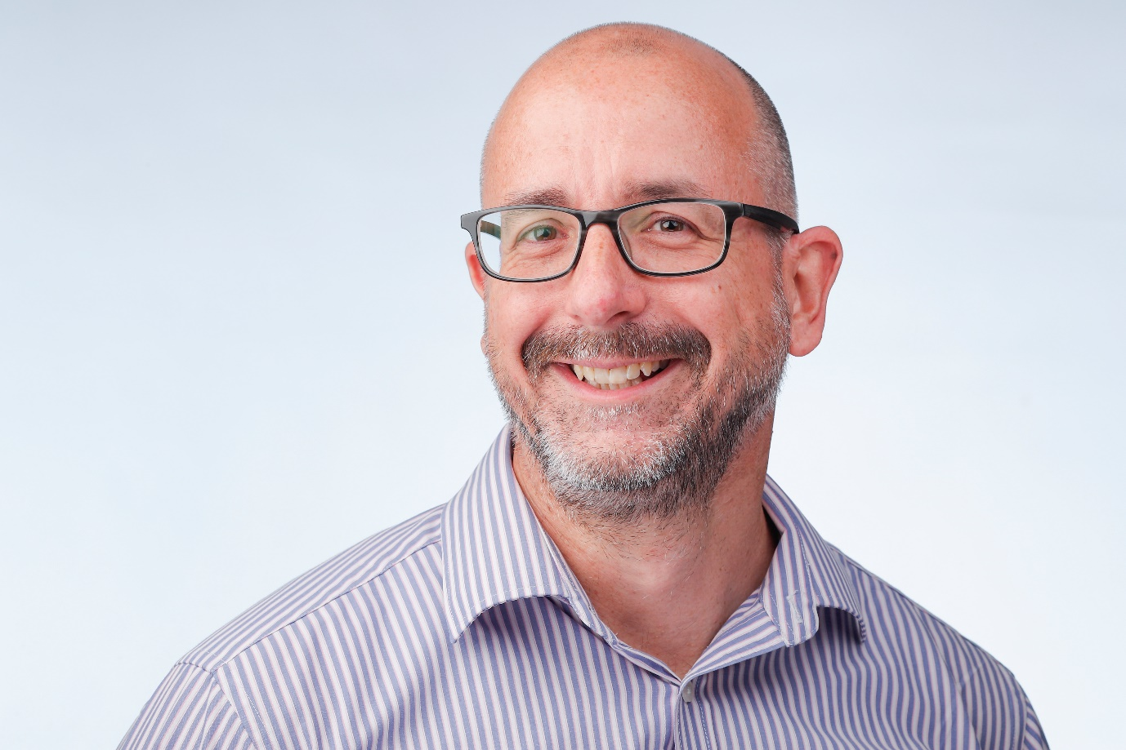
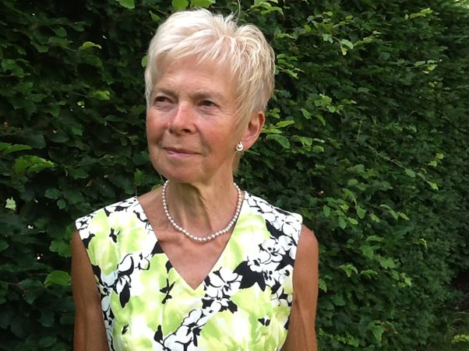
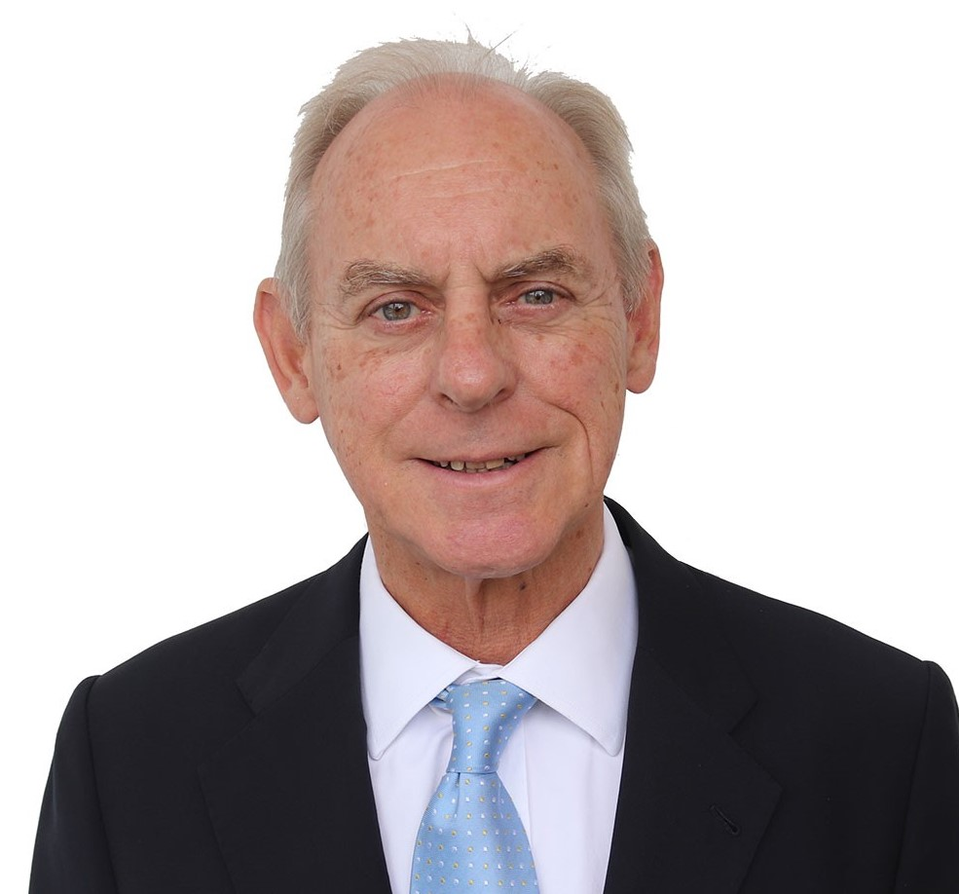
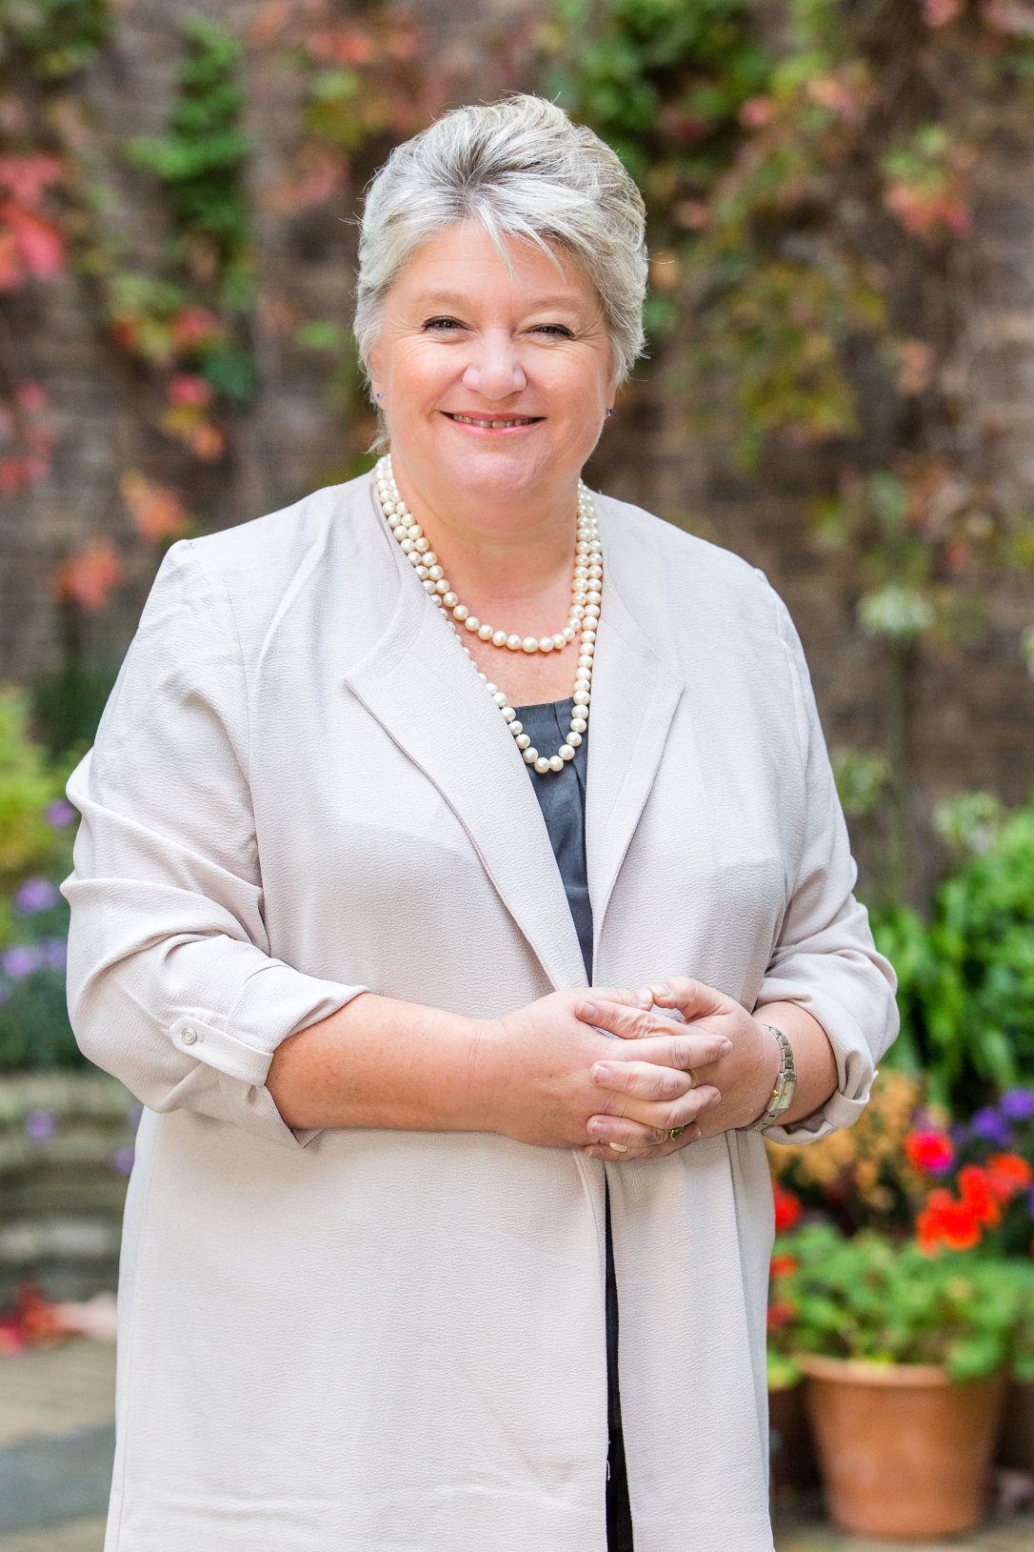
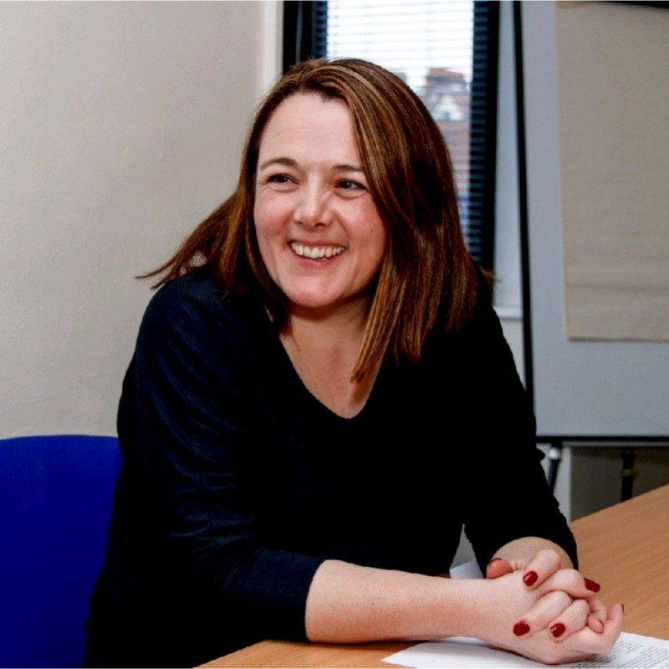
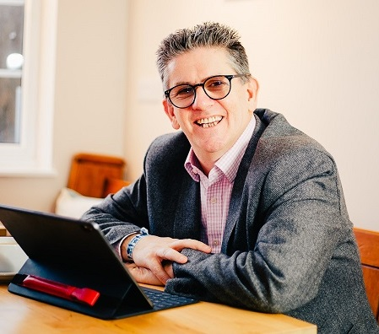
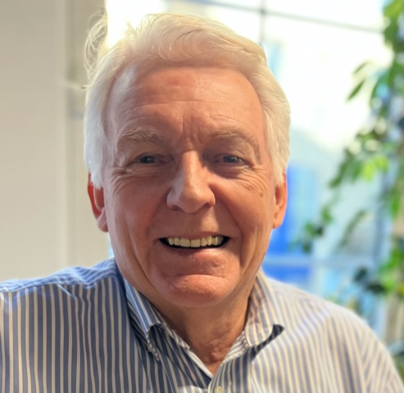
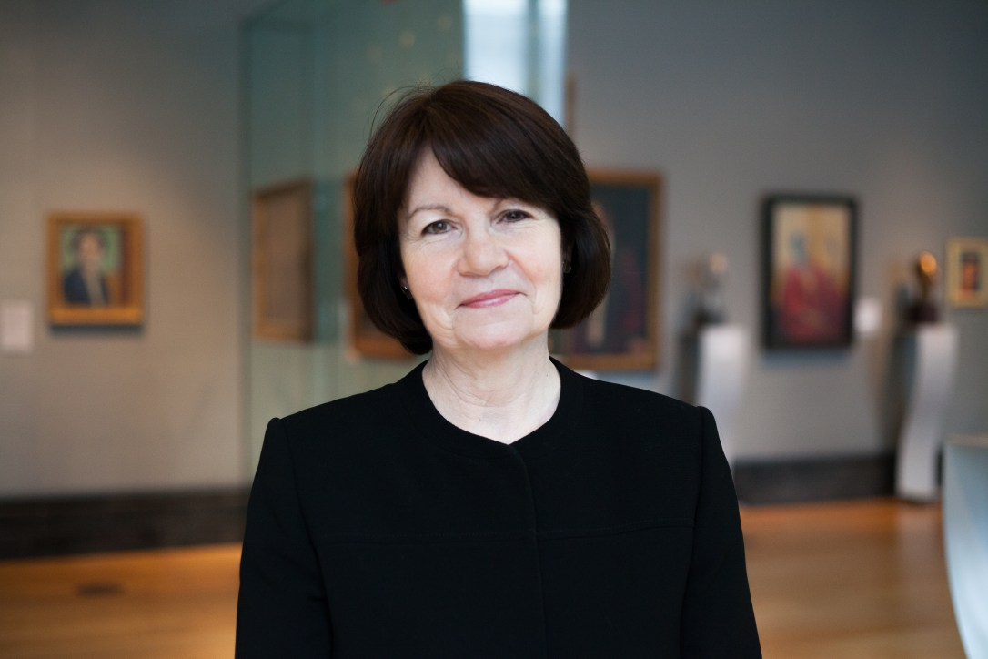
Our mentors
Experienced leaders from business and charity sectors who:
Listen well
Bring their own relevant experience
Act as a critical friend
Are catalysts for constructive change
Guide the mentee to develop their own solutions
Our Mentors are not consultants. They do not give professional advice, but we can signpost mentees to other resources, which give specialist advice

Slide 6
feedback from mentees
“I think the biggest thing for me was to be accepted and validated as a good manager who has created a rather wonderful organisation.
I think that as a result of this I am more settled as a CEO, I have positive self esteem and am confident. Just having someone else who understands the pressures and the loneliness of being a manager was so helpful.”
- Rebecca O’Neill, Brogdale
“I have found the meetings so useful, and it has given me tools, skills and also confidence in myself to push the charity forward to help even more Kent children.”
- Jane Pearman, CEO Hypo Hounds
4.7
overall score out of 5

Slide 7
How to engage
If you would like a Mentor please contact us:
contact@charitymentorskent.org
www.charitymentorskent.org
Even if you don’t need support right now others might, so please help us spread the word
Please come and talk to me to find out more
Any questions?

