Slide 1
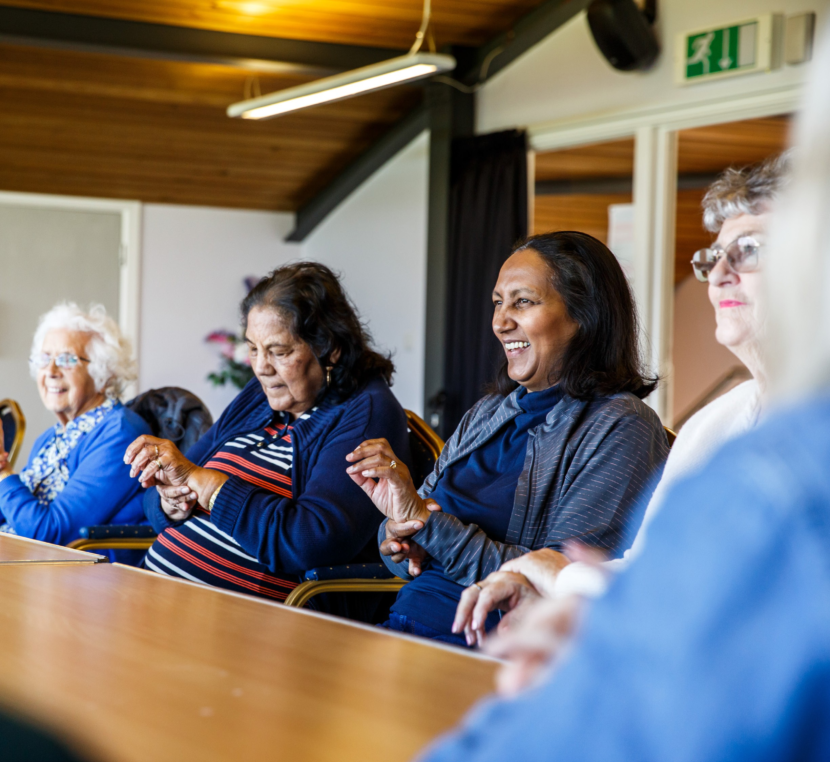

“Bright Shadow is joy and it brings joy!”
Welcome to Bright Shadow! We are a creative organisation where people living with dementia and our supporters live well and enjoy making our own high quality art.

Slide 2
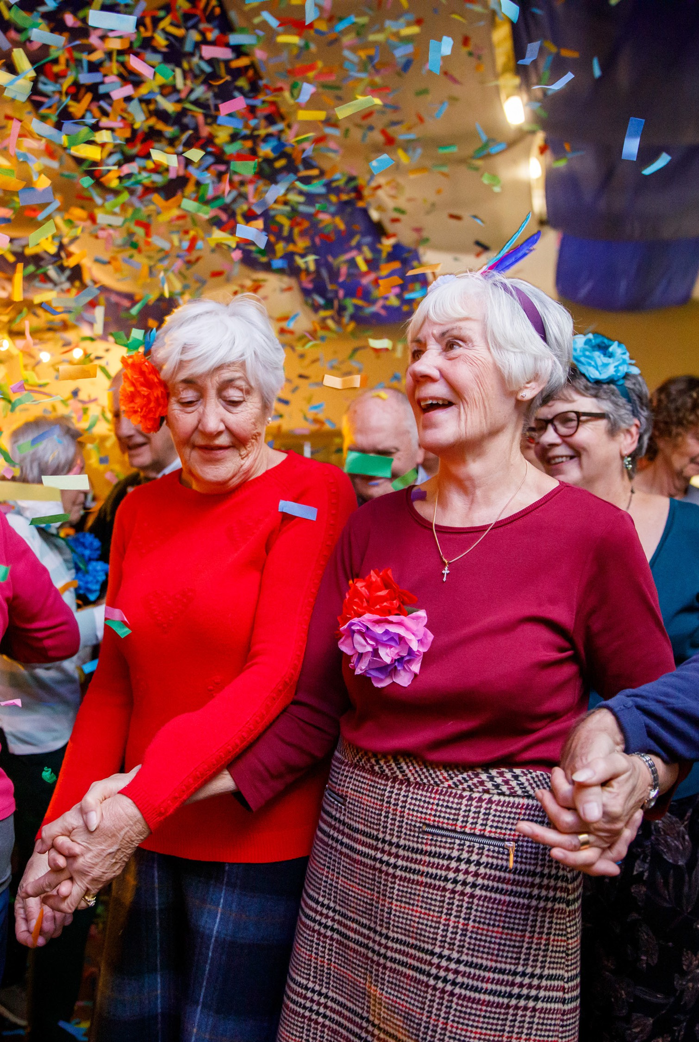
Our story
Serving Kent and Medway, we use the power of the arts and creativity to enable people living with dementia – and those who give care – to live happy, healthy lives.
Founded in 2009, we understand the impact of a diagnosis; yet our work fosters positivity: focusing on what we can do, not what we can’t.
We celebrate the joy, imagination and resilience of every individual, regardless of our challenges. We believe in the power of creative expression to enhance lives, create meaningful connections and challenge stereotypes.
Bright Shadow is more than an arts organisation. We are advocates, champions and allies. We amplify the voices, abilities and unique stories of this remarkable community.
www.brightshadow.org.uk

Slide 3
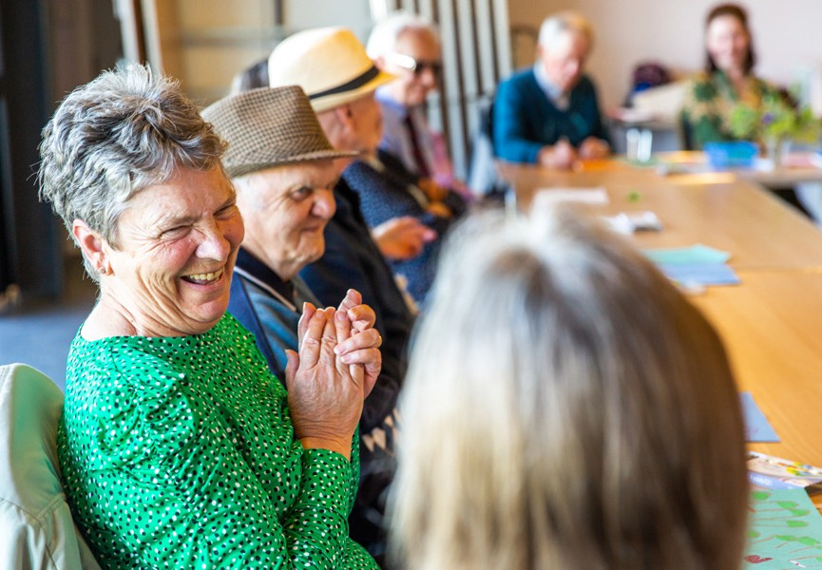
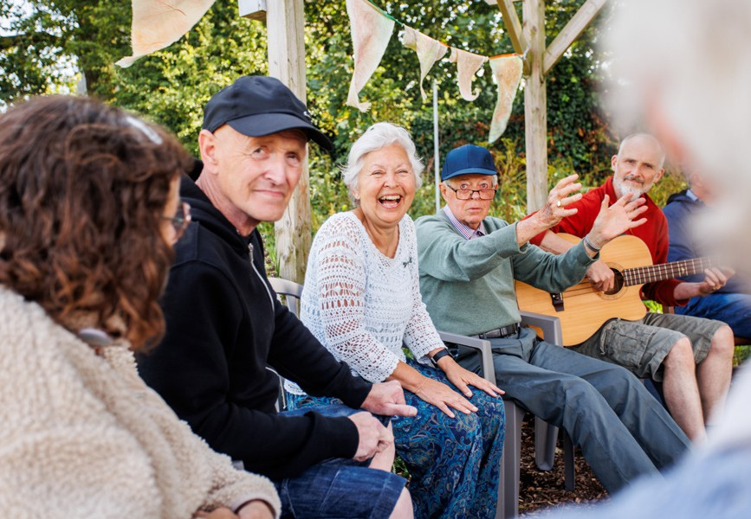
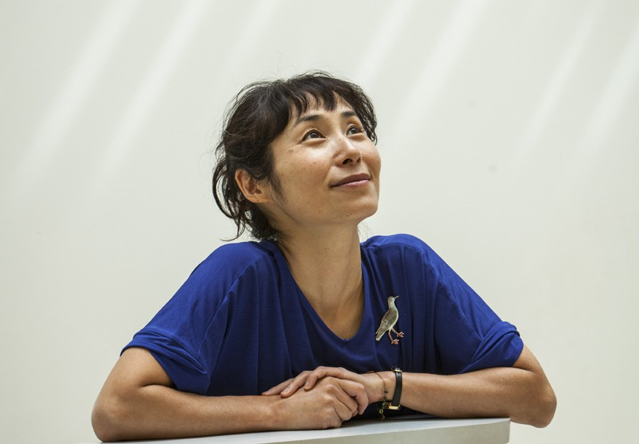
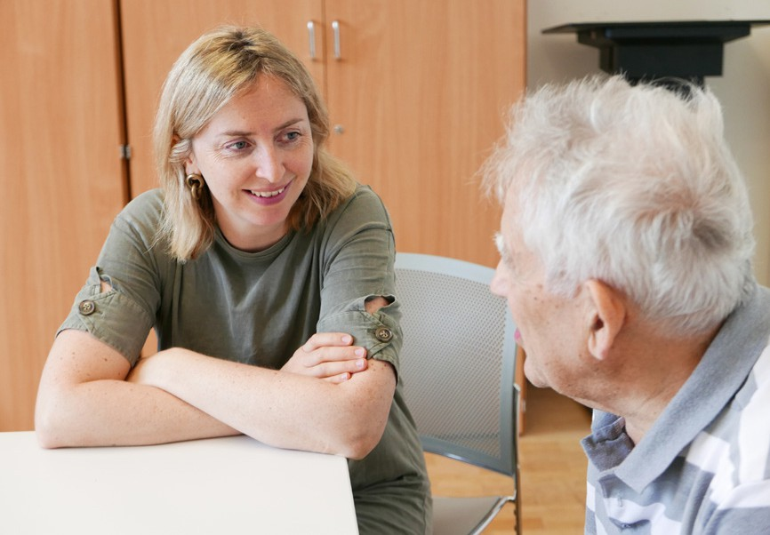

Who we are
Session
Participants
Coordinators & Volunteers
Artists
Staff team
www.brightshadow.org.uk

Slide 4


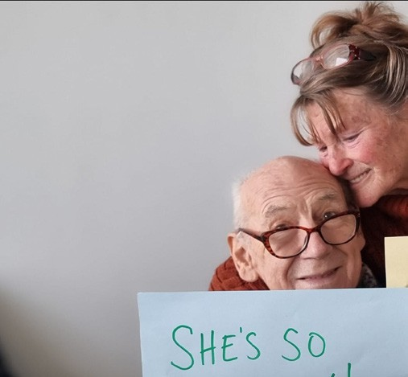
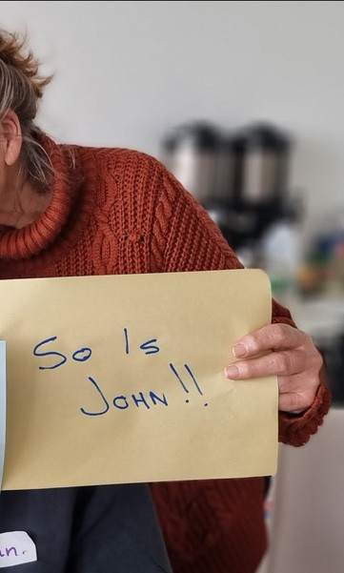
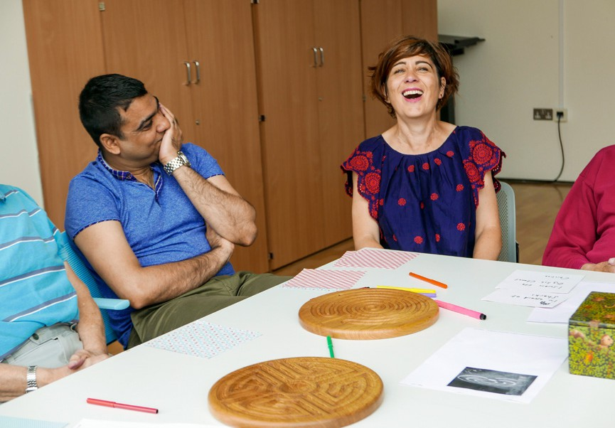
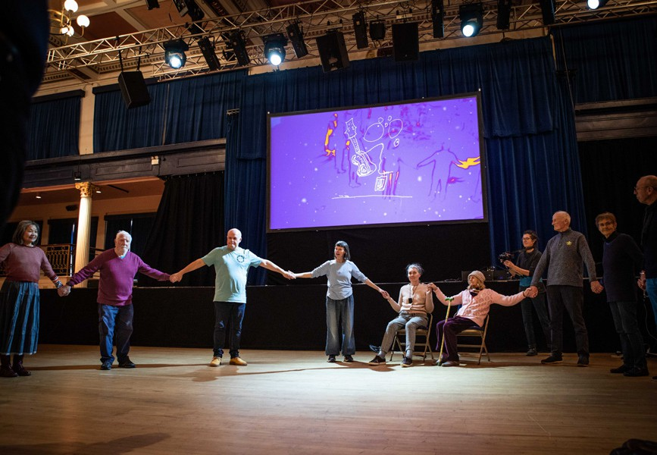
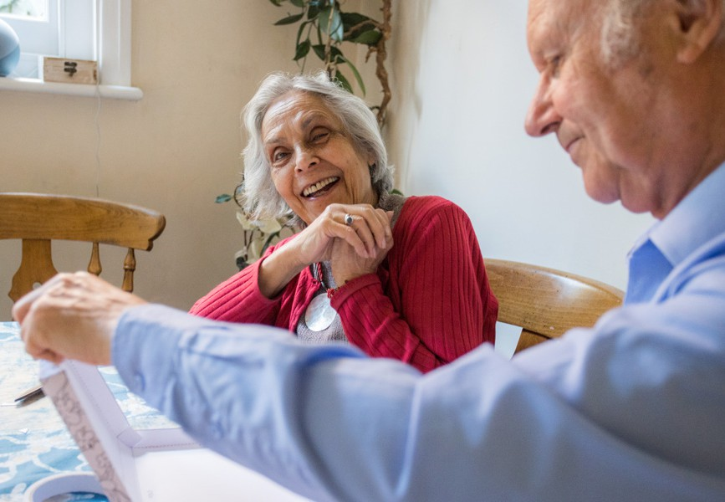
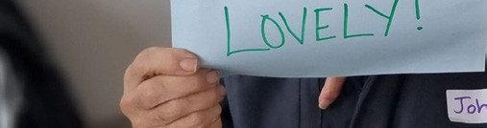


Slide 5
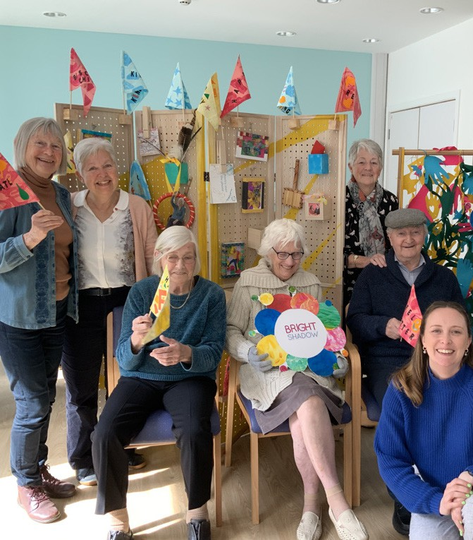
Our Zest Groups
“You come in feeling low and you leave on a high…”
Zest Groups are safe and accessible. They introduce a rich mix of arts experiences that are mood-boosting, invigorating and which enhance communication and relationships.
They bring life, energy and fun to communities and are an affirming and exciting way to
help people continue to lead fulfilling lives.
www.brightshadow.org.uk

Slide 6


www.brightshadow.org.uk

Slide 7
Our Zest Groups
New!
Our Zest Groups currently run in Medway, Whitstable, Deal and Hythe.
Sessions are free of charge, with donations welcomed to support our charitable work.
Medway
Tuesdays 10am-12pm The Sunlight Centre
Richmond Road, Gillingham
ME7 1LX
Whitstable
Tuesdays 2pm-4pm
Whitstable Umbrella Centre Oxford Street, Whitstable CT5 1DD
To book a free taster session, contact us on:
Deal
Thursdays 10am-12pm
Astor Theatre Stanhope Road, Deal CT14 6AB
Hythe
Thursdays 2pm-4pm
Hythe Sports Pavilion 2 South Road, Hythe CT21 6AR
 01227 467 272
 zest@brightshadow.org.uk
We look forward to meeting you!
www.brightshadow.org.uk

Slide 8
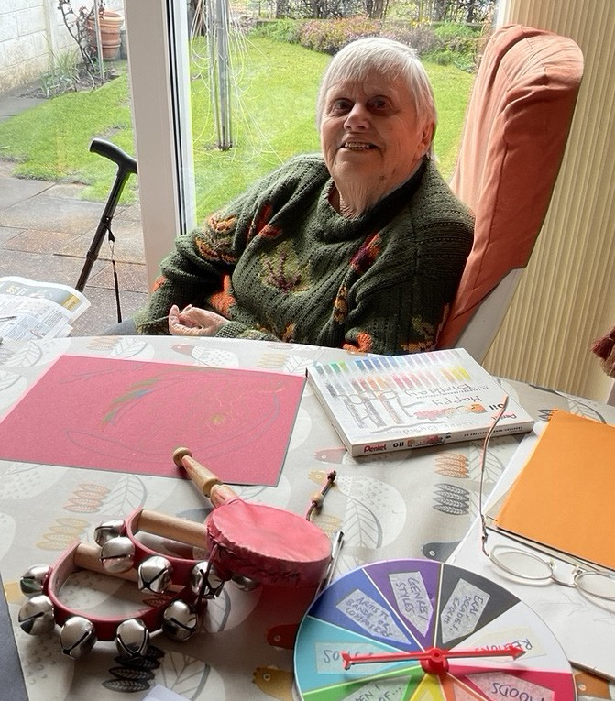
Zest at Home
“This is the kind of wonderful responsive intervention that Bright Shadow does so well...”
– David Leahy, Musician and Dancer
Zest at Home is an offer of creative sessions in your own home, for people living with dementia in Kent and Medway who are unable to access our group Zest sessions, are isolated, experiencing a crisis or a sudden loss of communication skills.
www.brightshadow.org.uk

Slide 9
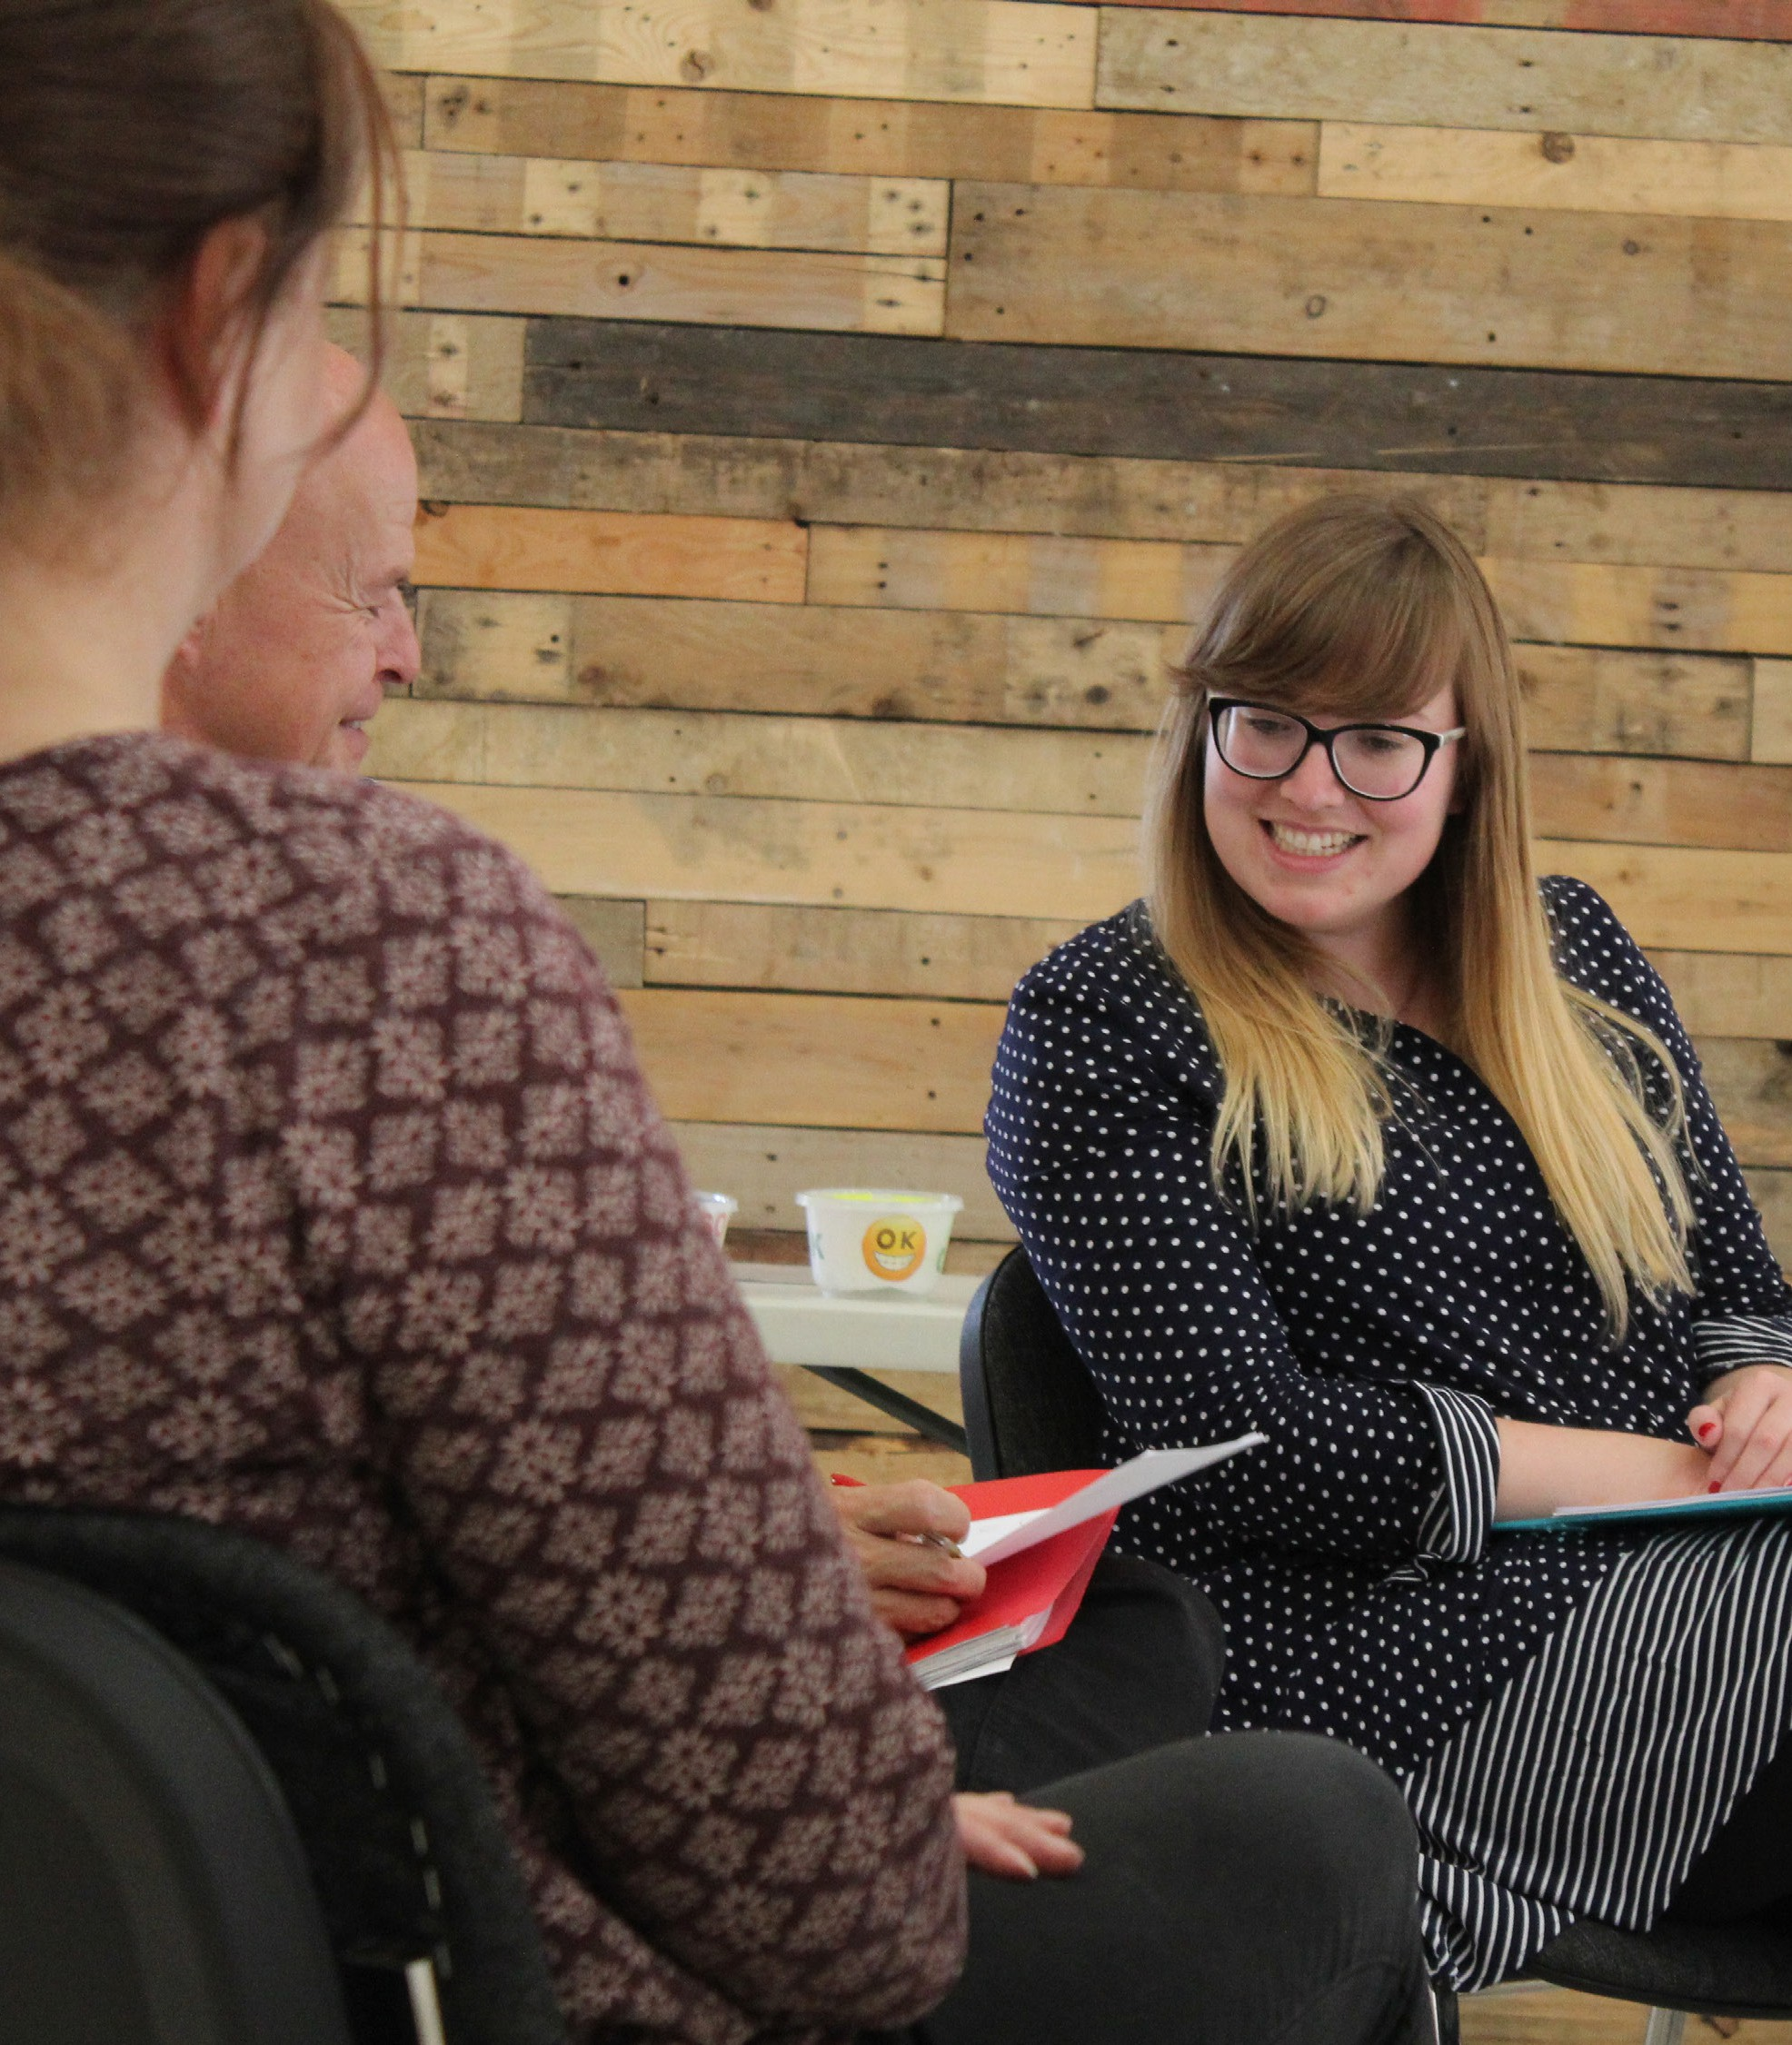
Training
"This training was a very bright light breaking through the shadow cast by the ‘stigma’ of dementia."
We’ve been training colleagues in the care, health, arts and community sectors for over a decade. Delivered by experts in dementia and arts practice, our training is always at least in part bespoke so that it truly meets the needs of your organisation and team.
www.brightshadow.org.uk

Slide 10
Training
Topics we cover include:
Enhanced dementia awareness
Creativity in Care - theory
How to plan high quality creative activities for people with dementia in your setting
Masterclasses with our experienced artist practitioners
www.brightshadow.org.uk

Slide 11

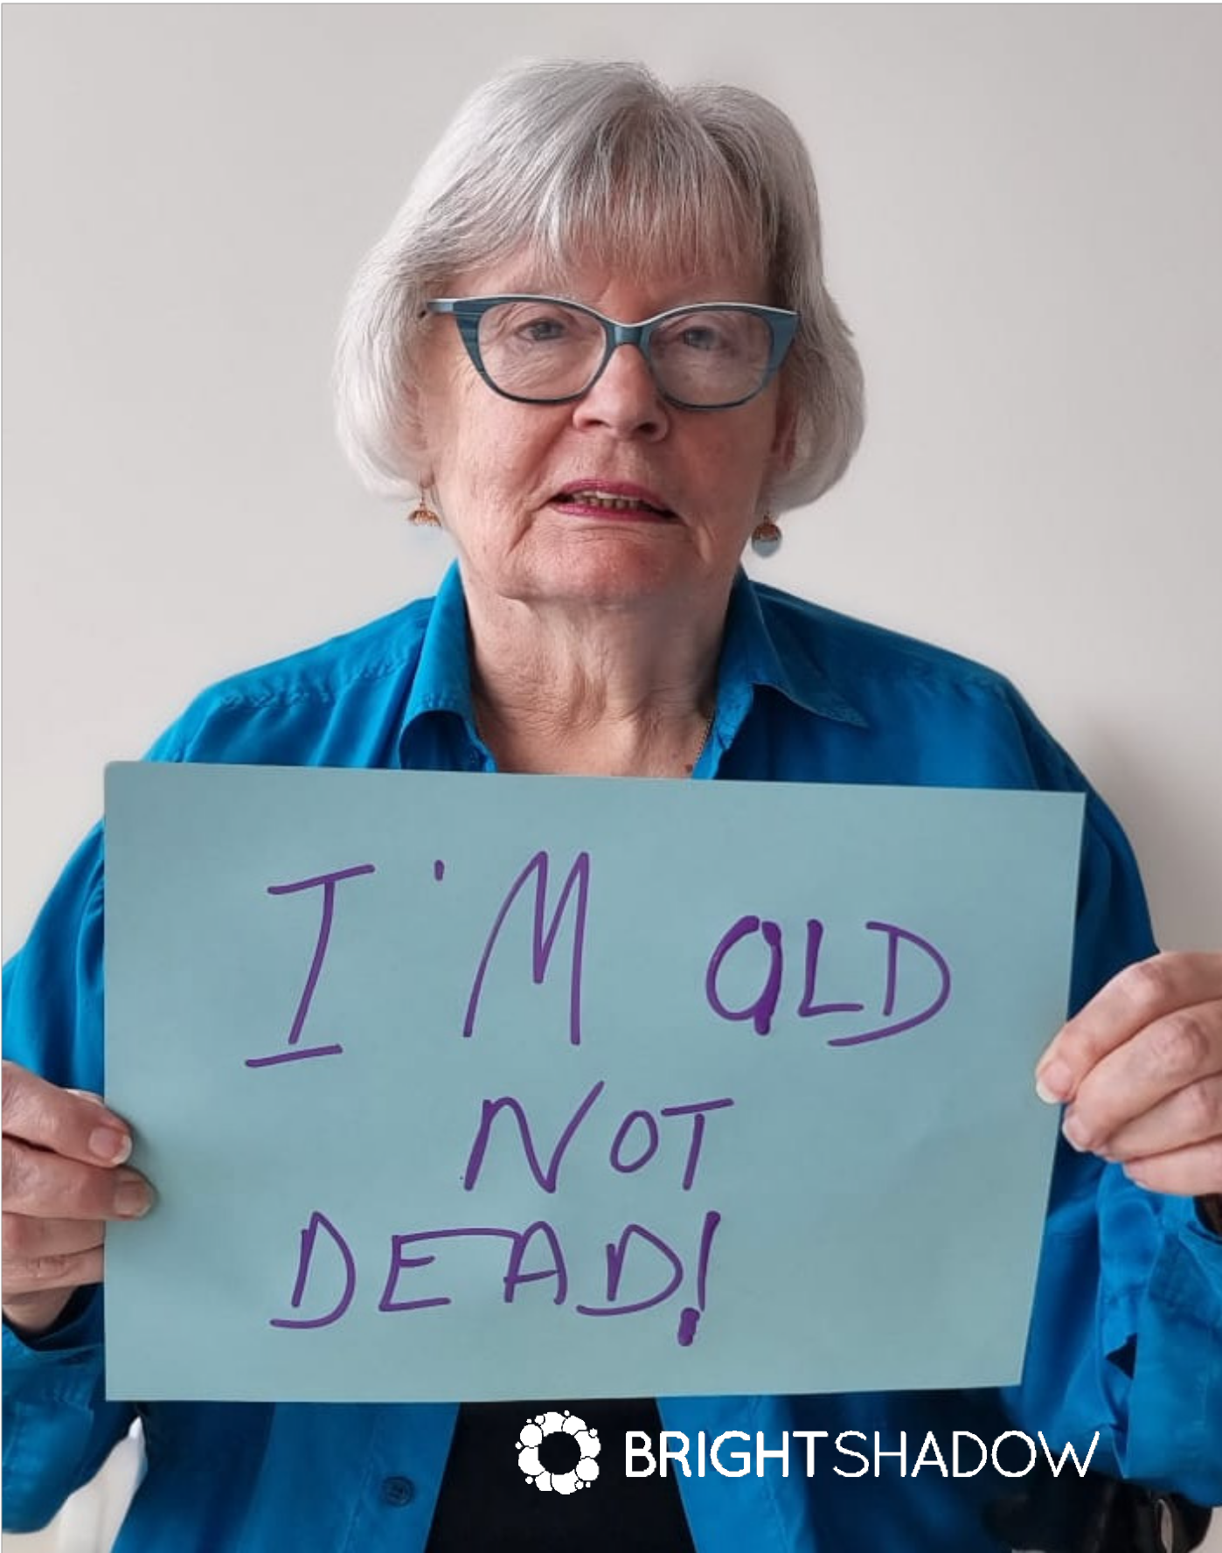













Slide 12
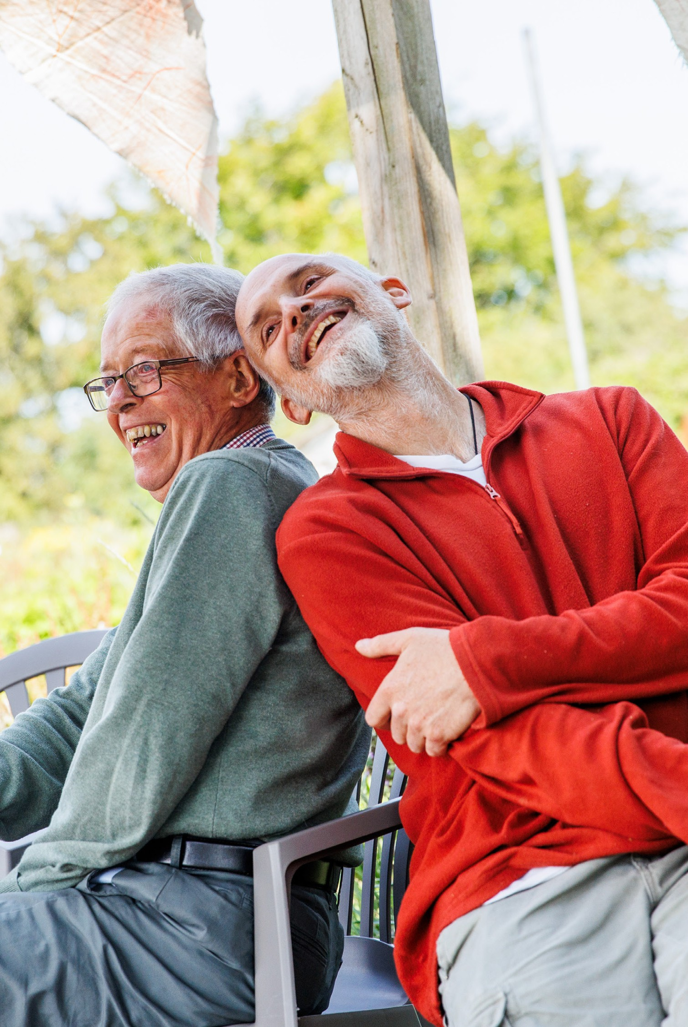
Our impact
“Having memory problems, Zest has helped me maintain some of my independence and confidence.
I love all the activities that we do and being introduced to new
things. It has encouraged me to do things for myself.”
- Zest participant
www.brightshadow.org.uk

Slide 13
Our impact
9 in 10
36.4%
80%
Participants feel ‘good’ or ‘great’ after Zest sessions.
Increase in wellbeing from the beginning to the end of a Zest session.
Participants living with dementia reporting Zest has helped reduce how often they feel lonely.
www.brightshadow.org.uk

Slide 14
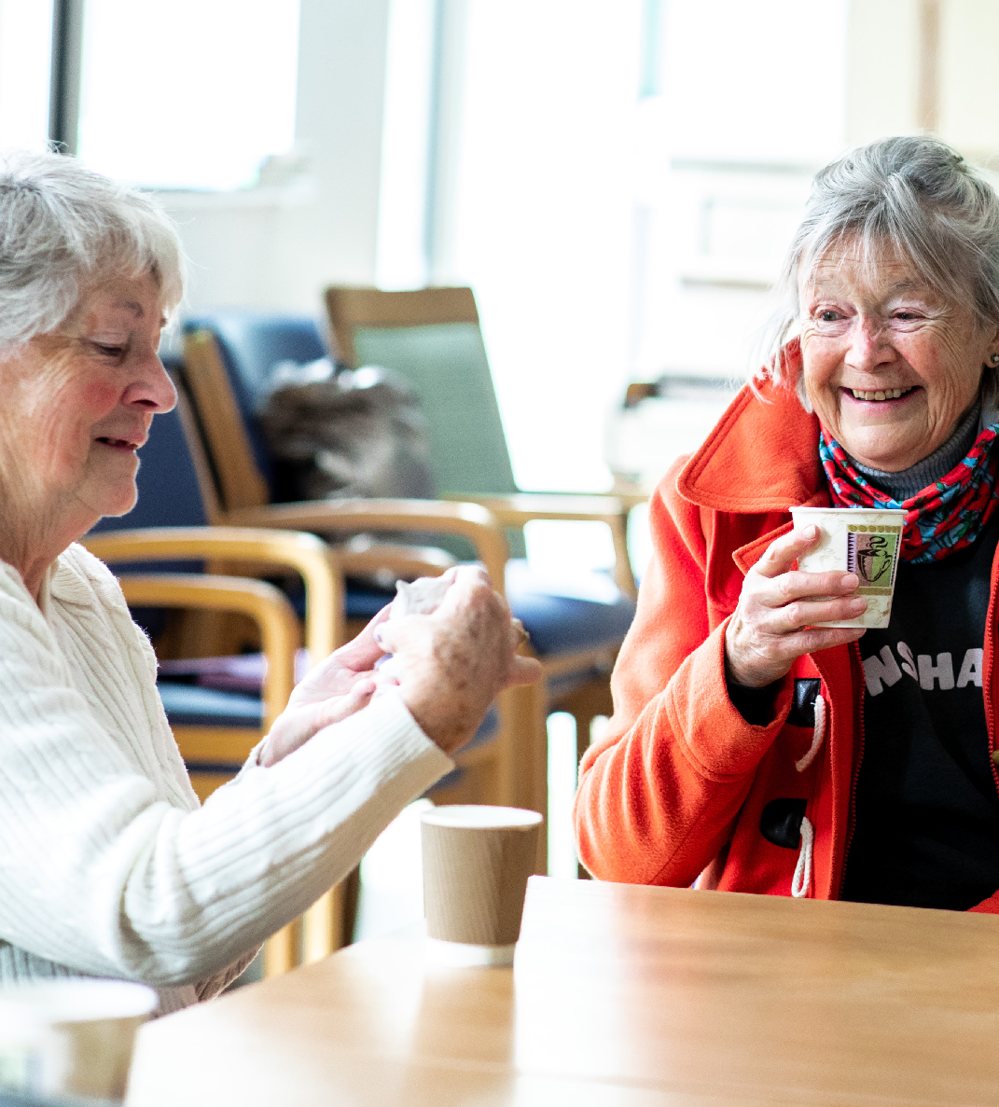
Any questions?
www.brightshadow.org.uk

Slide 15
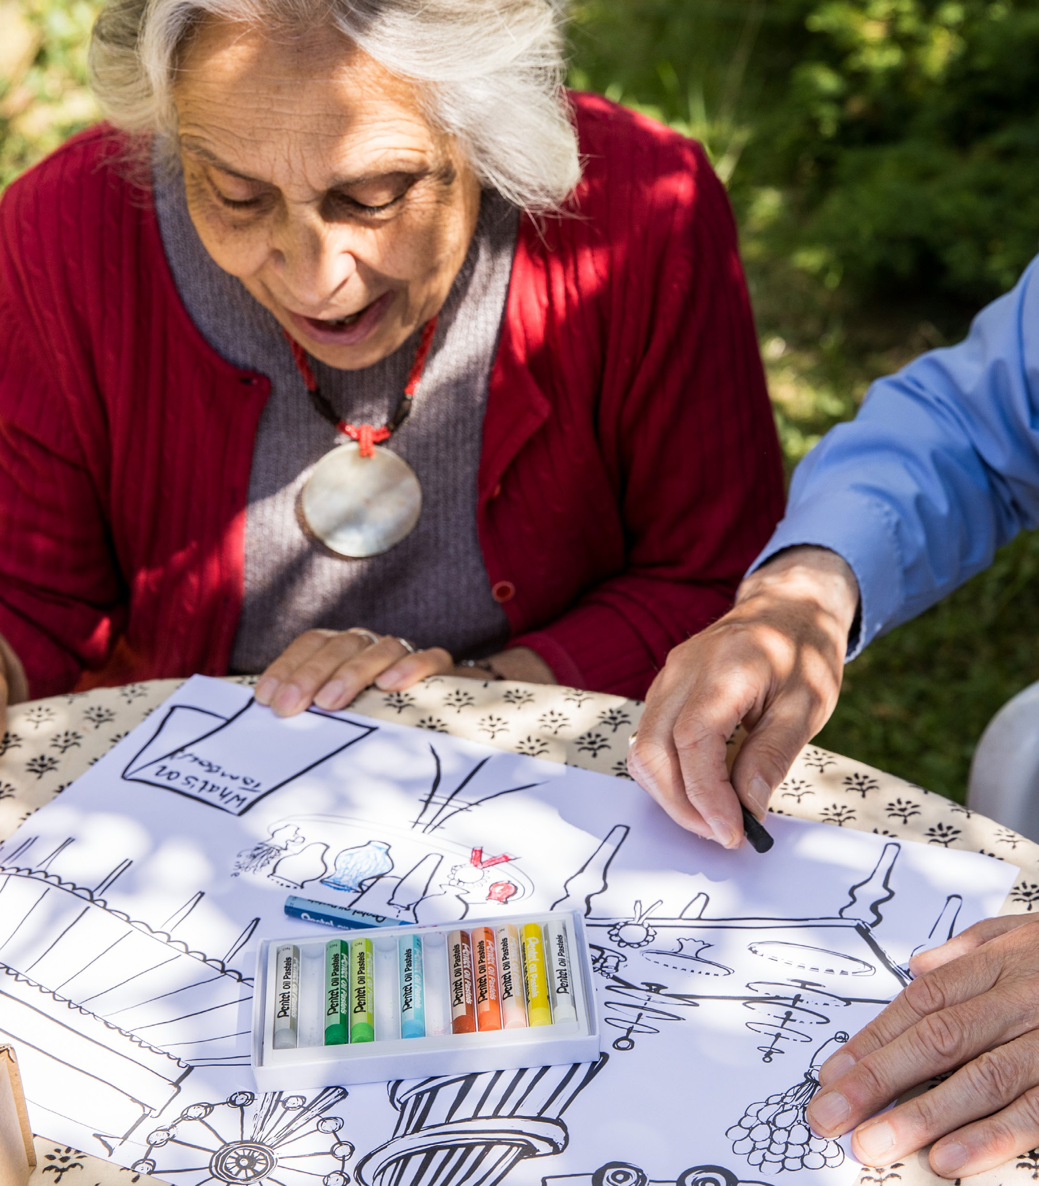









Slide 16


