Slide 1

Making Connections!
Martha Trust
Kerry Banks BEM
Fundraising & Events Officer
Notes:
Good evening, my name is Kerry Banks and I am the Fundraising and Events Office at Martha Trust. Thank you for inviting me here to talk about our charity
I have been with Martha Trust for 3 years now and I love every minute of it; no 1 day is the same and I get to meet great people like yourselves

Slide 2

Providing support for people with profound physical and learning disabilities
Notes:
We are a charity based in Kent and East Sussex providing a very special home for people with profound physical and multiple learning disabilities, people not as fortunate as you and I.
Our resident’s basic daily nursing care is funded by local authorities or CCG’s however other costs like hydrotherapy to day trips, specialist recreational equipment, minibuses and improvements have to be paid for entirely by voluntary donations and fundraising.
My job at Martha is to hold events, raise awareness of Martha, inspire and encourage people and organisations like yourselves to fundraise for us
These are the things that make the difference between giving supportive, holistic care as opposed to just minding someone.
This evening I’m going to talk about the people who live at Martha and how their disabilities affect their lives.

Slide 3

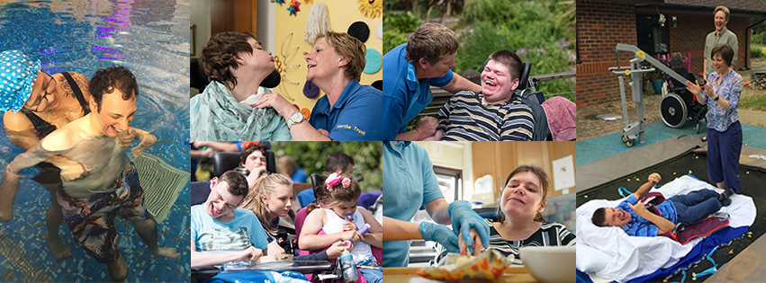
Our Journey
Notes:
Martha Trust was founded in 1987 by a small group of Christians from Deal. They felt there had to be a better alternative to the NHS long stay mental health hospitals and institutions where people with profound disabilities were being placed. They believed those with profound disabilities should be able to live life to the full and get the most out of each and every day. Their vision combined with a lot of hard work, determination and support from the local community means that thirty years on Martha continues to support families and their loved ones to live fulfilling lives in a safe loving environment.
Over the past thirty years they have built two modern homes, acquired a third, created a day centre, respite care facilities, sensory rooms, state of the art hydrotherapy pools and beautiful accessible gardens.
With health funding cuts at an all time high, we at Martha need to raise a minimum of £235,000 to continue to offer the level of holistic care that we are so very proud of

Slide 4

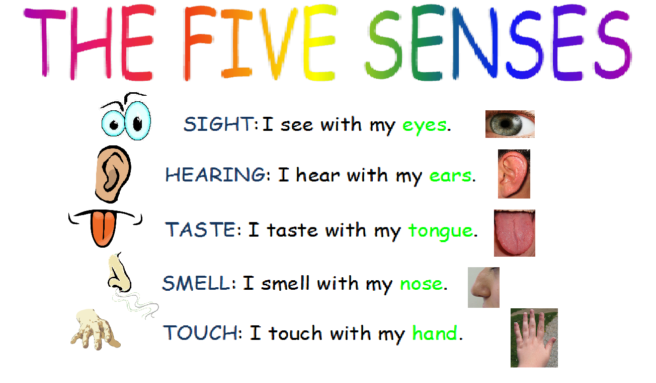
Notes:
Now I would like you to think about the 5 senses.
At Martha Trust some of our residents can’t see properly and some can’t hear properly.
All our residents can smell things, so their sense of smell is probably better than ours.
The people that we support can taste things, just like we can. But some of them aren’t able to chew and swallow food, so they have to be fed through a tube straight into their stomach.
And the last sense is touch. All of our people can feel things, so touch is a really important sense to them.

Slide 5
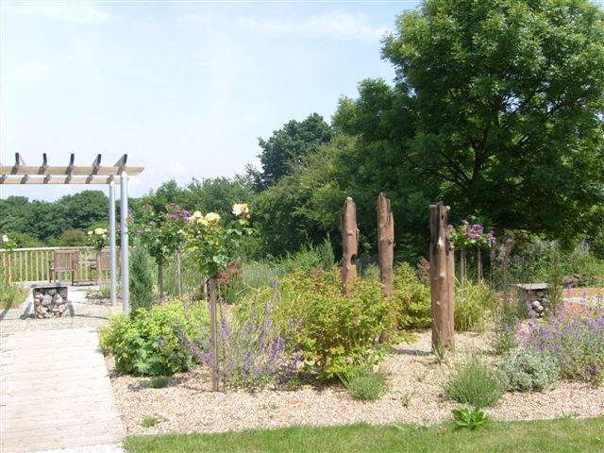
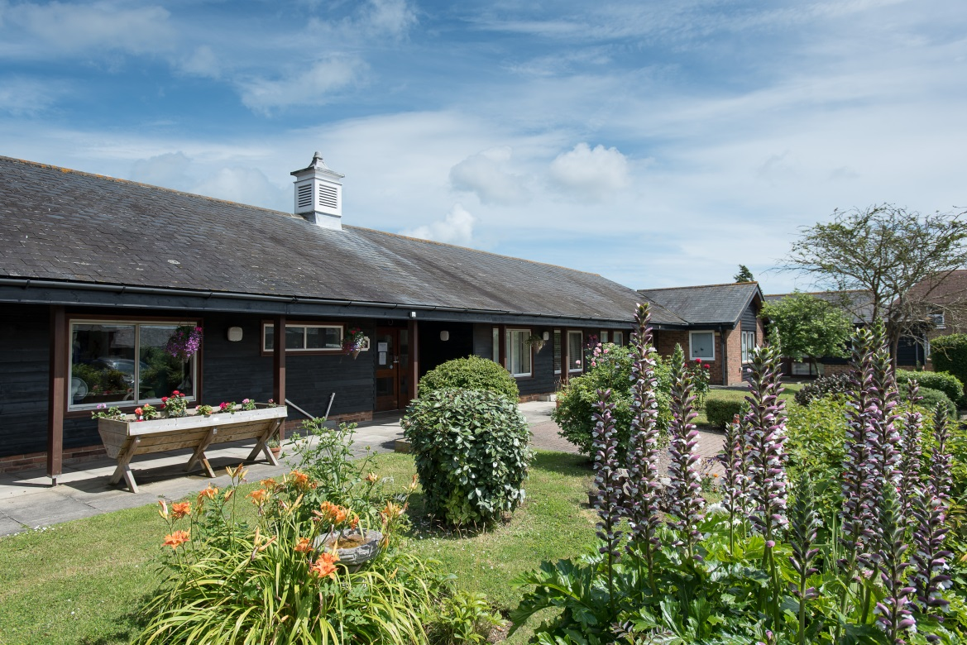
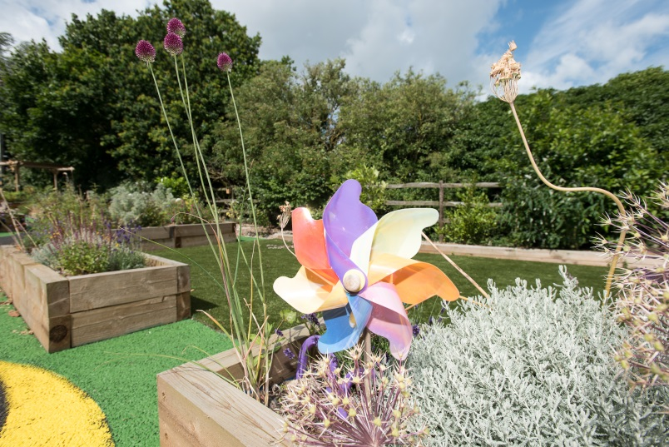
Our Sensory Gardens
Notes:
Now, when a sense doesn’t work as well as it should, we have discovered that it is important to stimulate the senses that do work properly. This is called sensory therapy.
Let me give you an example, at Martha Trust we have beautiful sensory gardens, which are designed to appeal to all 5 senses. When our people go into the garden they might not all be able to see or hear the waterfall, but they can touch it. The scent of the flowers and herbs and the rustling breeze through the grasses can make it like a peaceful haven for them.
We stock the sensory gardens with as many different things to stimulate all the senses as possible, including brightly coloured Koi Carp in the pond, plants that are interesting to touch and smell and wind chimes.
.

Slide 6
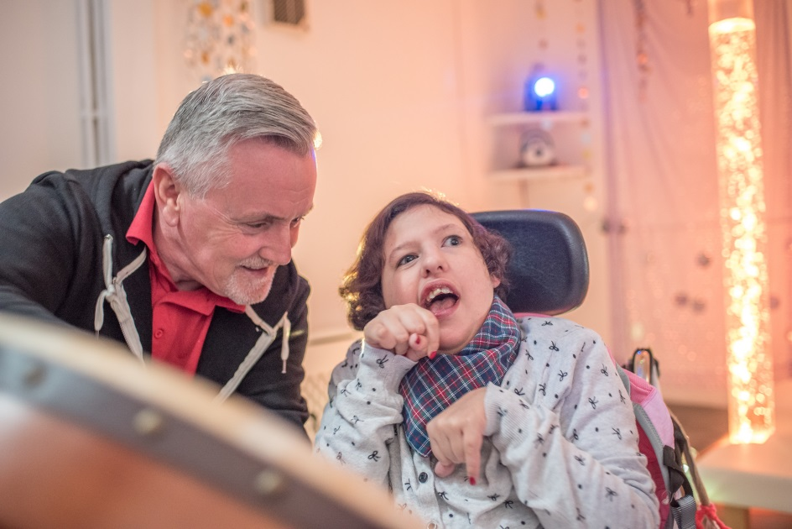
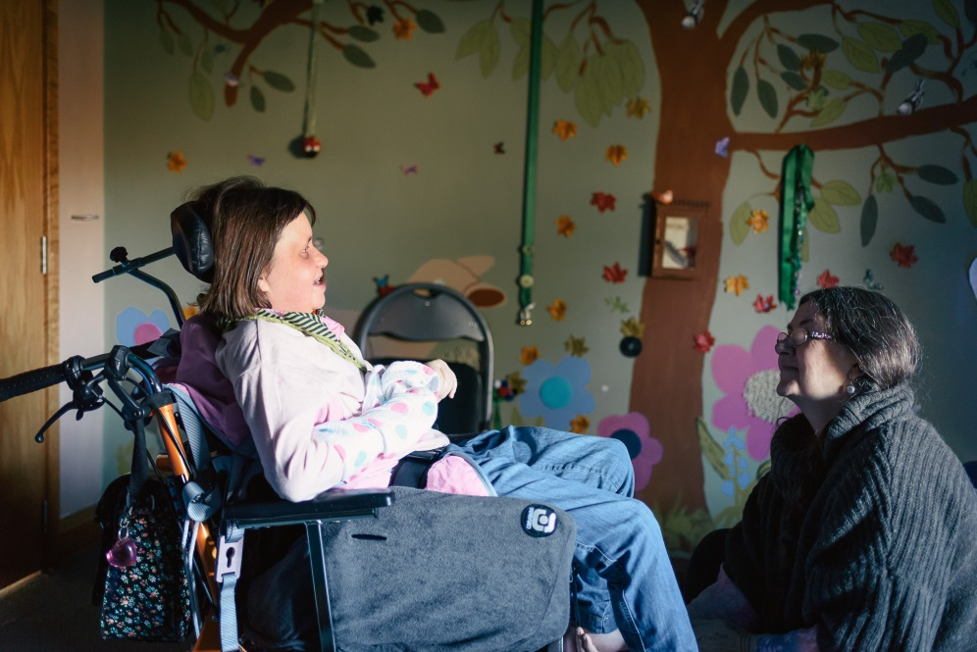
“Play is the highest form of research”
Quote by Albert Einstein
Notes:
It’s really important to listen to the senses that do work. As well as our wonderful gardens, we have sensory and music rooms to do just that. Our sensory rooms have recently been updated to and one of our new additions is a magic sensory carpet in each home. When a resident is laying on it and moving , the carpet will light up and music will play to the movement. We also have a water bed in the rooms plus a massage bed and now a light up ball pit pool.All our residents enjoy music in their own ways so our sensory rooms are always full of laughter when the music is playing.
Because of this, we have a campaign called Music4Martha

Slide 7


Coronavirus hit the world in 2020

Slide 8

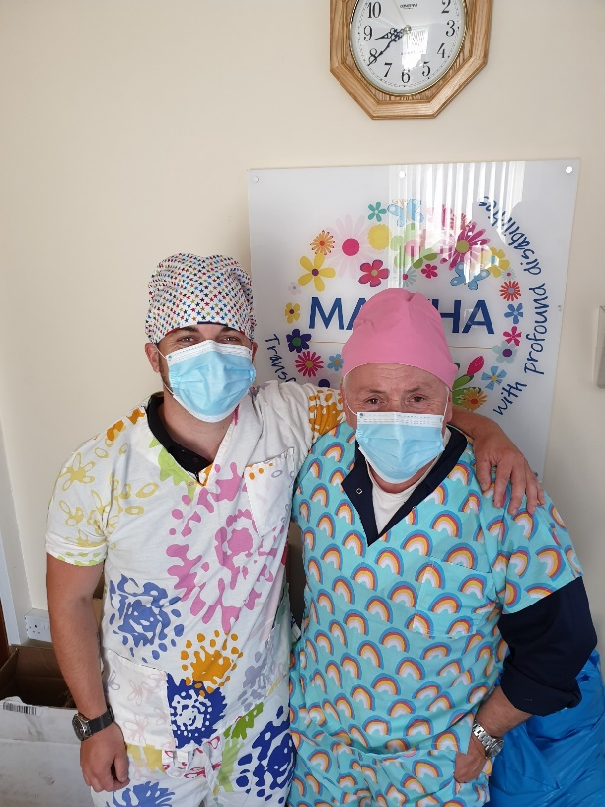
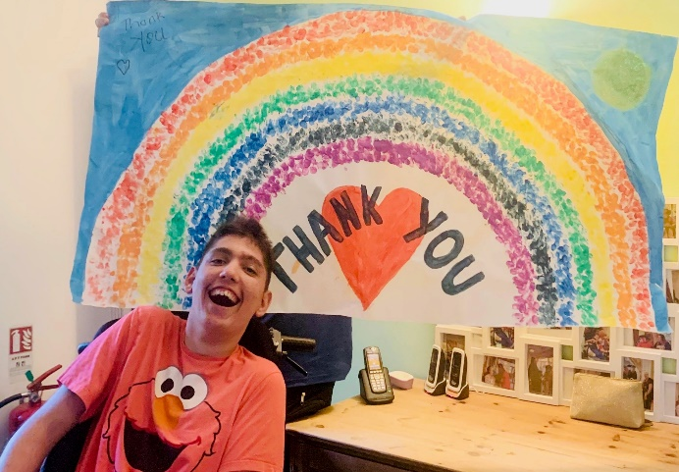
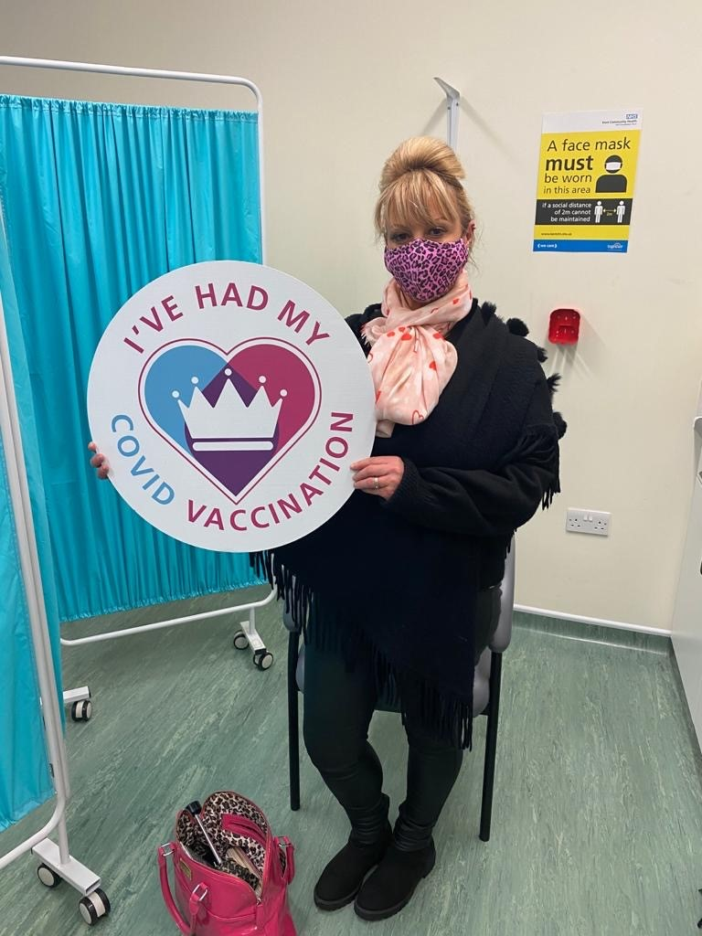
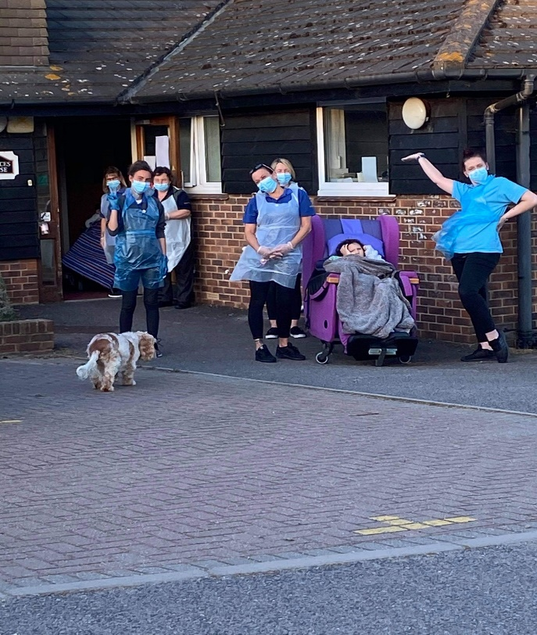
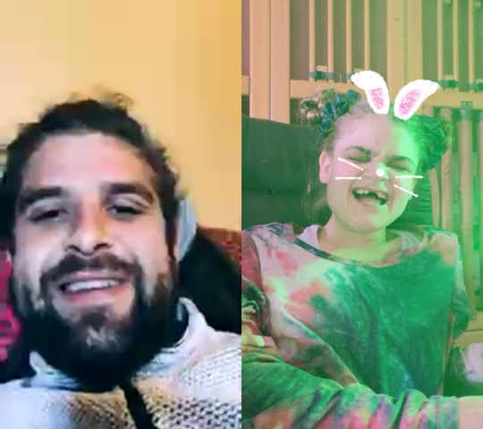
A new way of living.

Slide 9
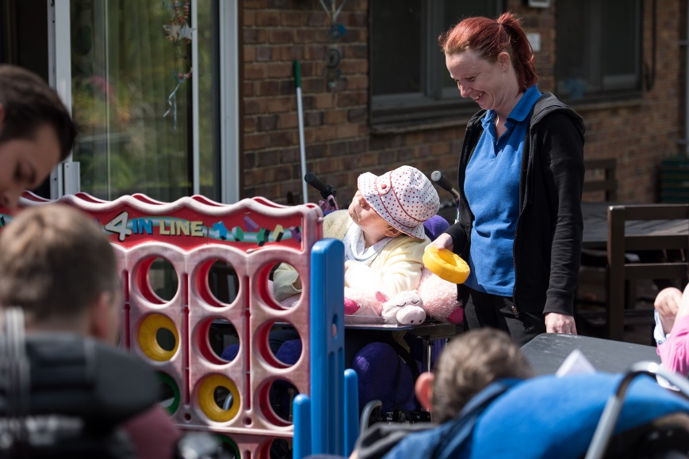
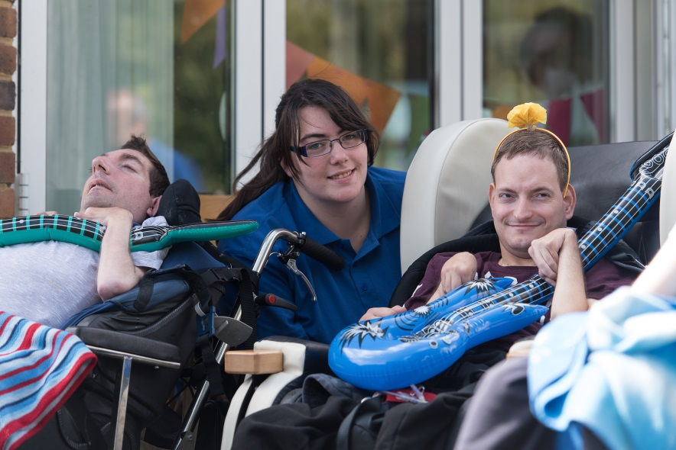
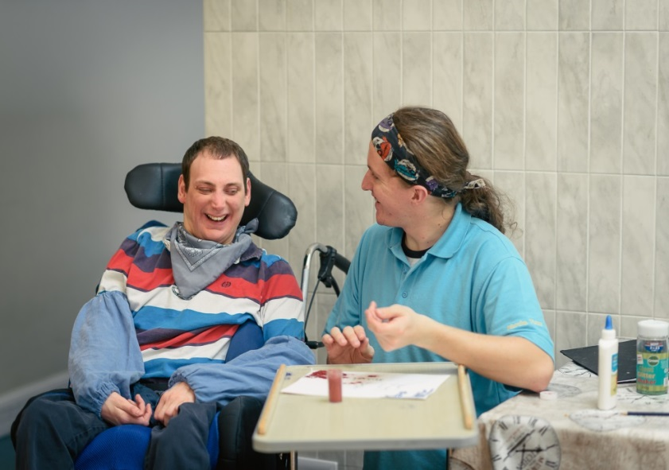
“ A great employee is like a four leaf clover- hard to find and lucky to have “
Tammy Cohen
Notes:
For our residents the two most important things are the senses that they are able to use and the carers who can understand them. We have support workers and a nurse on duty 24 hours a day and each resident has a named nurse and keyworker who really get to know their needs and how to communicate with them.
They can’t turn the TV on or off, take themselves for a walk, or leave a room when they are fed up with people around them. But they have learnt how to communicate in their own way, maybe blinking, raising a finger, crying, laughing – all signs that their carers look out for.
We all need help sometimes, but the people who live at Martha need round the clock help.

Slide 10
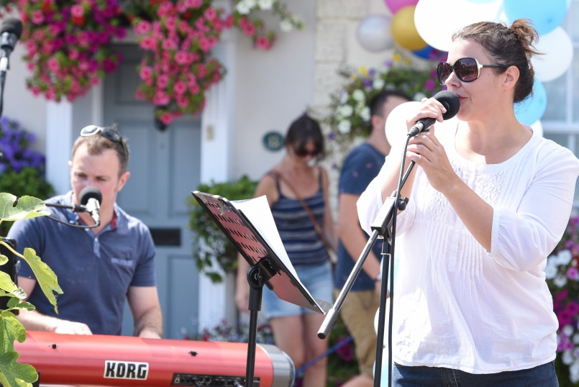
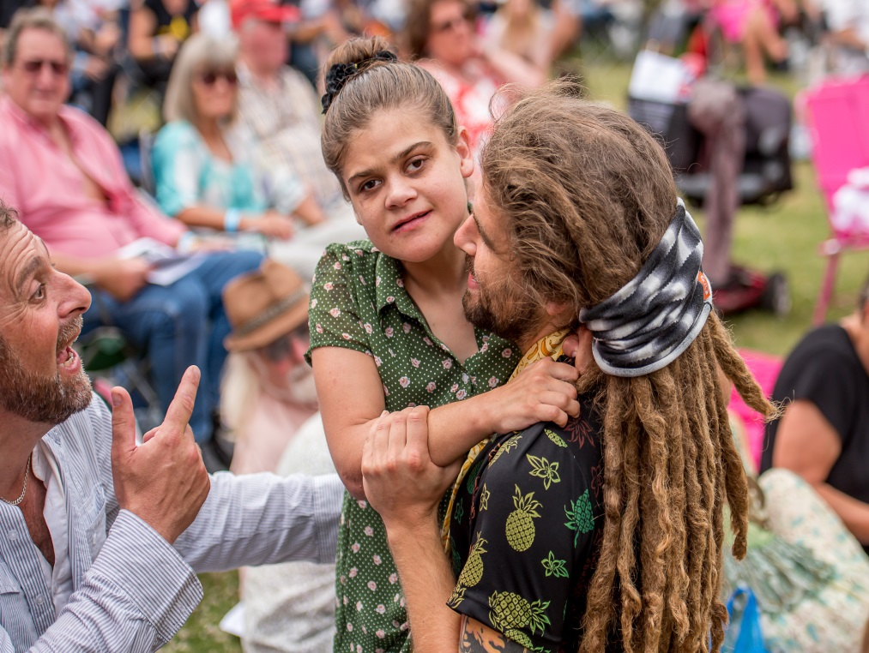
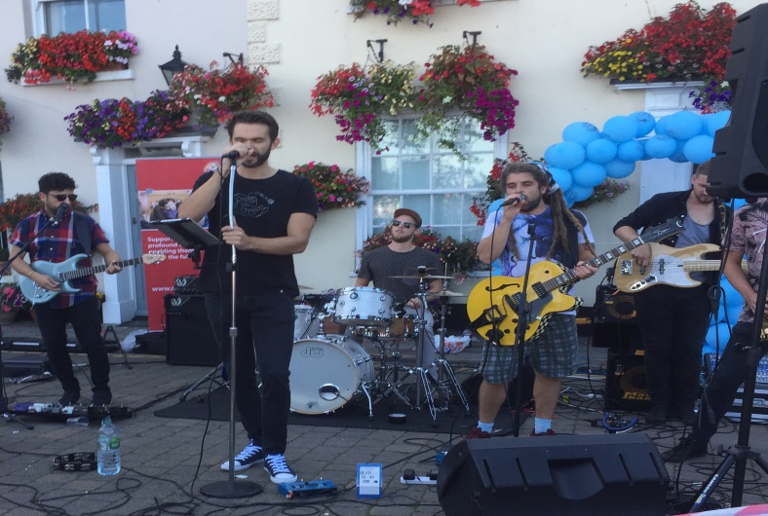
Music4Martha
Notes:
TALK ABOUT MUSIC4MARTHA events

Slide 11
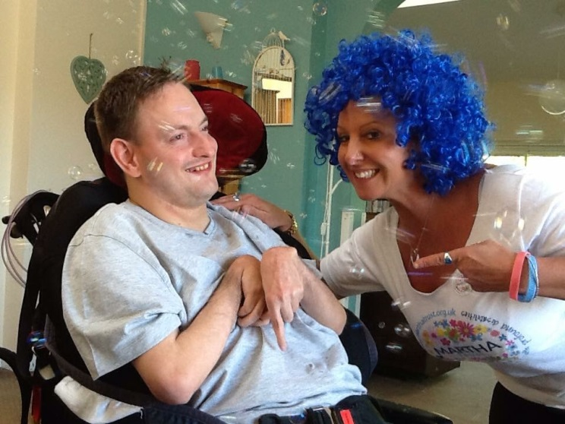
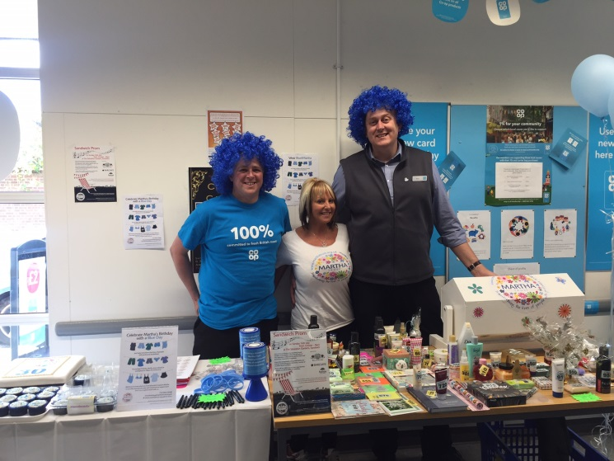
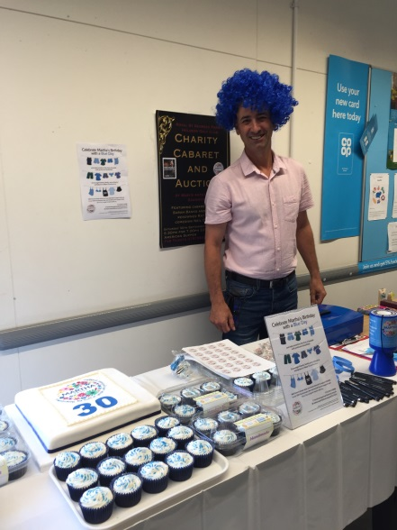
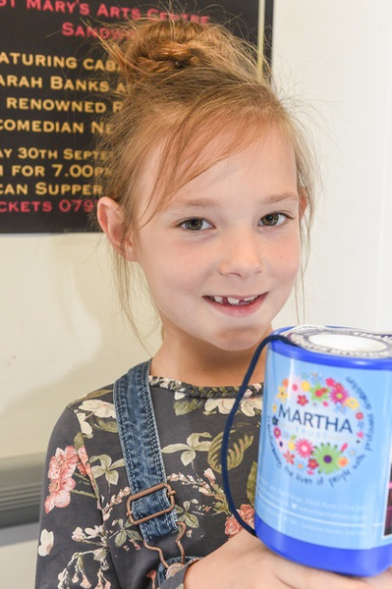
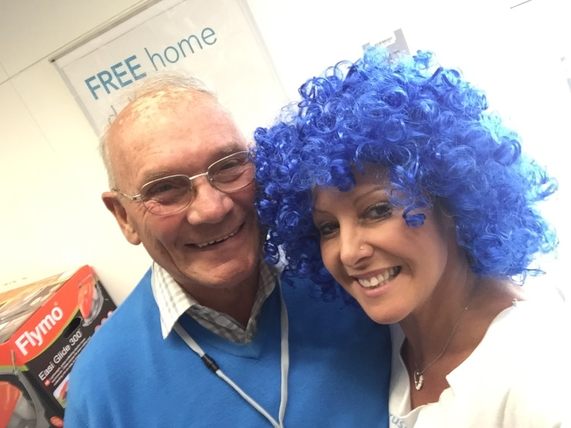
Wear Blue4Martha
Notes:
TALK ABOUT WEAR BLUE4MARTHA events

Slide 12
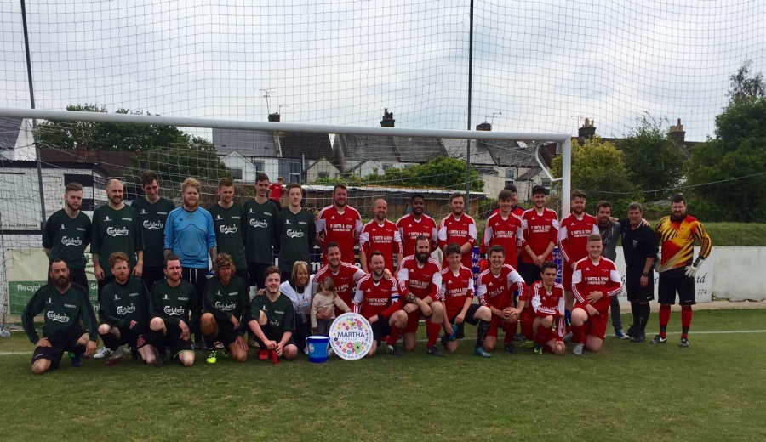
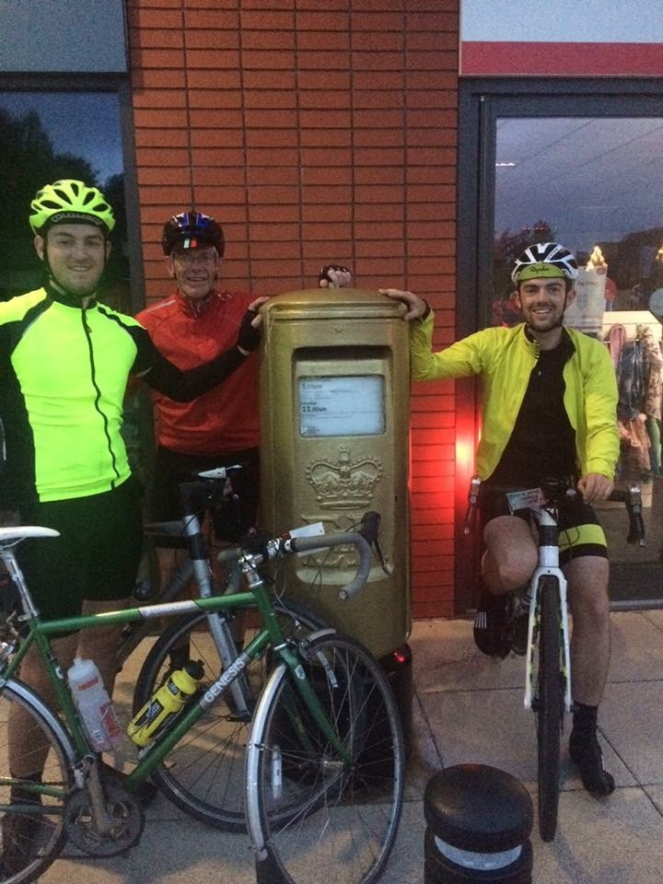
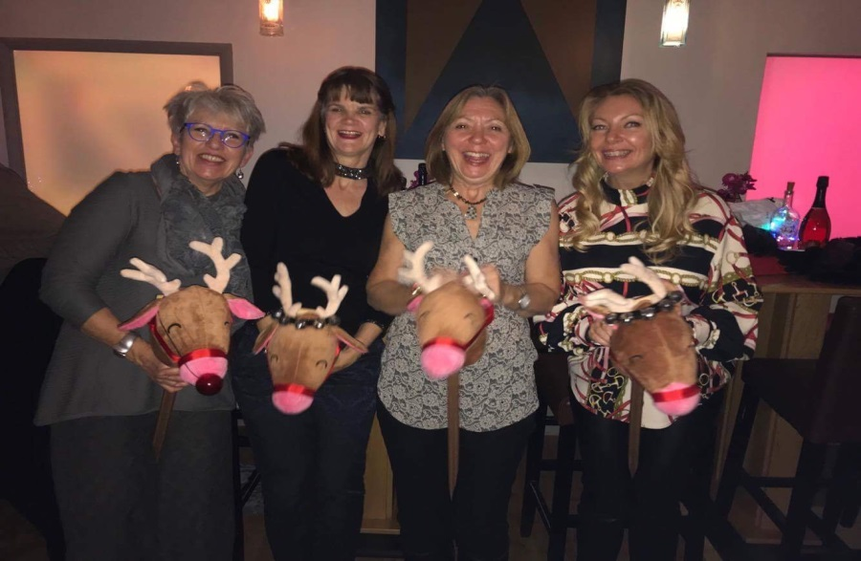
Sporting Summer
Notes:
If you are looking to fundraise for Martha this year why not consider supporting – Martha’s Sporting Summer?
As 2019 promises to be an amazing summer for flagship sporting occasions, why don’t you and your friends, family and colleagues support Martha through fun themed Summer Sports Days.
Celebrate the FA Cup Final, Rugby Six Nations and of course Wimbledon. Choose just one of the following elements or run several activities but all under the banner of ‘Martha’s Sporting Summer’.
Sweep Stakes
Match Day raffles
Sport Screening – organise a screening of a big sporting event and ask for a donation for entry
Dress Down Days - Wear your kit to school/work day
Host a Cricket Tea
‘Strawberries and Cream’ Days for Wimbledon - sell cream tea boxes
Themed Lunches
Table Cricket/Table Football Matches
Hold a Race Night
Question of Sport – Become Sue Barker for the evening and host a sporting quiz night
5-a-side Football, Touch Rugby or Quick Cricket Matches
Fancy dress Football match
Keepy Uppy Challenge
Sponsored Walk

Slide 13
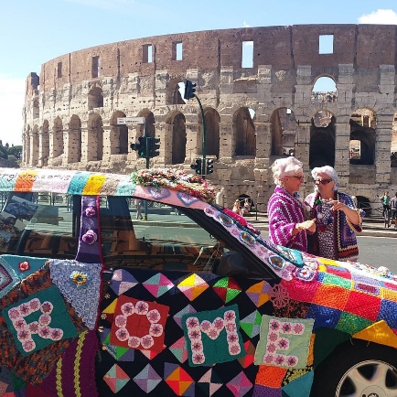
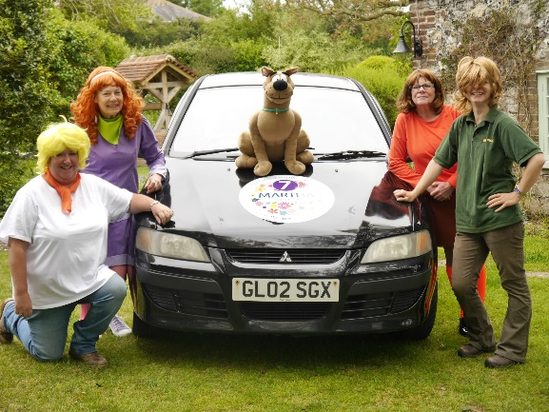

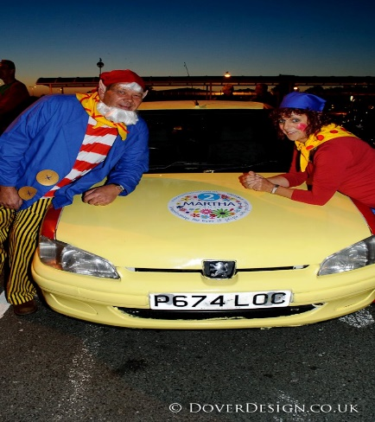
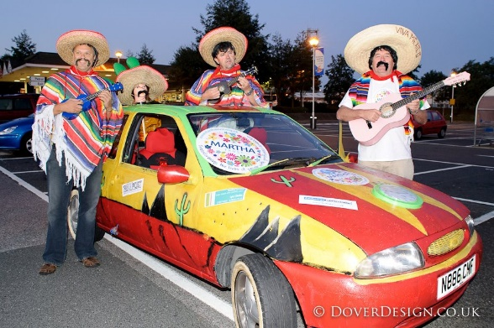
Bonkers in Barcelona Martha Car Challenge!
September 2023
Your car must be worth no more than £500, Tax and MOT required!
Notes:
CAR CHALLENGE
If you would like to get involved or find out more, visit www.marthatrust.org.uk , email fundraising@marthatrust.org.uk or call 01304 610448.
Wear Blue 4Martha
Encourage your colleagues and members to get involved by holding a Wear Blue4Martha day. Get them to donate a £1 to Wear Blue4Martha.
Music4Martha
Ways to support:
Wear Blue4Martha
Music4Martha
30 ways to show your support
It has been a real pleasure meeting you all tonight, I do have some handouts of how to support Martha @ 30.. do you have any questions?
Thank you for listening.
Does anyone have any questions?

Slide 14

Chances to win whilst supporting Martha!
Notes:
Dover Lotto

Slide 15











Fundraising Ideas!
Notes:
There are lots of ways to raise money for us which are great fun!- YOU COULD ALWAYS CONSIDER US AS YOUR Charity of the year
Music4Martha events Indoor Boot Sales, Quiz Nights, Tombolas and Raffles, Guess the name of the Teddy, race Nights, Murder mystery evenings, Sponsored Walks, Silences, anything sponsored really plus Cake Sales are always good too !

Slide 16

If you would like to get involved or find out more, visit www.marthatrust.org.uk , email fundraising@marthatrust.org.uk or call
01304 610448.
Notes:
Thank you so much for listening , do you have some questions for me at all please?
If you would like to get involved or find out more, visit www.marthatrust.org.uk , email fundraising@marthatrust.org.uk or call 01304 610448.
Wear Blue 4Martha
Encourage your colleagues and members to get involved by holding a Wear Blue4Martha day. Get them to donate a £1 to Wear Blue4Martha.
Music4Martha
Ways to support:
Wear Blue4Martha
Music4Martha
30 ways to show your support
It has been a real pleasure meeting you all tonight, I do have some handouts of how to support Martha @ 30.. do you have any questions?
Thank you for listening.
Does anyone have any questions?

