Slide 1
Community Health & Wellbeing
Claire Shelton

Slide 2
Social Enterprise Kent
Who we are
What we do
Community Interest Company
Operating for nearly 40 years
Specialise in supporting communities and individuals to thrive
Community Health & Wellbeing
Support for individuals in the community
Integration with health & Statutory systems
Business & Skilla
Training and development
1-2-1 and peer support for SME organisations

Slide 3
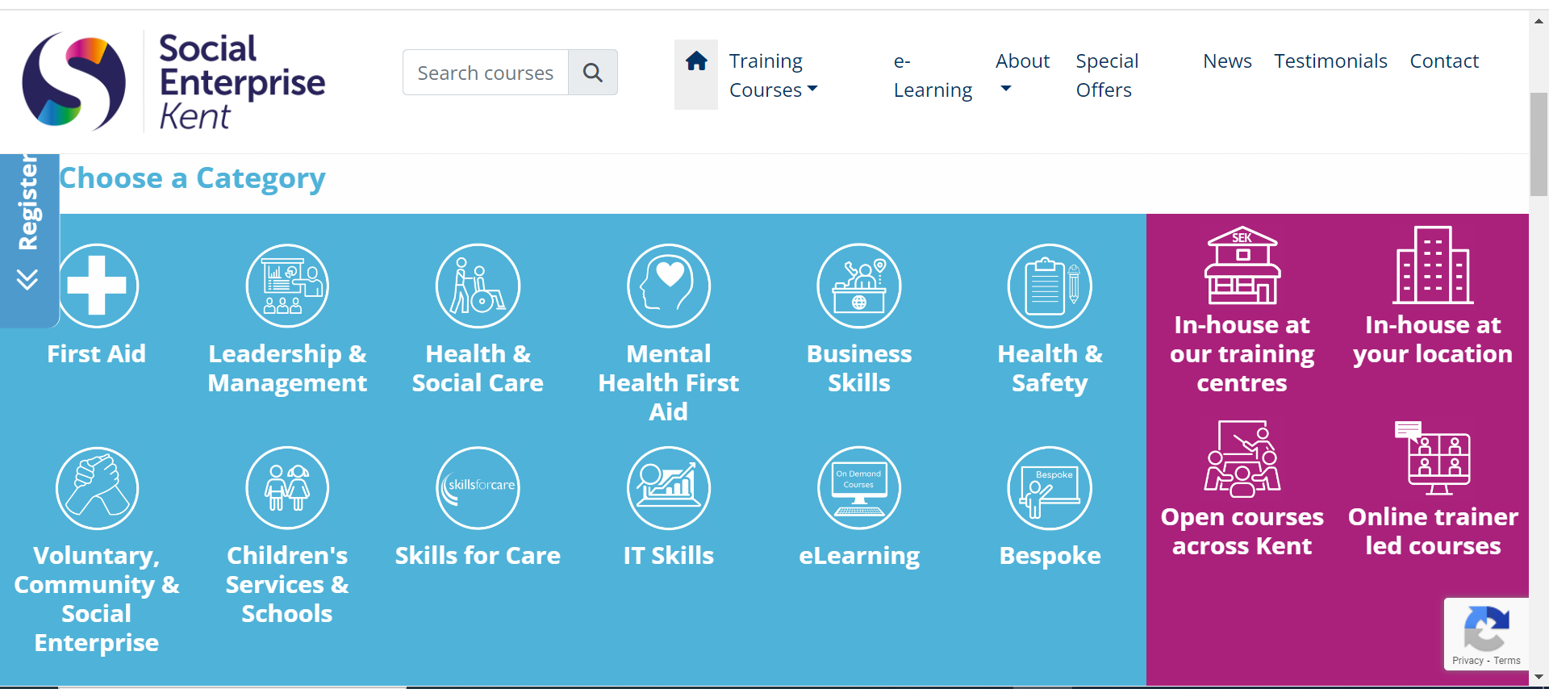
Business & Skills

Slide 4
Business & Skills
VCSE Support Programmes:
KCF Infrastructure
Ashford Borough Council
SEK Schools
Green Schools Kent Teacher of the Year
STEM Young Cooks

Slide 5
Community Health & Wellbeing
Older people’s wellbeing services
Prevention
Cost of Living/Energy support
VCSE Alliance

Slide 6
Connect Well East Kent
Over 55’s or 18+ with complex needs
4500+ supported in 2022/23
50% of referrals for financial support
connectwell@sekgroup.org.uk
0300 302 0178
Notes:
Contract background
East Kent has some of the most deprived wards in the country, as well as an ageing population, with an average of 25% of people over 65 along our coasts, according to the most recent census data. Connect Well East Kent is a service delivering enhanced social prescribing across East Kent to people over 55 and 18plus with complex needs. Connect Well are here to support individuals regaining or maintaining their independence. Our service can offer up to 12 weeks of support on a 1 to 1, personalised basis to help improve the persons overall wellbeing. The service has been created to bring together roles currently delivering care navigation and social prescribing services (for older people and Carers) in order to deliver a more holistic service that is available to all eligible Kent residents. Community Navigators will work in partnership with those commissioned to fulfil similar roles in health (by both CCGs and Public Health) and district council settings, to both avoid duplication in the support they provide to members of the public, and to promote innovative solutions to community navigation requirements.
Employing a person-centred, ESTHER approach, support is tailored to each individual client. We use a strength based approach, focusing on the person’s personal assets, interests, independence, and social inclusion so that they can be supported to: maintain and improve their wellbeing, become more resilient, and find solutions and support within their community.
aimS

Slide 7
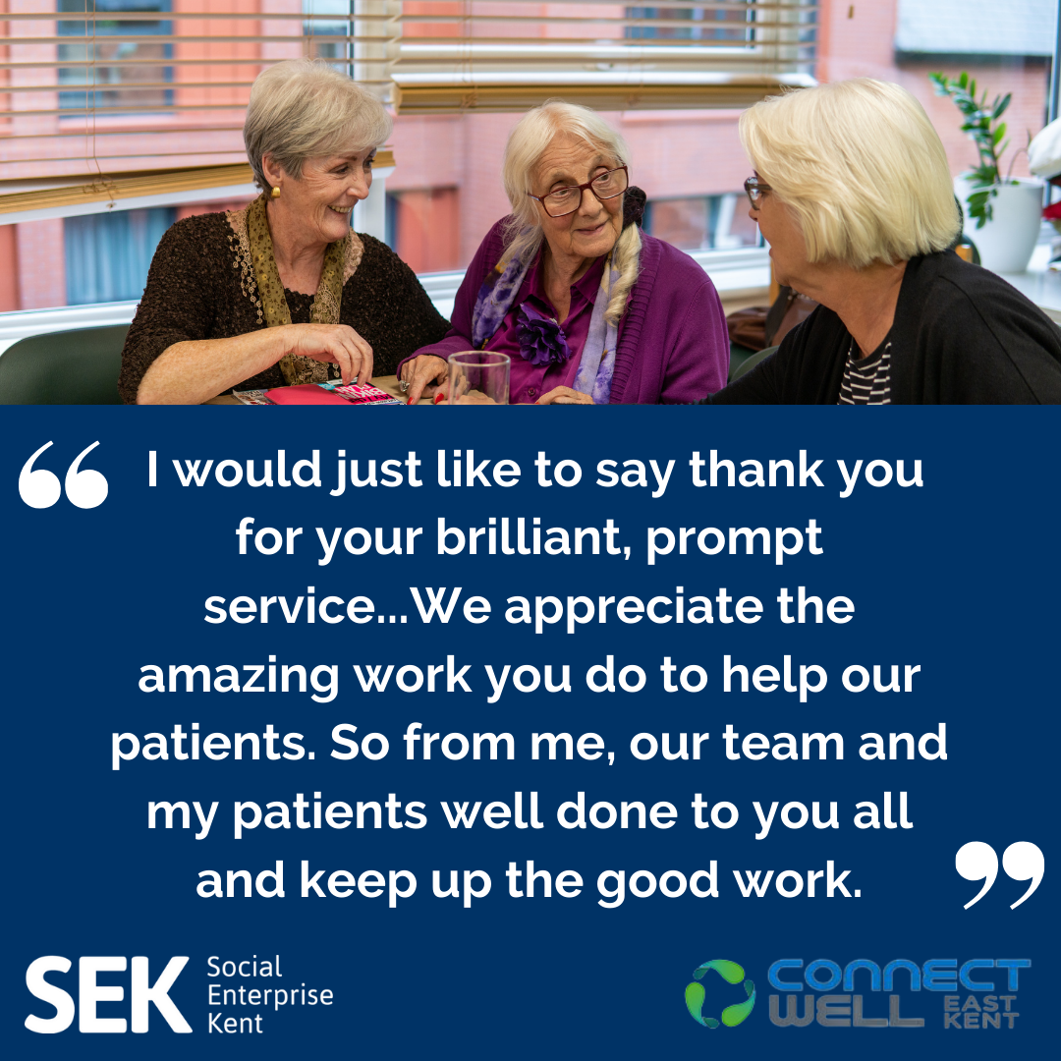
Key Outcomes
12% increase in life satisfaction
10% increase in wellbeing
9% improvement in ability to manage money
11% increase in happiness
Notes:
Referrals from different sources, majority are from KCC but also from social prescribers, gps and other health professionals.
The support helps tackle the wider determinants of health which we know account for 80% of a persons health.
Nearly 95% of people supported through community navigation have a disability or long term health condition. They are almost at a point of crisis when they are referred to us, often their needs are a complex mix of mental health, financial need, newly diagnosed or existing physical illness, unsuitable housing and relationship breakdowns.
While the service can’t solve all the problems, it does act as a focal point of support guiding the individual through their current difficulties and supporting their independence.
As you can see from the outcomes the service has a real impact on quality of life for individuals.

Slide 8
Cost of Living Support
Notes:
The cost of living 1-2-1 support element of this programme has been live since end of September 2023.
Available for adults 18+ our connectors look at individual circumstances holistically and identifying key support needs with a focus on employability, budgeting, healthy eating and cost of living support.
Resources are focused on areas of highest deprivation in east Kent.
Delivery has initially been focused on Thanet as a key area of need. Thanet has 18 LSOAs within the most deprived decile, the highest number in Kent.
Delivery has now started in Folkestone and Dover as the east Kent districts with the next highest number of LSOAs within the most deprived decile, with Ashford and Canterbury delivery starting in February.
People being referred into the programme are presenting with very complex needs which need multiple interventions.
87% have a recognised disability or long term health condition, the majority of these have multiple conditions.
43% of participants have a mental health condition
19% have a criminal conviction
14% identify as LGBTQI+
22% are homeless
75% are currently not working
71% are receiving some form of benefits.
The gender split is 63% male, 34% female.
83% of participants are white British.
Part of this programme is also a white goods fund.
Over a million households in the UK currently are without one or more of the ‘essential’ white goods. Recognising the impact that living without a fridge or washing machine has on mental and physical health, this fund seeks to address some of those issues.
Referrals need to come from a professional source like yourselves or your social prescribers who understand that person’s need. We have already supported 50 families with fridges and freezers.
One family was using a small countertop fridge to buy food and store medicine – meaning they had to spend more on food and more often as well as potentially compromising the safe storage of diabetes medication.
Social enterprise Kitchen for anyone based in Thanet supports with low cost groceries

Slide 9
Prevention Projects
Early Cancer Screening
Bowel Cancer
West Kent & DGS
Cervical Screening
Canterbury
Mammography
Folkestone, Dartford, Maidstone
Early training
East Kent
Notes:
As a trusted community partner we are well placed to work with communities who are suffering health inequalities. A key focus for the health care partnership, ICB and K&M CA is early cancer identification.
We are working on a programme of awareness raising with communities across Kent who see the lowest screening rates and the some of the worst outcomes.
Built on a programme of community outreach, talking to individuals and sharing signs and symptoms as well as listening to individuals barriers to attending screening.
In Canterbury we are working in partnership with the PCN who are changing their processes to enable target groups to make appointments easily, with cancer specialist nurses attending our community events to answer questions, and make appointments there and then.

Slide 10
Thank you!
Claire Shelton
c.Shelton@sekgroup.org.uk

