Slide 2
Mission: To Empower Women, Girls And Young Men To Walk The Streets Safely And To Live A Life Less Diminished

Slide 3
Through Teaching Self Defence

Slide 4
We Teach; Situational Awareness (Spider Sense), Conflict De-Escalation,
Pre Fight Indicators And Escaping To Safe Zones

Slide 5
Or By
Creating Your Own Window Of Escape Using Easy To Learn Self Defence Techniques
That Negate The Size And Strength Disparity That Exists

Slide 6
When Violent Situations Occur That Are Often Fuelled By, Drink, Drugs, Opportunity Or Revenge

Slide 7
With Effective, Easy To Use And Remember Non Ego Driven Instruction

Slide 8
Because Our Students Really Need To Be Able To Believe And Understand That They Can Dispatch These Techniques If Called Upon In The Real World

Slide 9
Not Just In A Classroom Setting!

Slide 10
My Name Is Robert (Bob) Dodd

Slide 11
And I am The Founder Of Kent Self Defence Workshops

Slide 12
I Am A Black Belt In Full Contact Kyokushin Bare Knuckle Karate

Slide 13
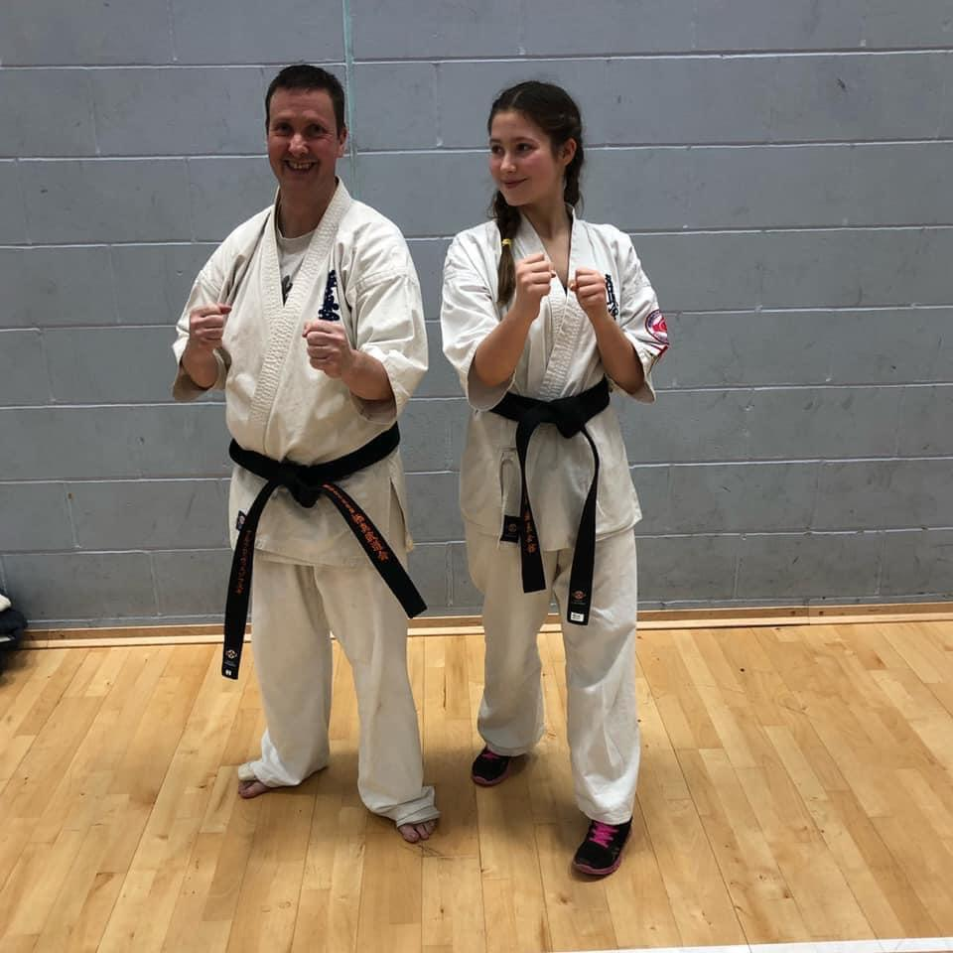

Slide 14
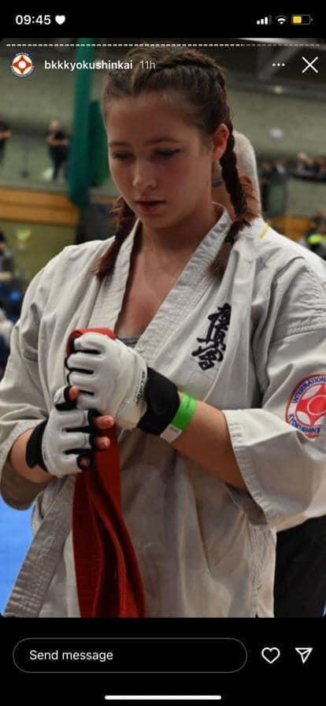

Slide 15
I Also Train In MMA And Cage Fighting

Slide 16
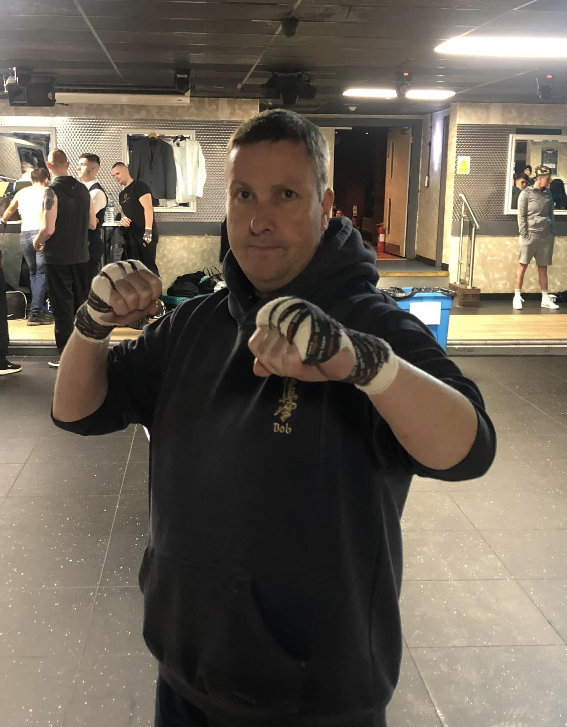

Slide 17
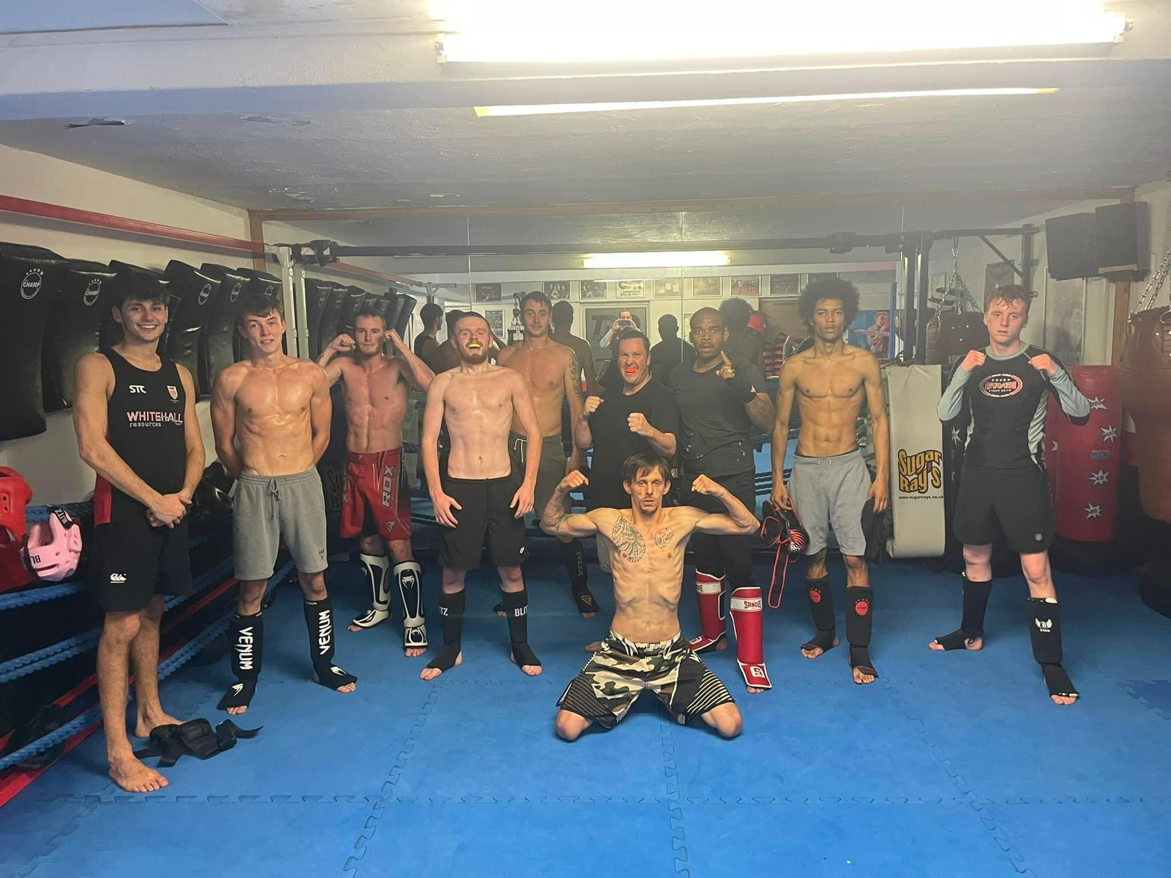

Slide 18
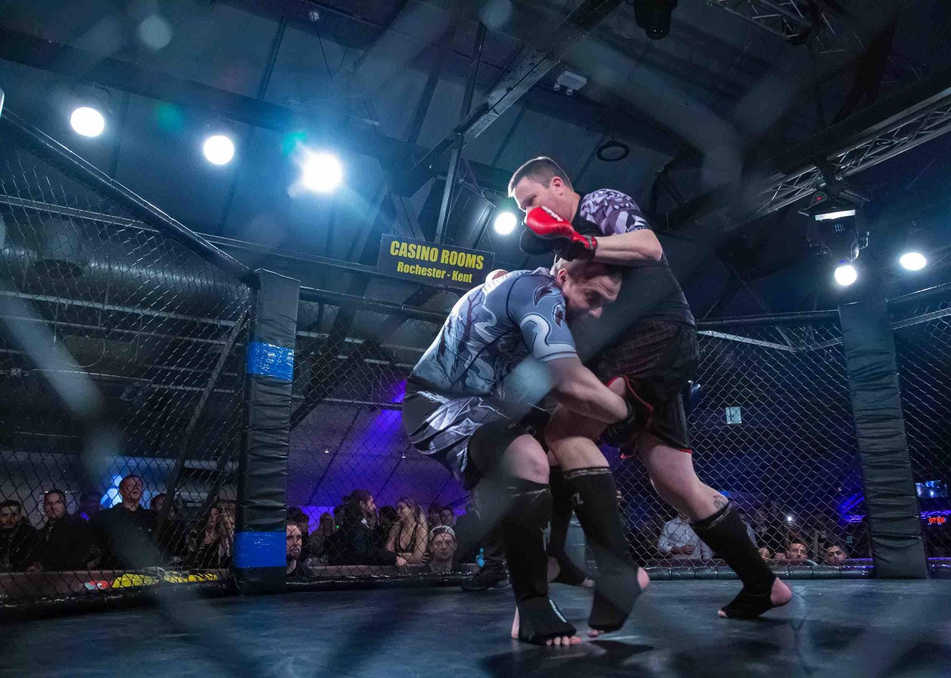

Slide 19
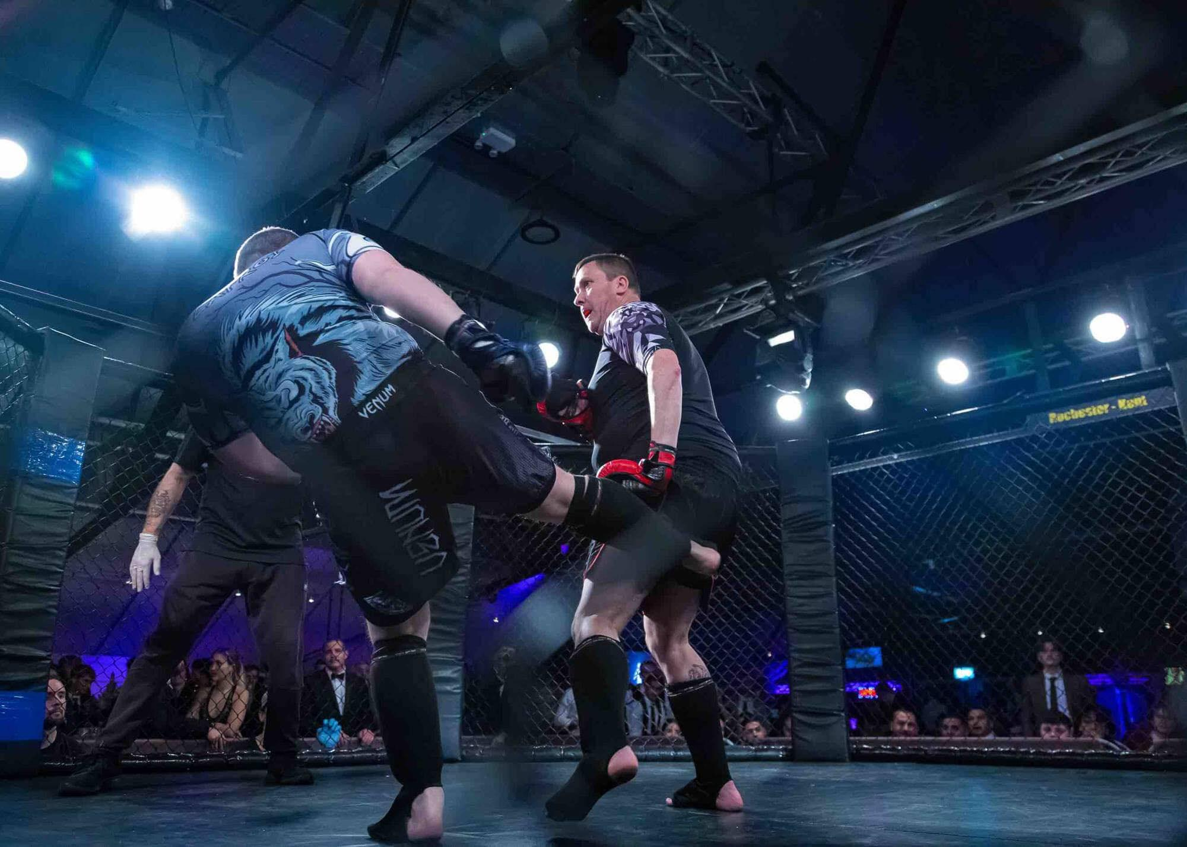

Slide 20
As Well Learning From The Best For My CPD In Self Defence

Slide 22
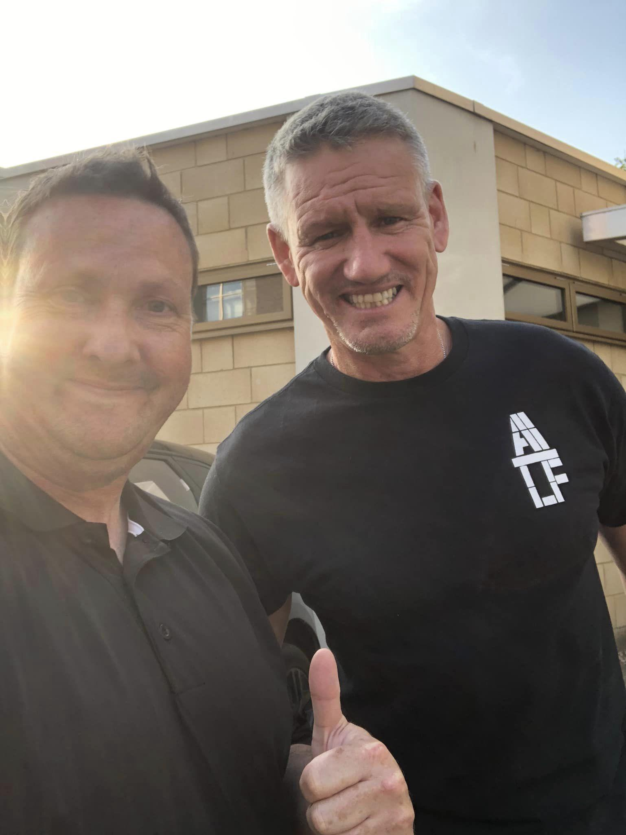

Slide 23
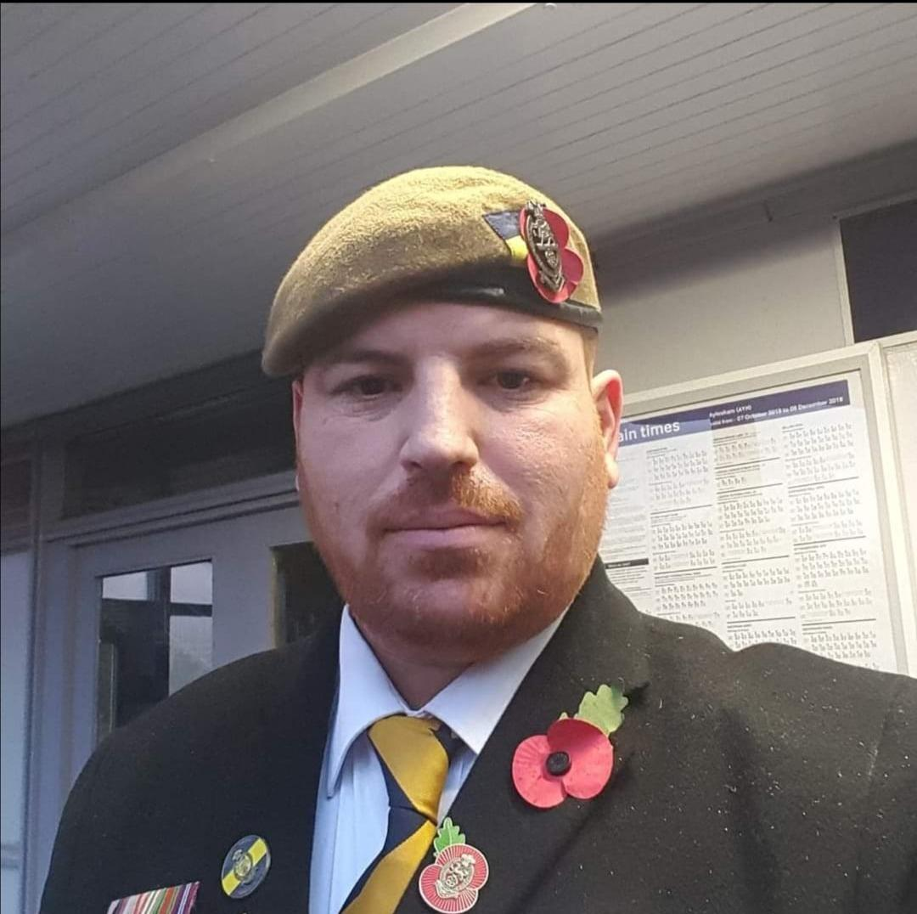
Gareth My 2IC

Slide 24
Gareth My 2IC. Tours Of Duty At Northern Ireland, Kosovo and Iraq
Close Protection For Beyonce, Will I Am And Johnny Depp

Slide 25
We Teach Our Proven, Tested Proprietary Self Defence System Using Our 9 Pillars Of Self Defence

Slide 26
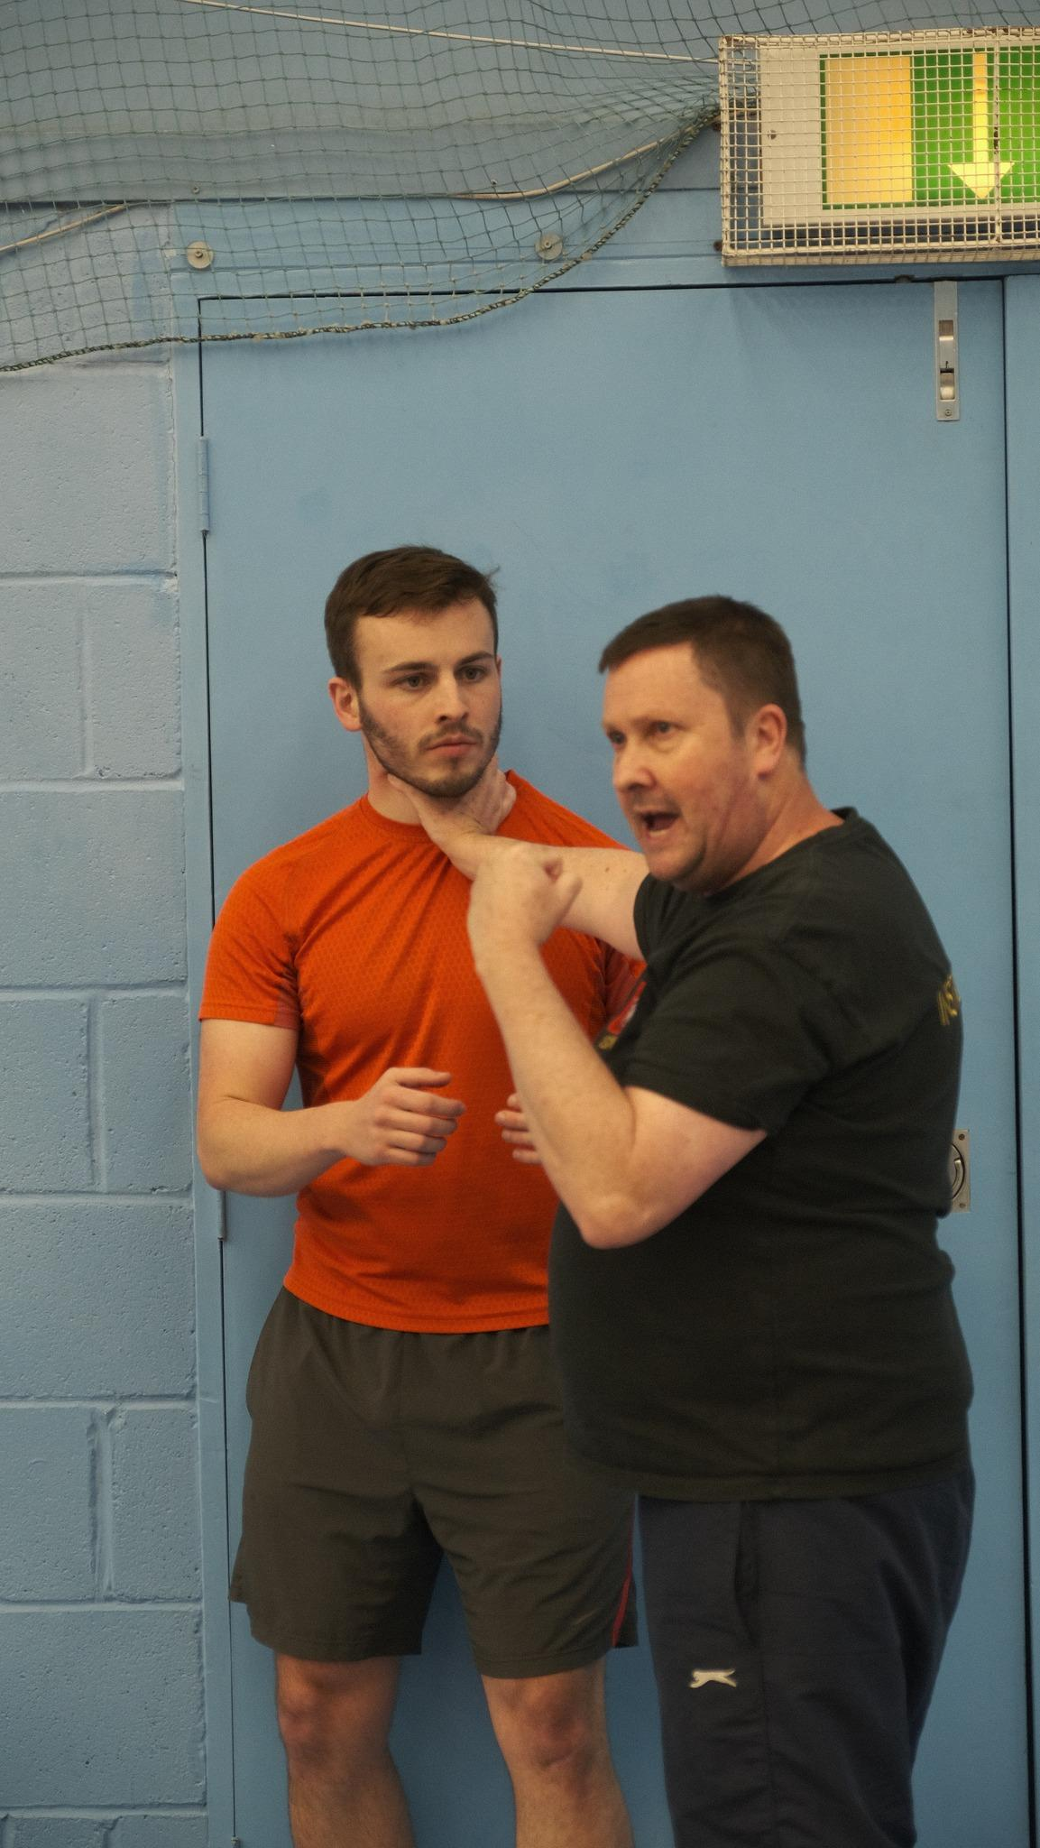

Slide 27
Pillar #1
The three different types of aggressors, their difference in mindset and how to use that to escape from any trouble

Slide 28
Pillar #2
How you don't have to be strong or use strength to overwhelm an aggressor. Our methods negate the obvious size and strength disparity which often occur in violent situations. Also a consideration is most violence happens when an aggressor has had their physiology altered through drink or drugs. Our methods address these disparities and negate them.

Slide 29
Pillar #3
The difference between fear aggression and confidence aggression and how that impacts your decisions
Pillar #4
How a handful of carefully crafted words can de-escalate most violent situations

Slide 30
Pillar #5
How to use situational awareness and to avoid situations where violence is most common

Slide 31
Pillar #6
When de-escalation is not effective, how to act swiftly, effectively and without guilt.
If a person is trying to hurt you and they have bad intentions they simply will not care if they hurt you. Therefore an appropriate level of aggression returned is appropriate to enforce self protection

Slide 32
Pillar #7
Justifiable force and the law.

Slide 33
Pillar #8
Safety within the night time economy. Date rape, situational awareness and how to stay safe once the bars are closing training (age appropriate to the audience).
Pillar #9
Consent, how to enforce and protect your personal space

Slide 34
Just as we use our situational awareness to predict the future and move away from danger.
An aggressor or predator uses situational awareness to find his victim.
It's their choice to look for a very confident looking woman walking with purpose and intent or someone else with entirely different energy.
It is often the case that people who know self defence are less likely to be attacked as they carry themselves differently and are not recognised as a quick win.

Slide 35
As We Tell Our Students
Self Defence starts with them believing they are worth defending in the first place. We bring this level of confidence to our students.

Slide 36
Regardless Of Fitness (or confidence) Levels

Slide 37
Just Normal Women And Teens Learning How To Protect Themselves

Slide 38
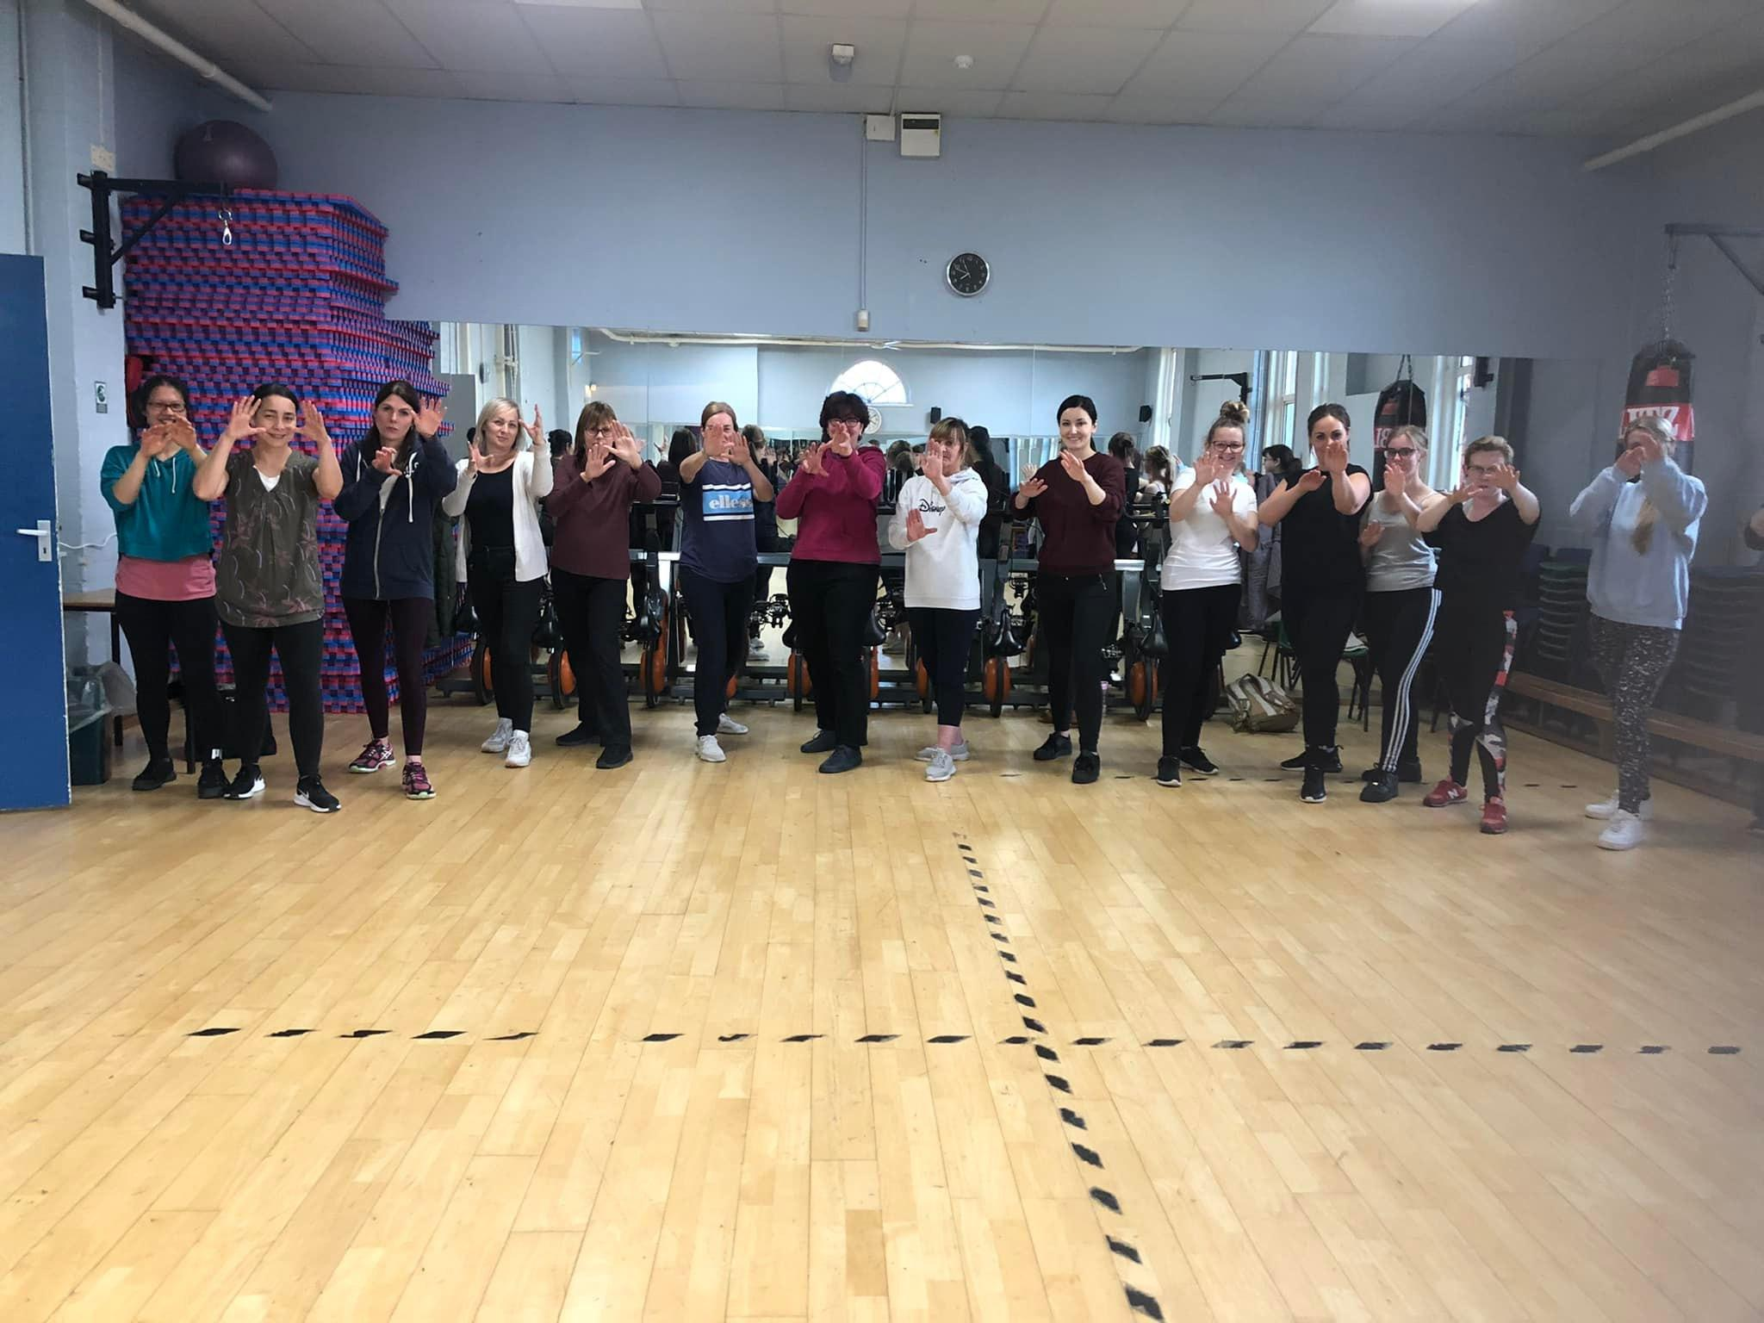

Slide 39
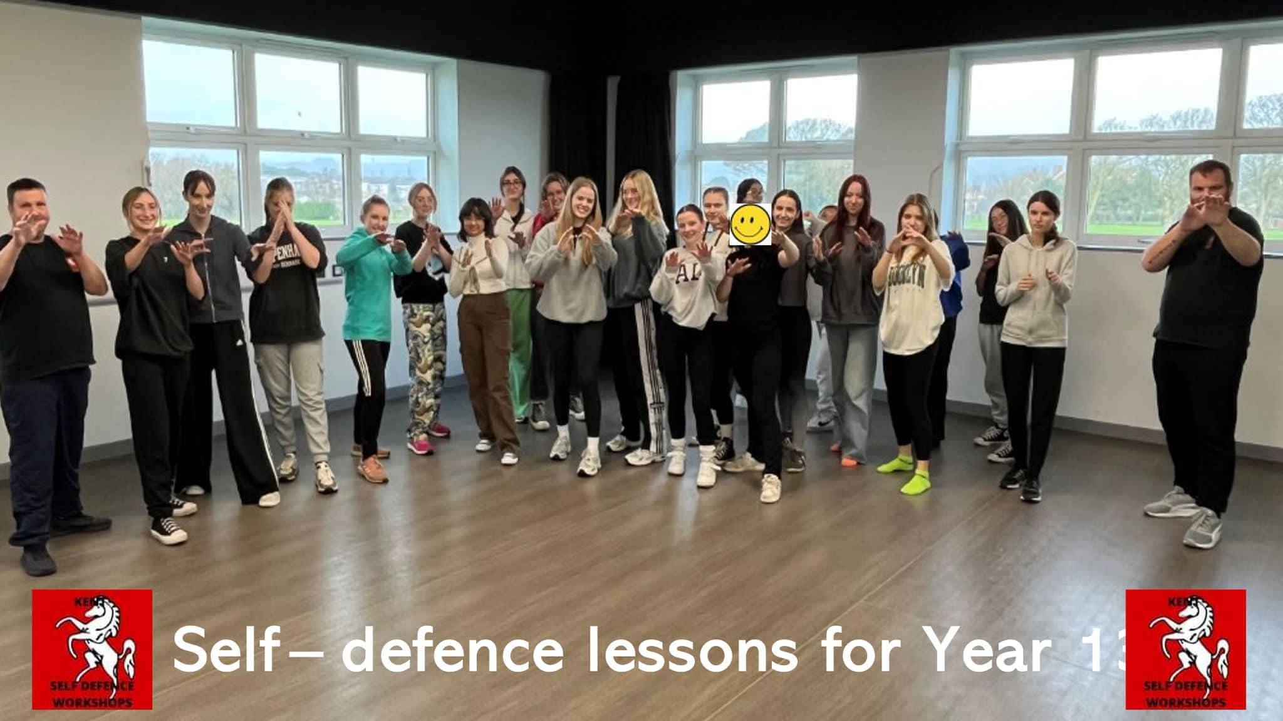

Slide 40
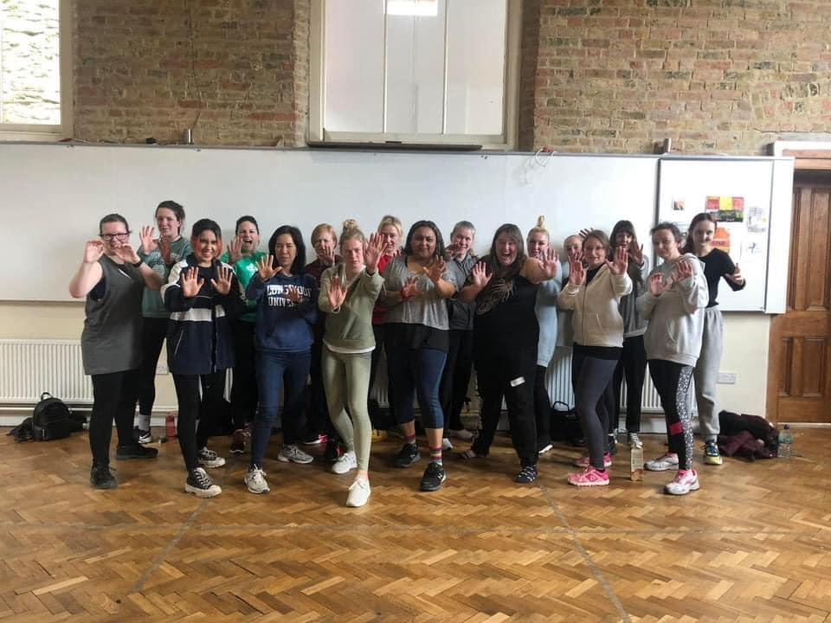

Slide 41
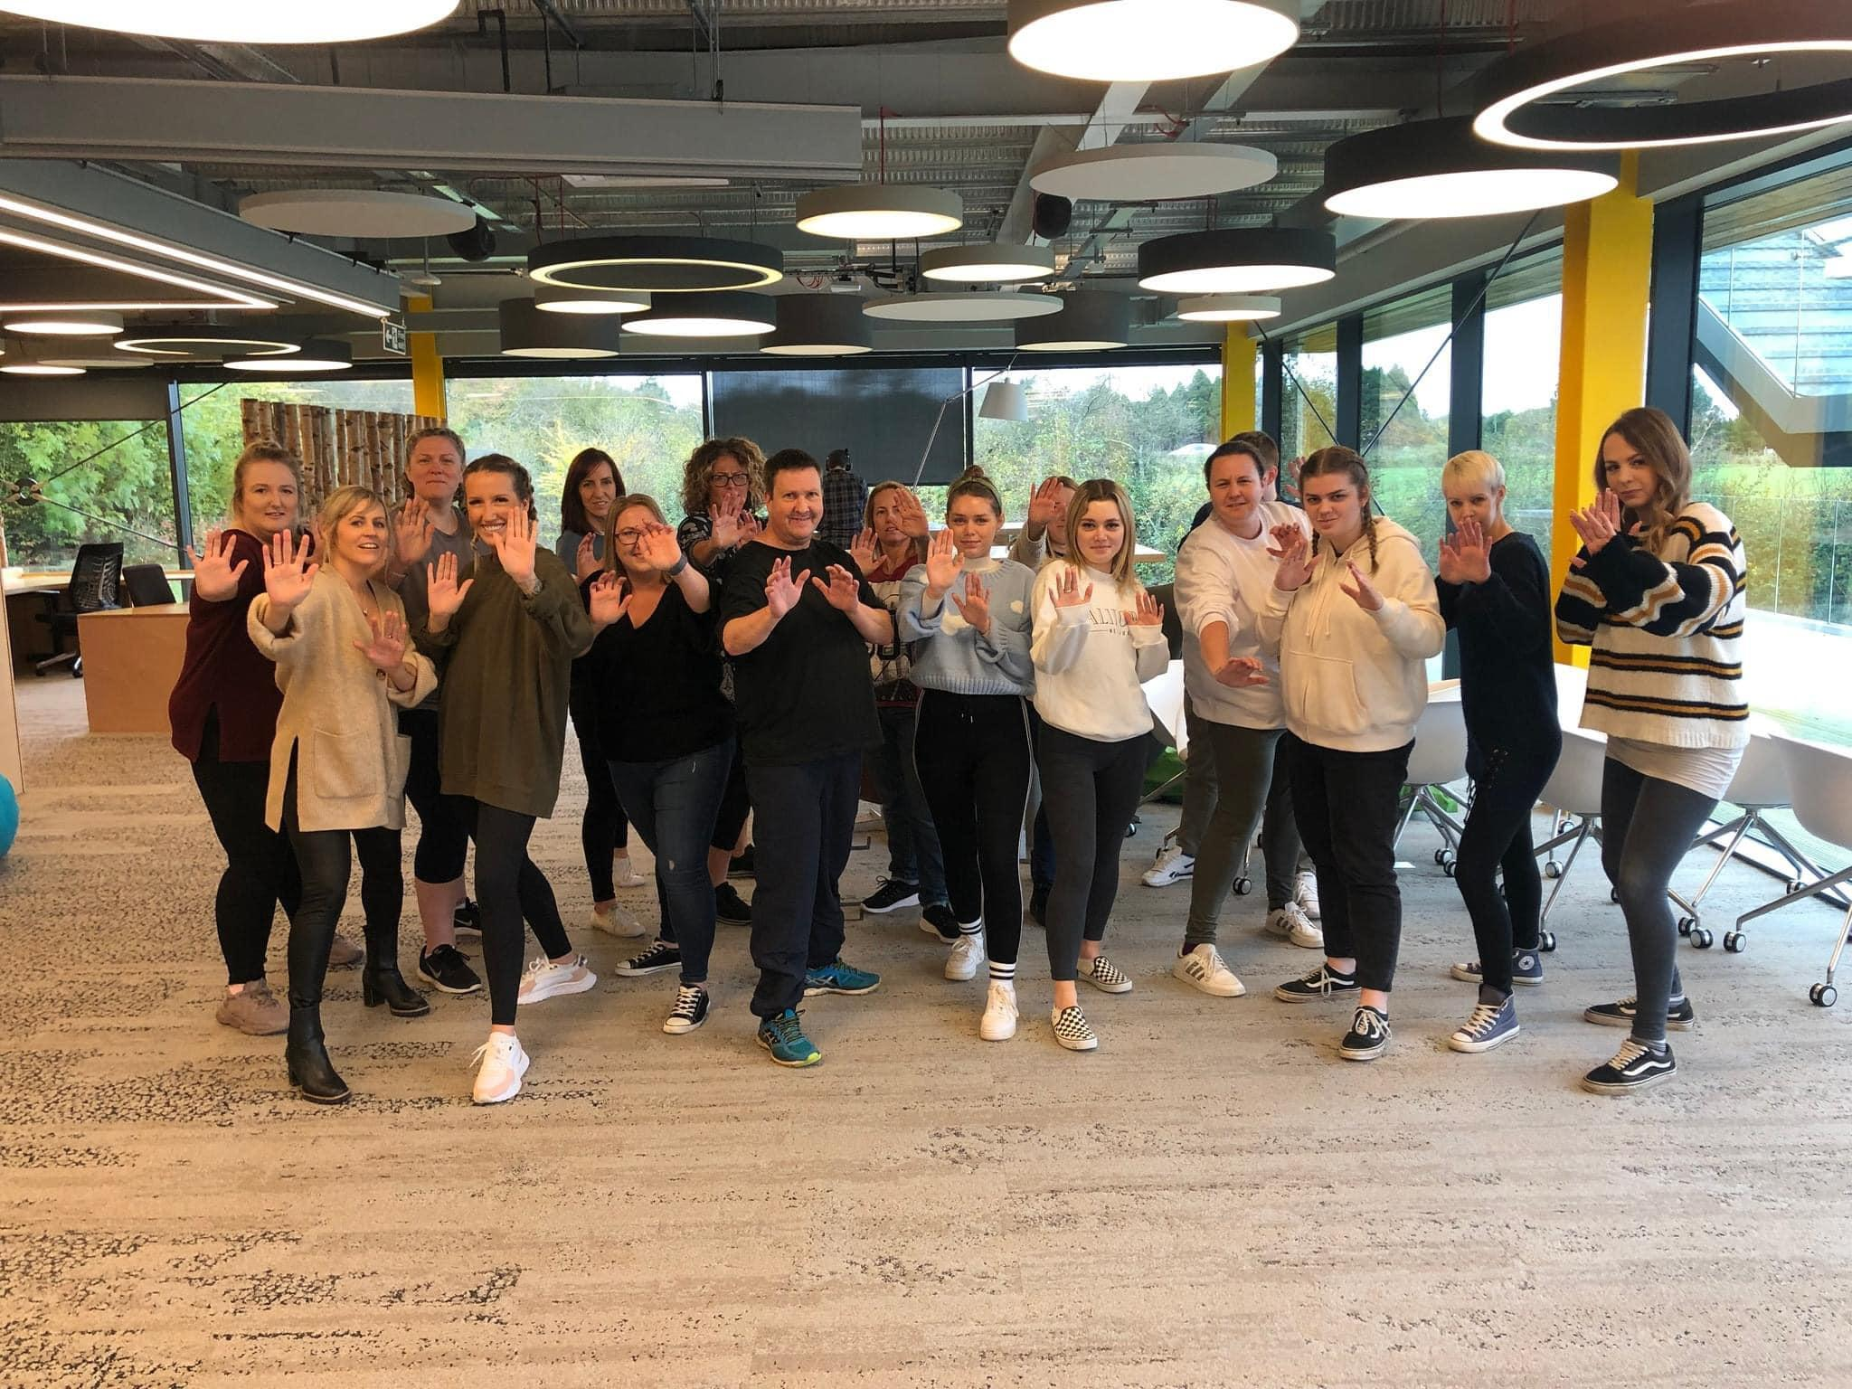

Slide 42
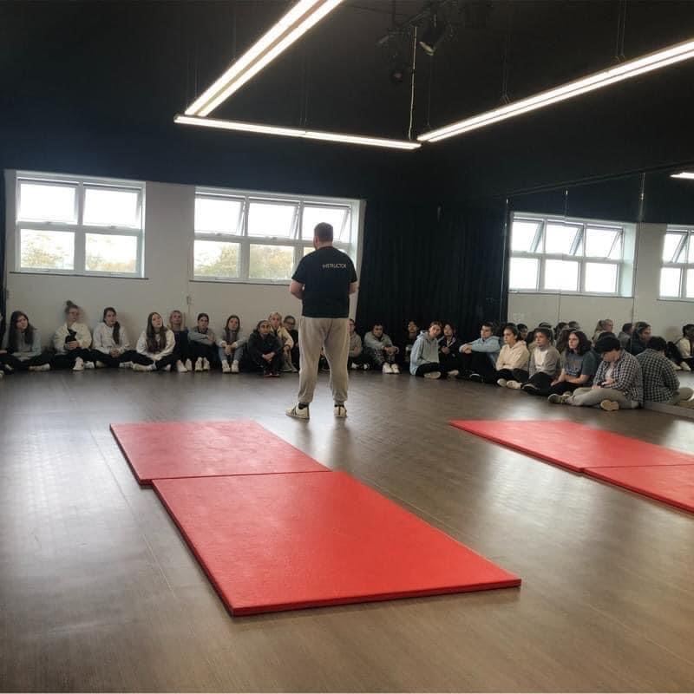

Slide 43
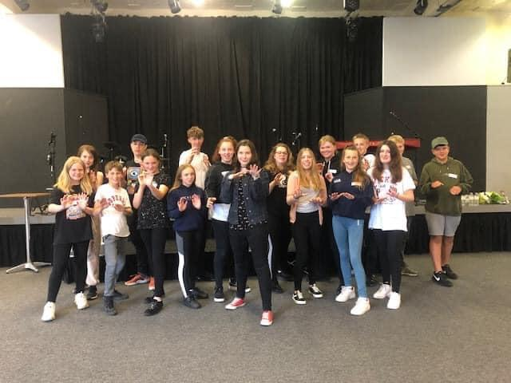

Slide 44
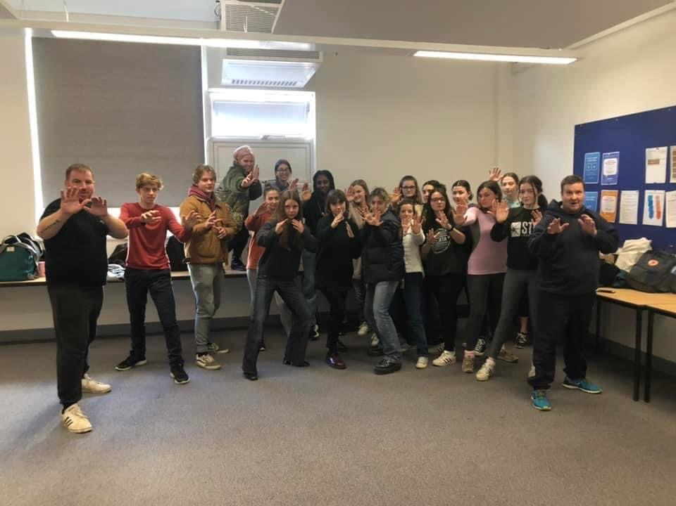

Slide 45
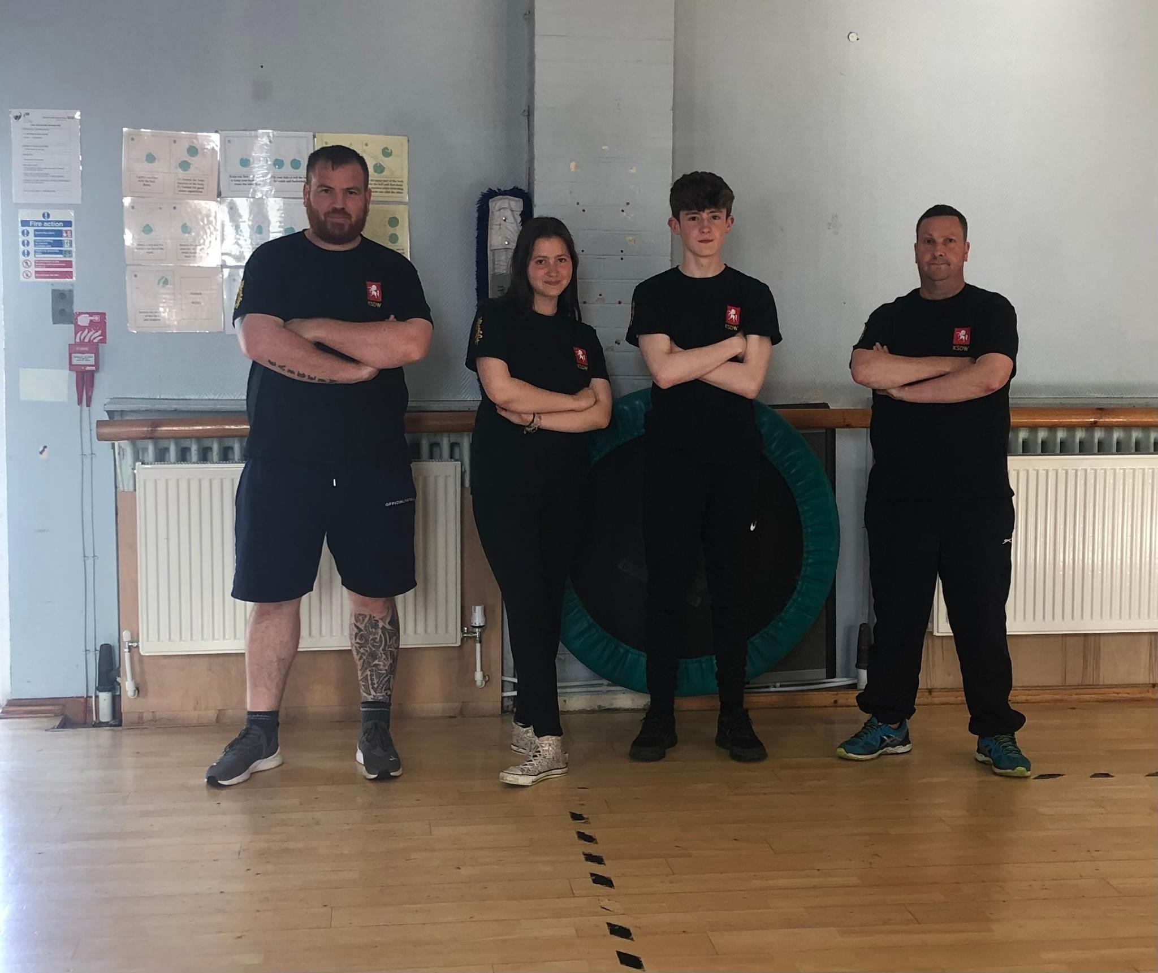

Slide 46
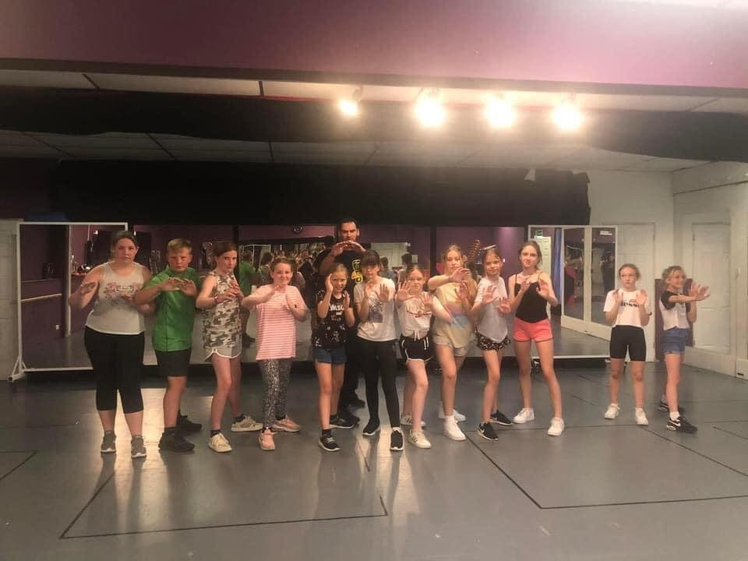

Slide 47
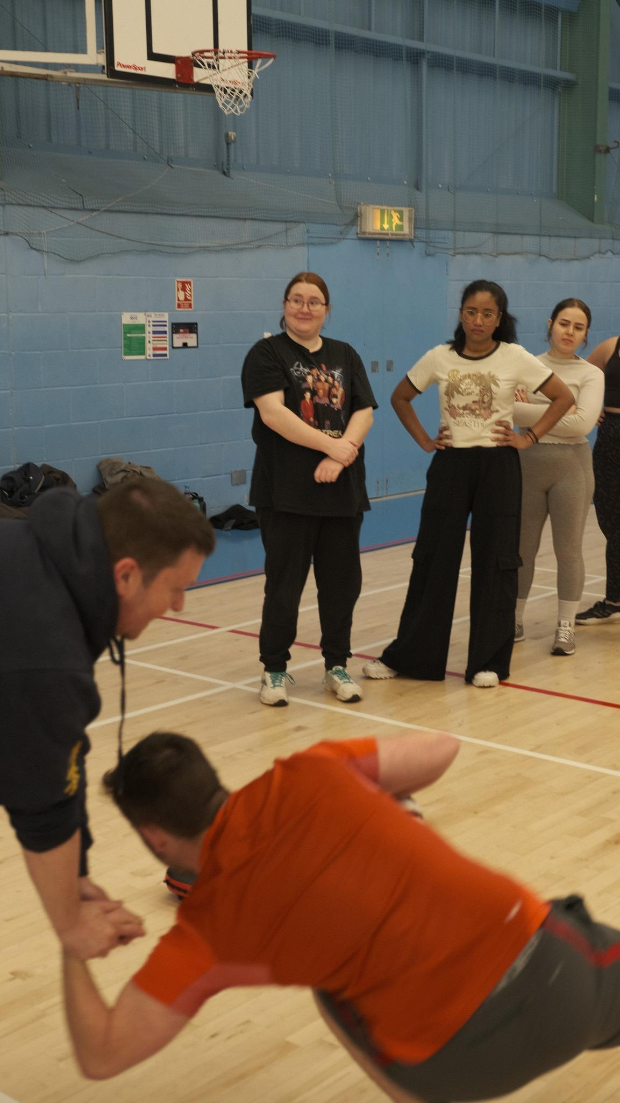

Slide 48
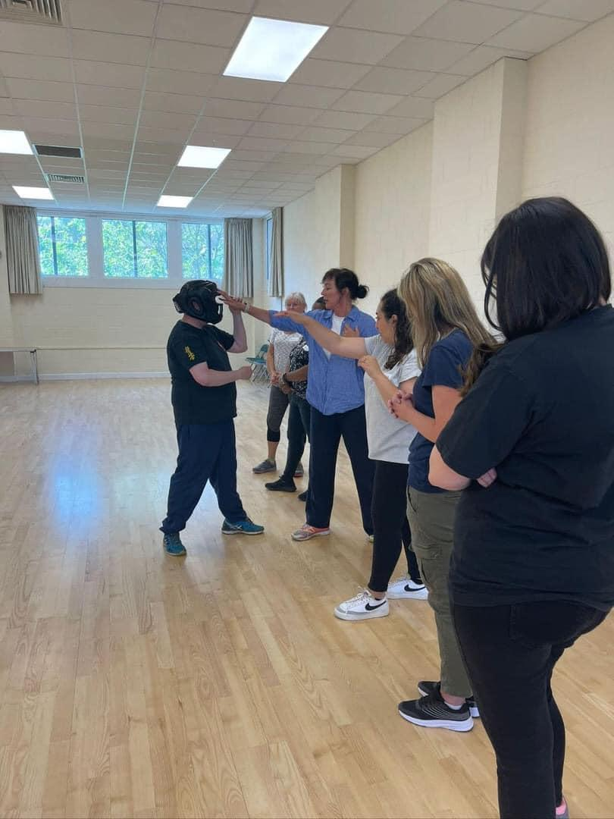

Slide 49
Thank You
And Any Questions?

