Slide 1
Imago Infrastructure Support, 2023-2025

Slide 2
Who are Imago
Creating Change Together
Provider of Infrastructure support in Ashford, Folkestone & Hythe, Maidstone, Sevenoaks, Tonbridge and Tunbridge Wells.
Deliver Kent Young Carers, Wellbeing Matters Plus & Social Prescribing in Ashford
Dial2Drive
Social Prescribing
Community Navigation
Young Adult Carers
Short Breaks
It’s our 60th Birthday!

Slide 3
Infrastructure Support
Awarded KCC Infrastructure Support funding, 2023-2025

Slide 4
Infrastructure Support
Imago Community
CVS North West Kent
West Kent Mind
Funding For All
Social Enterprise Kent
CAP Enterprise
Stronger Kent Communities
Charity Mentors Kent
Safer Communities Alliance CIC
Infrastructure Support Fund (kentcf.org.uk)

Slide 5
What is Infrastructure Support
Local infrastructure is the direct support and services that the voluntary and community sector needs to thrive. (Connecting Locally: local voluntary and community sector infrastructure in England, NAVCA)
The Four Functions of Infrastructure
Advocacy
Partnerships
Community development
Volunteering

Slide 6
What can Imago offer you
Bi-monthly networking meetings
A bi-monthly newsletter
Direct support to individual VCSE’s
Training

Slide 7
Individual Support
Support designed to meet your immediate needs and help your longer-term sustainability through tailored information, advice, guidance and training.

Slide 8
Networking Meetings Sharing ideas, experiences and practices
Hybrid Format
16th May, 10am-11:30am – location TBC
18th July, 10am-11:30am – location TBC
19th September, 10am-11:30am – location TBC

Slide 9
Kent Young Carers
Supported over 900 Young Carers across Ashford through Kent Young Carers, our service for children and young people aged 5-18 who are providing practical or emotional care for a parent or sibling, who has a disability, long-term health condition, mental health issue or drug/alcohol misuse issue.
Deliver FREE monthly Young Carer’s Awareness Training to professionals (Schools, GPs, community groups) supporting children & young people
Contact: youngcarers@imago.community or call 0300 111 1110
www.imago.community/Children-and-Young-People/Kent-Young-Carers

Slide 10
Wellbeing Matters Plus & Social Prescribing
Wellbeing Matters Plus is for anyone aged over 55 or those under with complex health needs, people can refer themselves or can be referred in by a health professional. The team offer one-to-one support in accessing social activities, creating community and tackling loneliness.
Social Prescribers are based in 7 GP surgeries across Ashford. Signpost to social activities and also help with debt, loneliness, finding the right legal advice, accessing public health services, benefits support.
https://www.imago.community/Adult-Support

Slide 11
Questions?

Slide 12
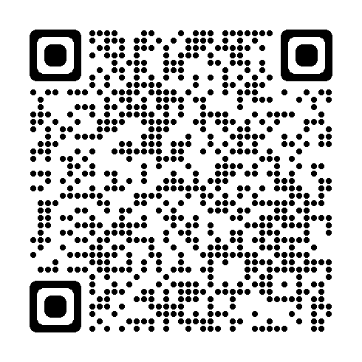
Contact us!
Email: charitysupport@imago.community
Find out more: https://www.imago.community/charitysupport
Subscribe to our newsletter: Scan the QR code
Next one out in April

Slide 13
Imago, John Spare House, 17-19 Monson Road, Tunbridge Wells, Kent, TN1 1LS

