Slide 1
Chris Twydell, Volunteer and Grandad to Liam

Slide 2
In a nutshell….
Were part of Sands Charity - amicable ‘divorce’ in 2020
Turnover £10k to £15k
No funding –rely on fundraising and donations
No staff – all volunteers
No premises – operate from home
Complete freedom to do what we want (more or less!)

Slide 3
ESTIMATED ANNUAL NUMBER OF BABY DEATHS IN EAST KENT
 | Births | Miscarriages | Stillbirths | Neonatal Deaths | Infant Deaths | Total
Ashford | 1,378 | 276 | 5 | 4 | 6 | 291
Canterbury | 1,310 | 262 | 5 | 4 | 5 | 276
Dover | 1,073 | 214 | 6 | 3 | 4 | 227
Folkestone | 1,027 | 205 | 5 | 3 | 4 | 217
Swale | 1,717 | 343 | 9 | 5 | 7 | 364
Thanet | 1,414 | 283 | 7 | 4 | 6 | 300
E Kent Total |  | 1,583 | 37 | 23 | 32 | 1,675
A baby is a baby from day one.

Slide 4
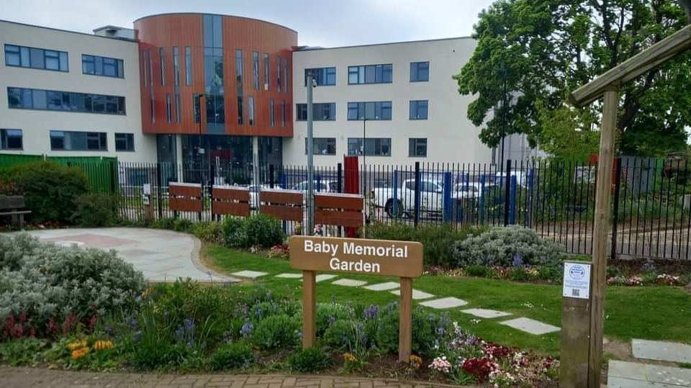
Ashford Baby Memorial Garden

Slide 5
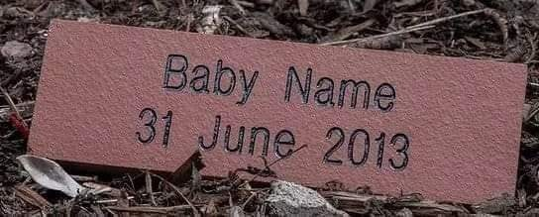

Slide 6
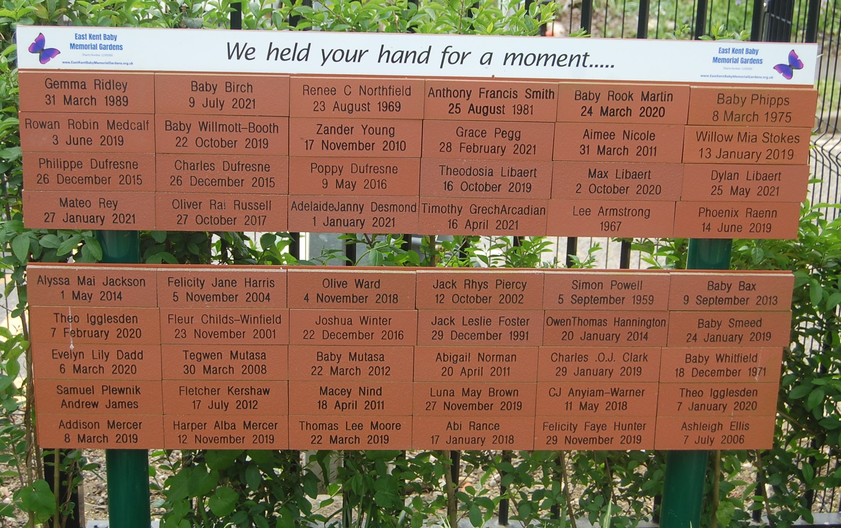
“Somewhere special to remember my baby”.

Slide 7
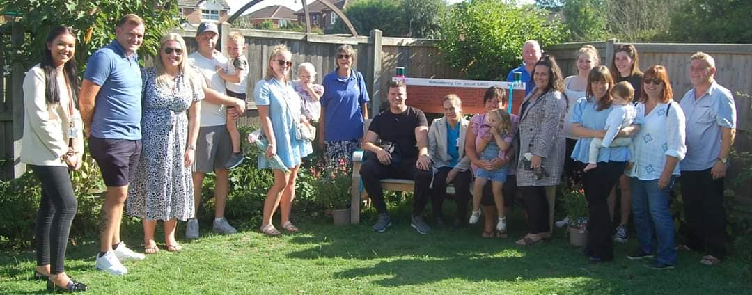
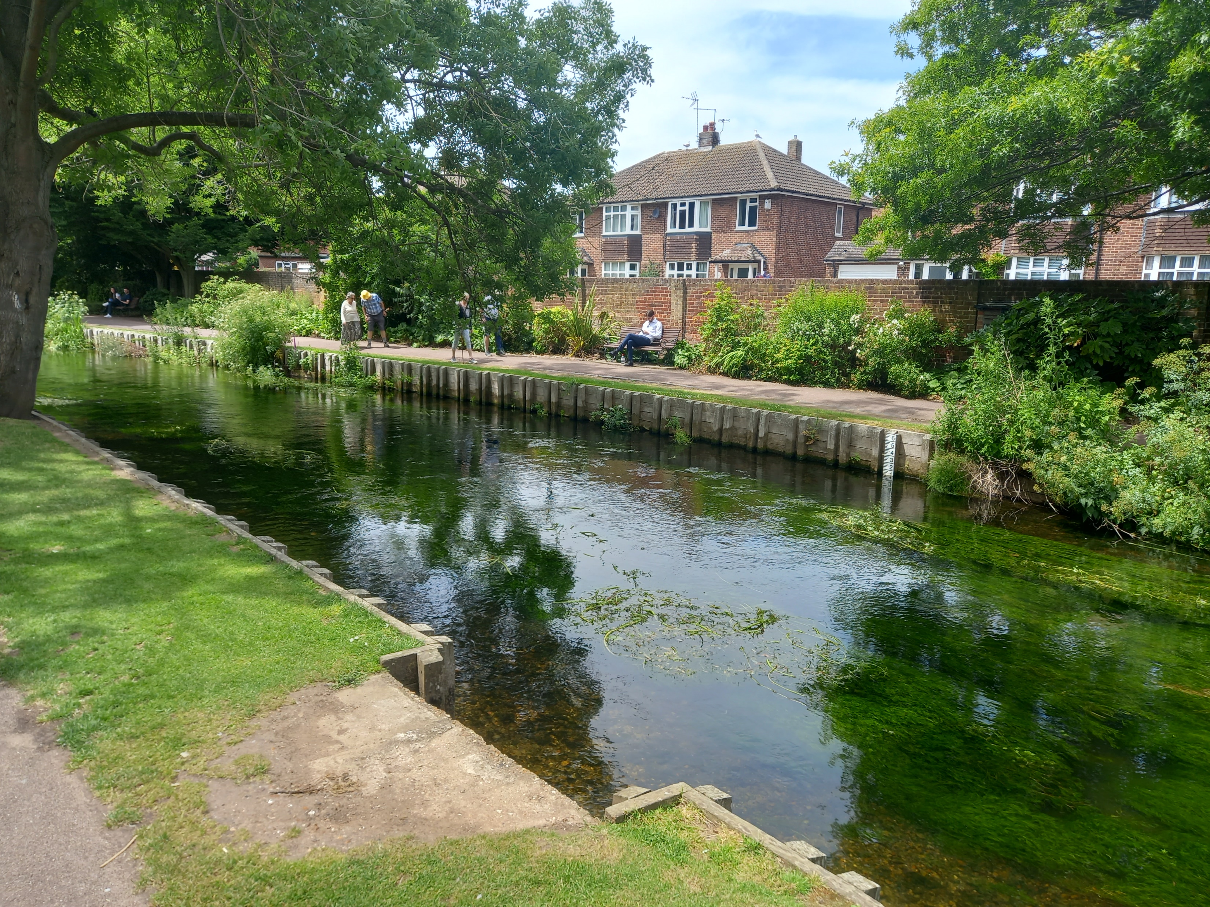
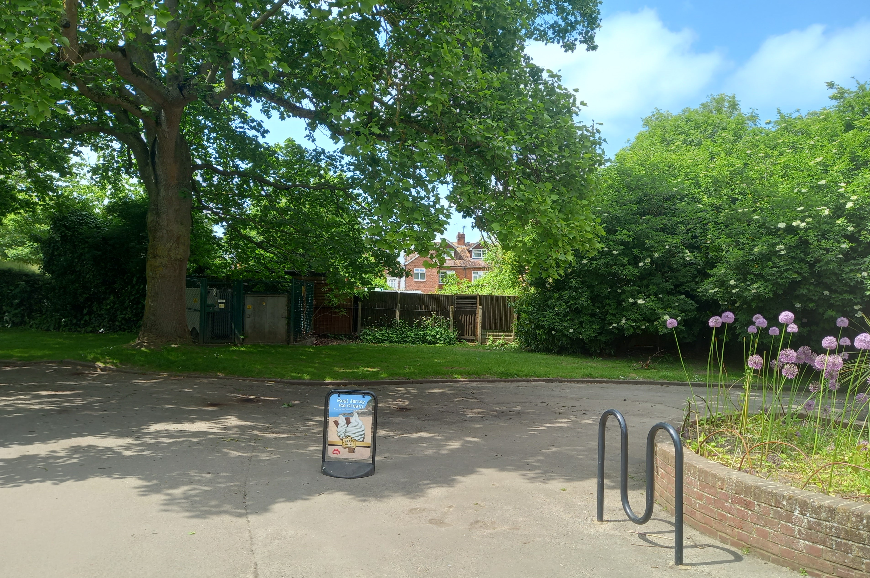
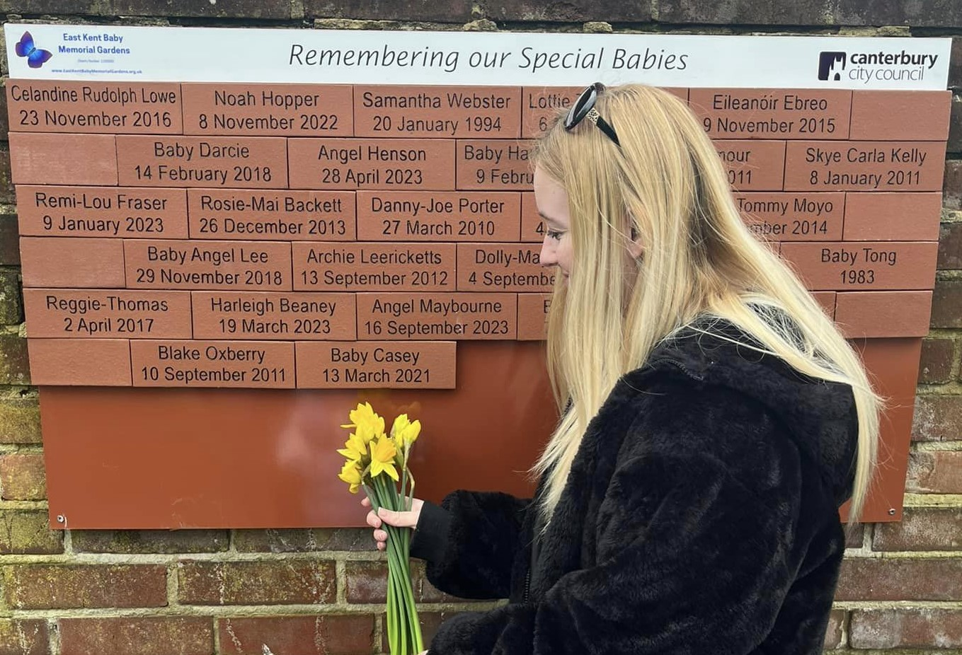
West Faversham Comm Centre
Canterbury Westgate Park
Sittingbourne?
Other areas?????

Slide 8
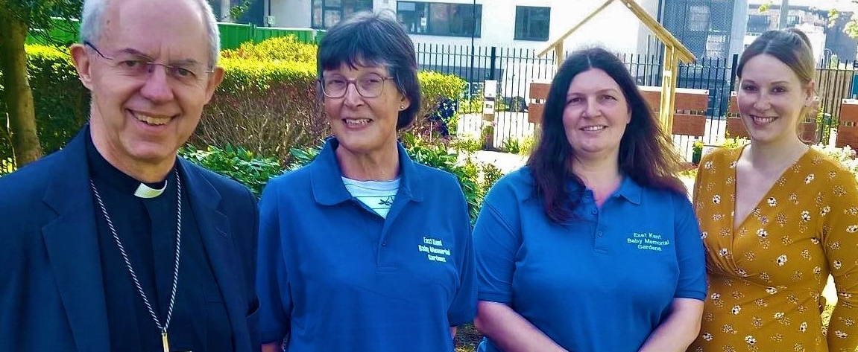
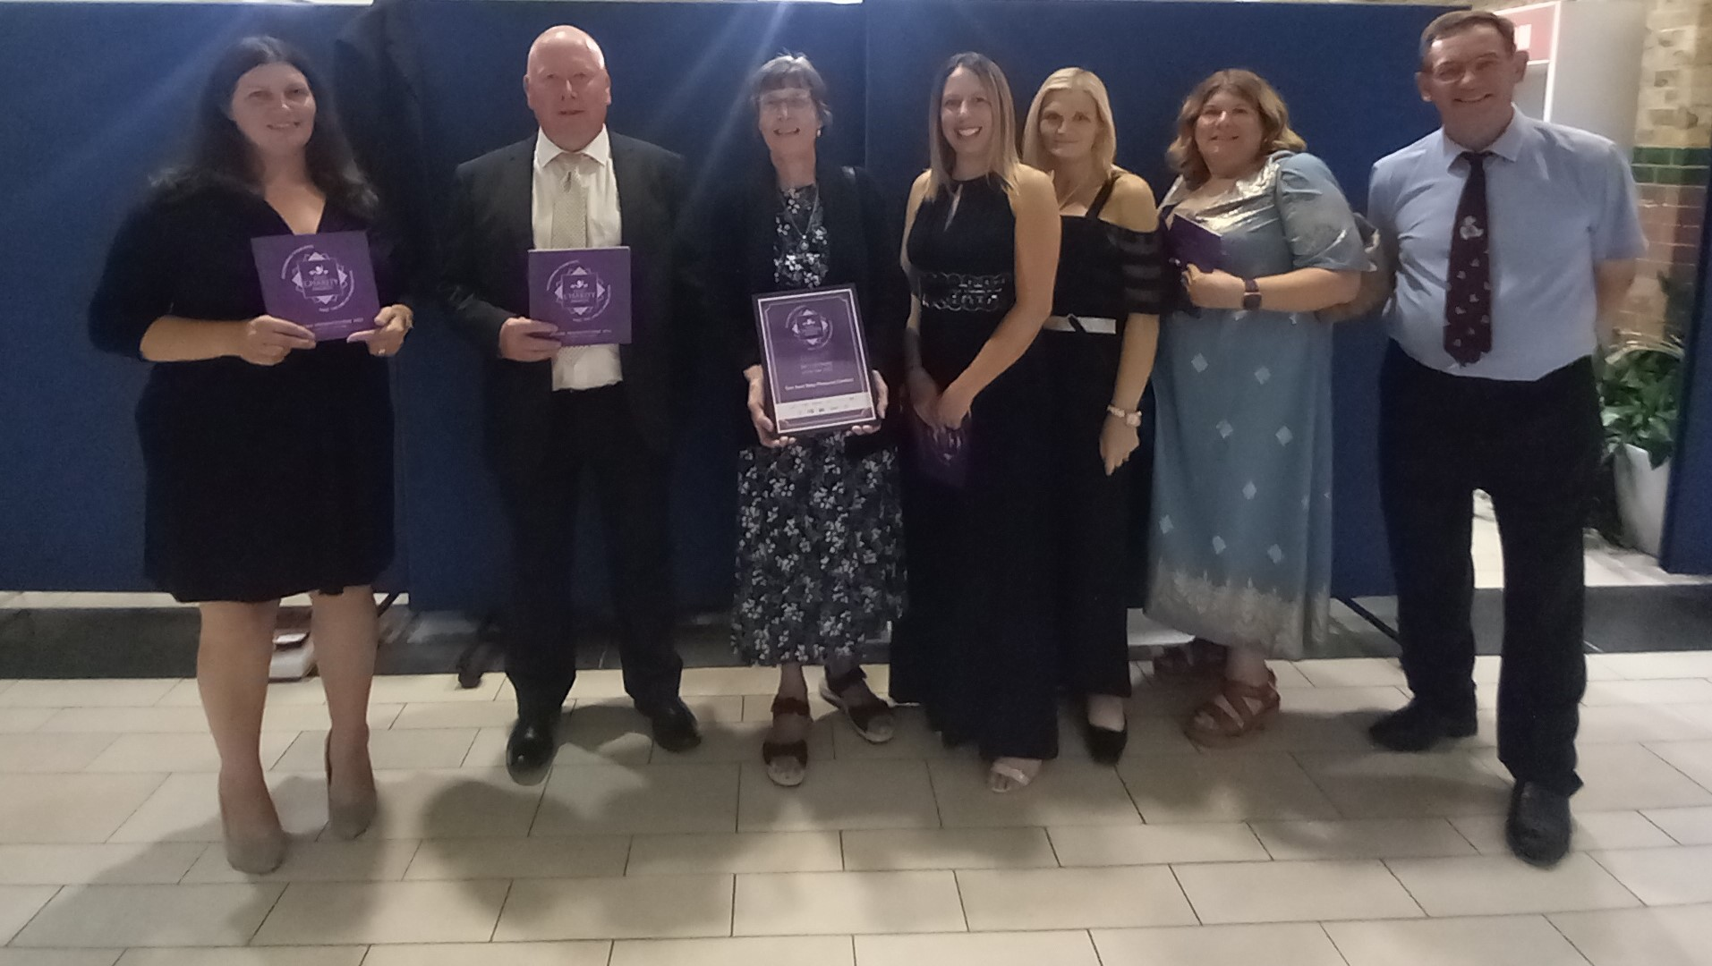
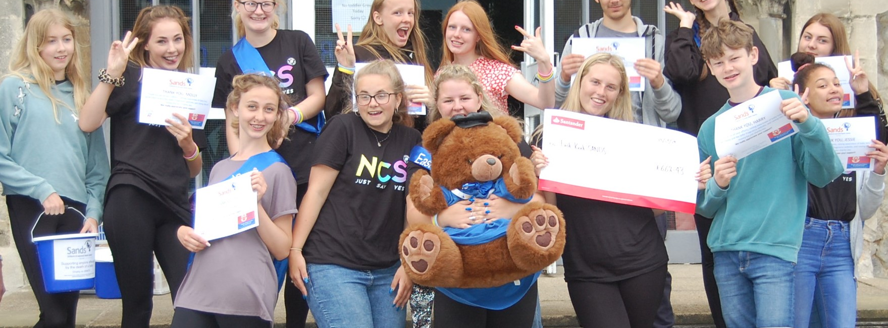

Slide 9
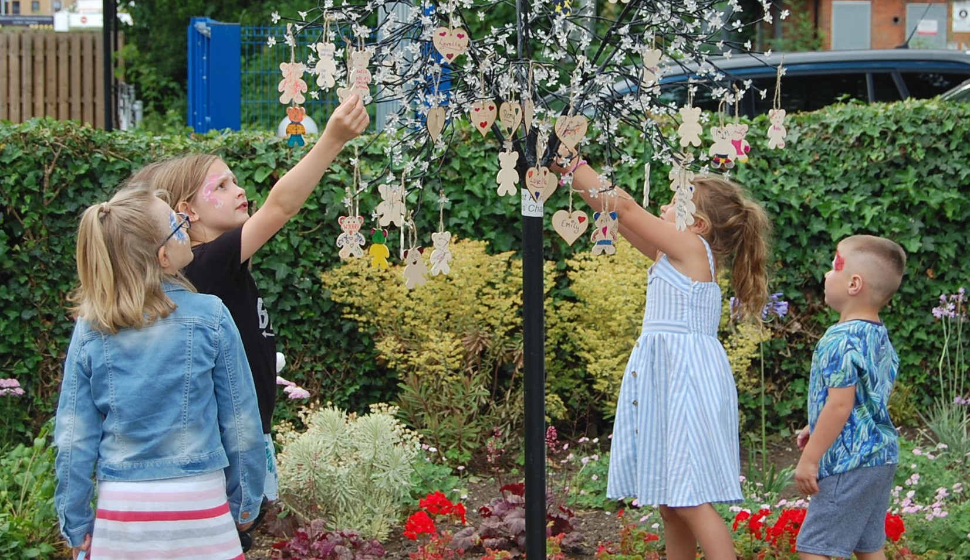
Memories are special
– at any age.
Notes:
Babies often ‘in the stars’

Slide 10
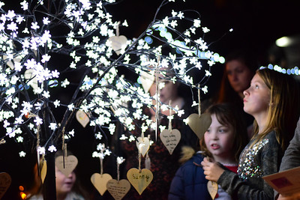
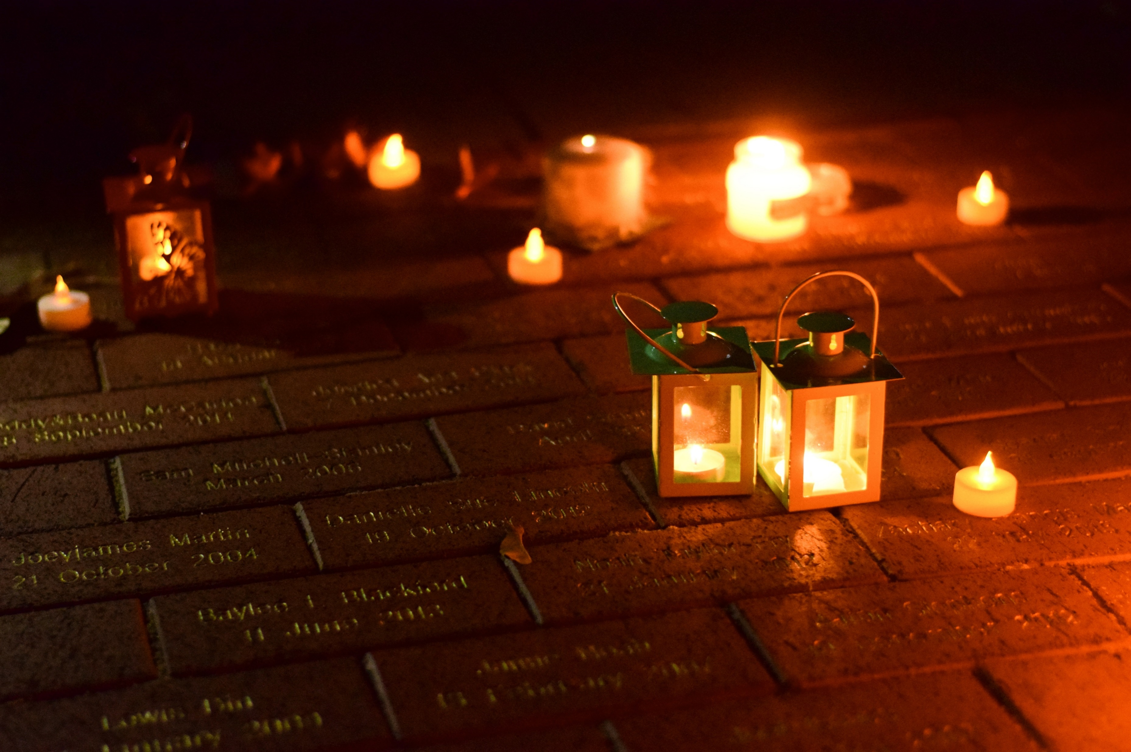
Each October. Remembering our babies.
Notes:
Baby Loss Awareness Week 9-15 October
Parliamentary debate
Wave of Light
Buildings pink and blue

Slide 11
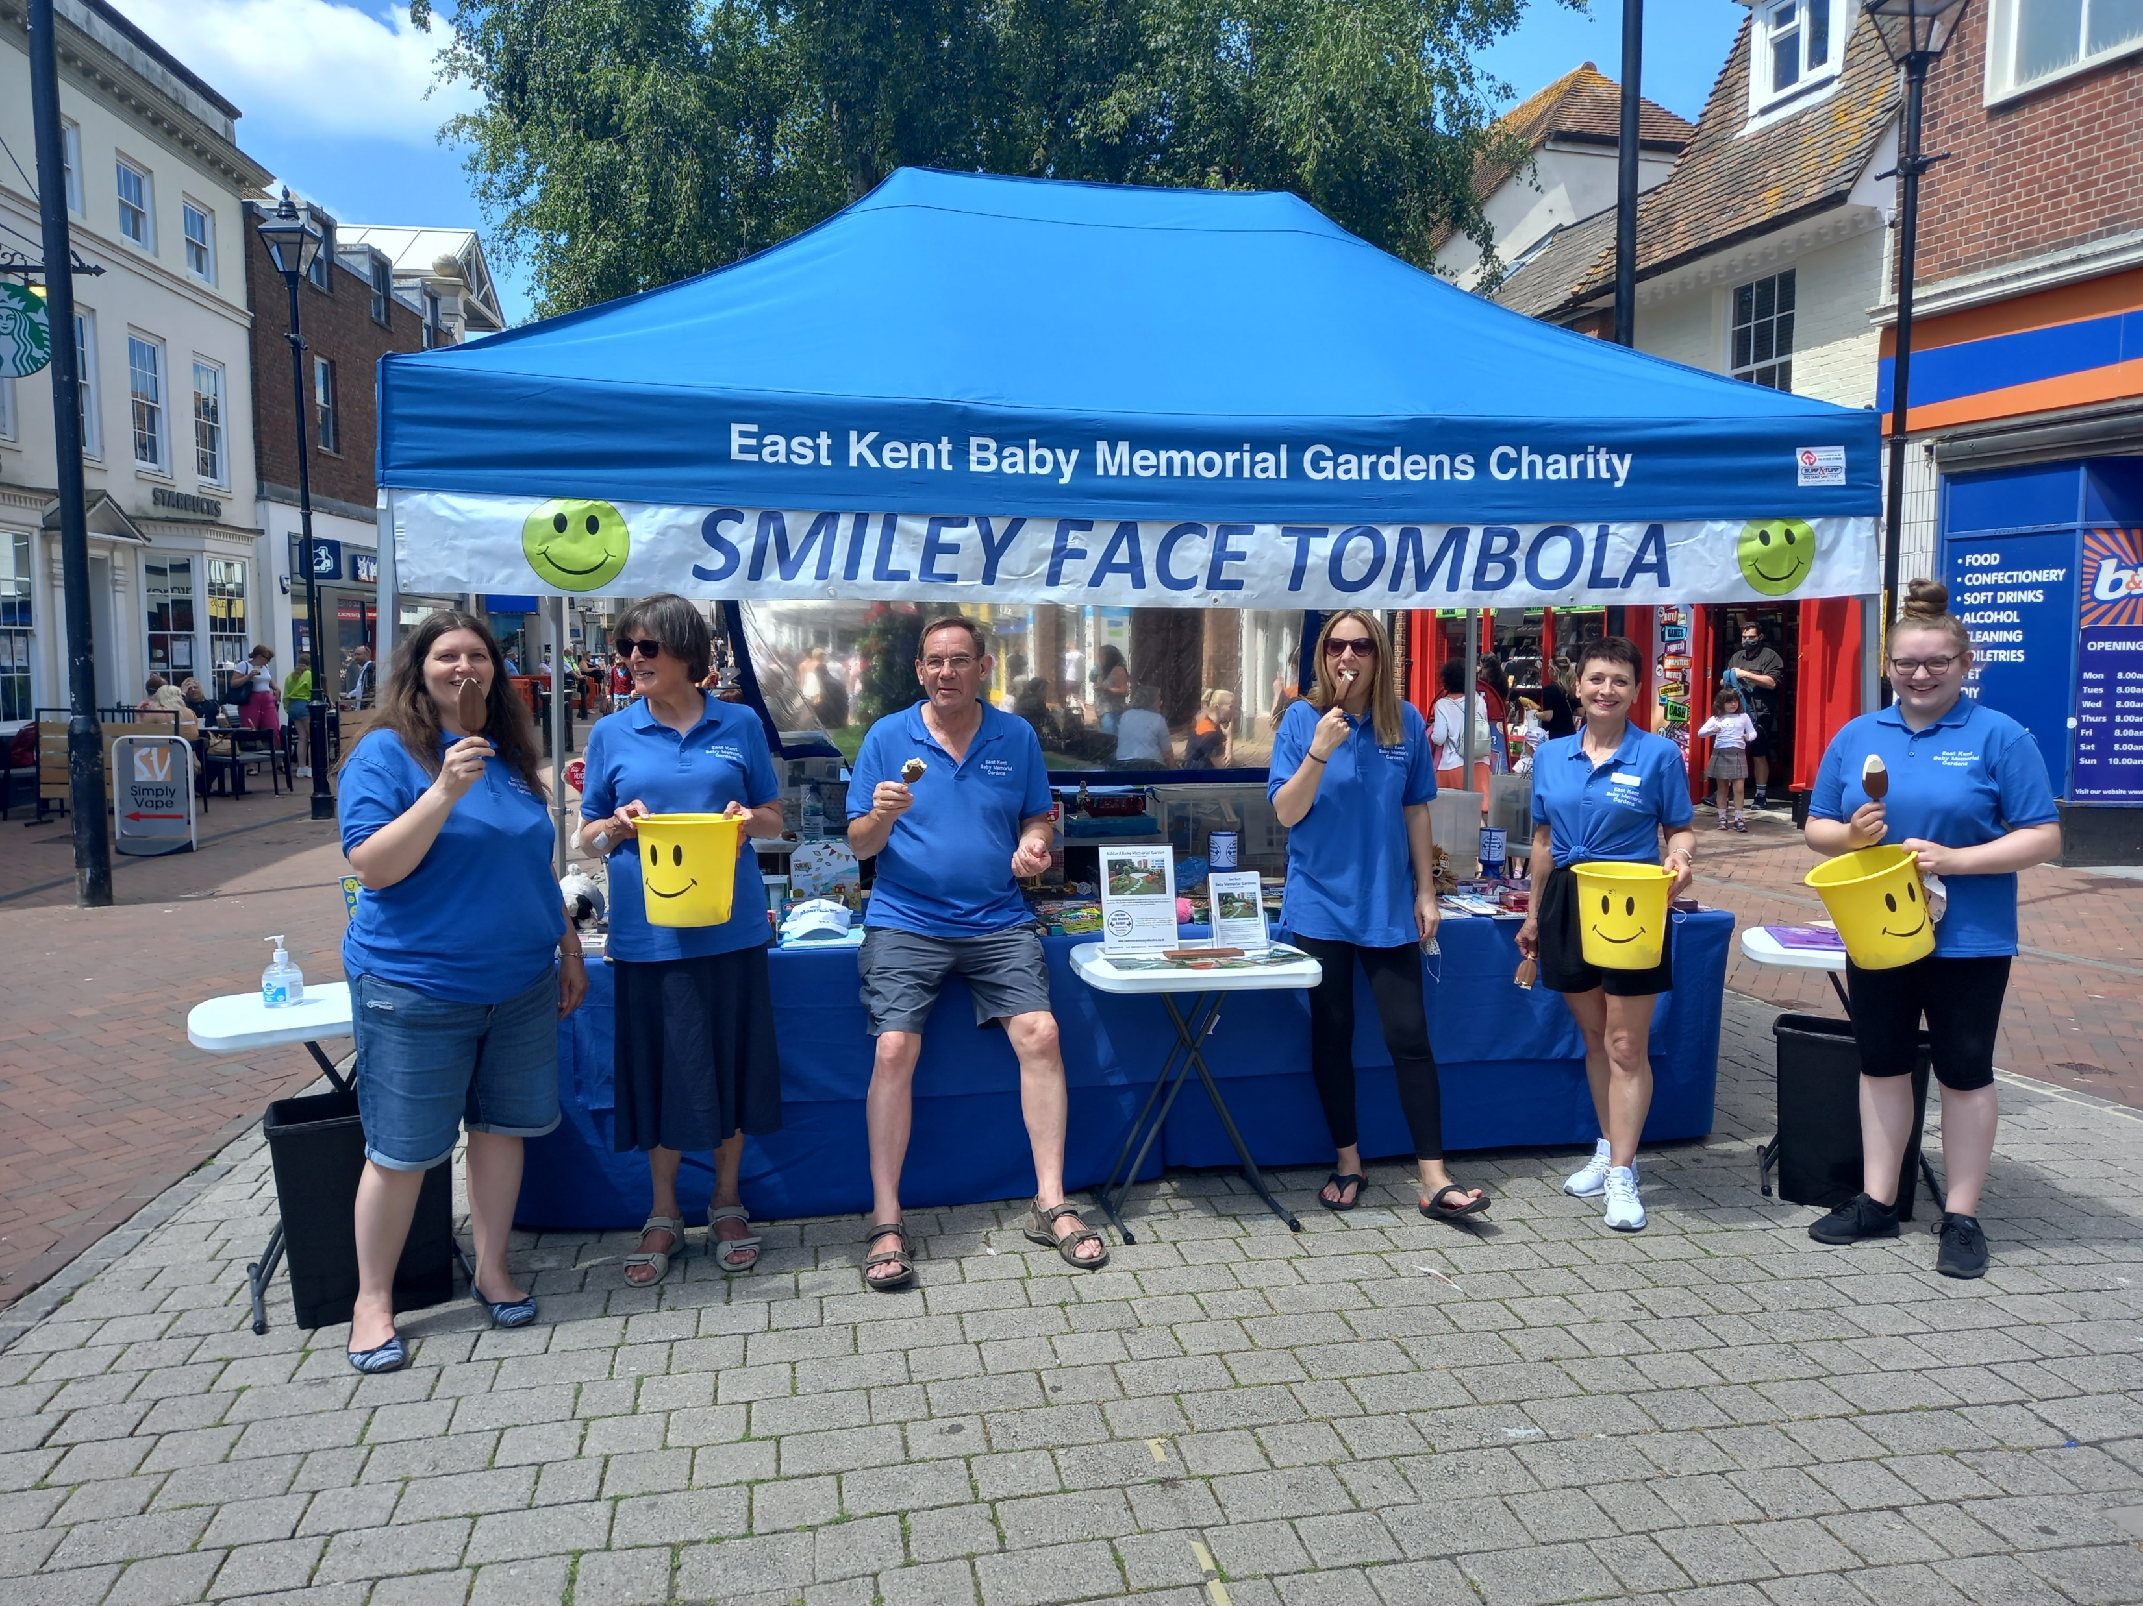
Lots of Smiley Face Tombolas……raising money, raising awareness, having fun!
2024 plans
April Sheerness Family Fun Day
May Headcorn School May Fair
May Ashford Town Centre
June Sittingbourne Volunteers Week
June Kennington (Ashford) Fair
June Folkestone Armed Forces Day
July Eccles Family Fun Day
July Great Chart Big Lunch
August Folkestone Lions Family Fun Day
August Herne Bay Baytastic
August Festival in the Park, Ashford
August Sittingbourne Carnival
September Ashford Town Centre
September Challock Summer Fair
September Dover Urban Fair
October Wave of Light at Victoria Park 7-8pm
November Highworth School Fair, Ashford

Slide 12
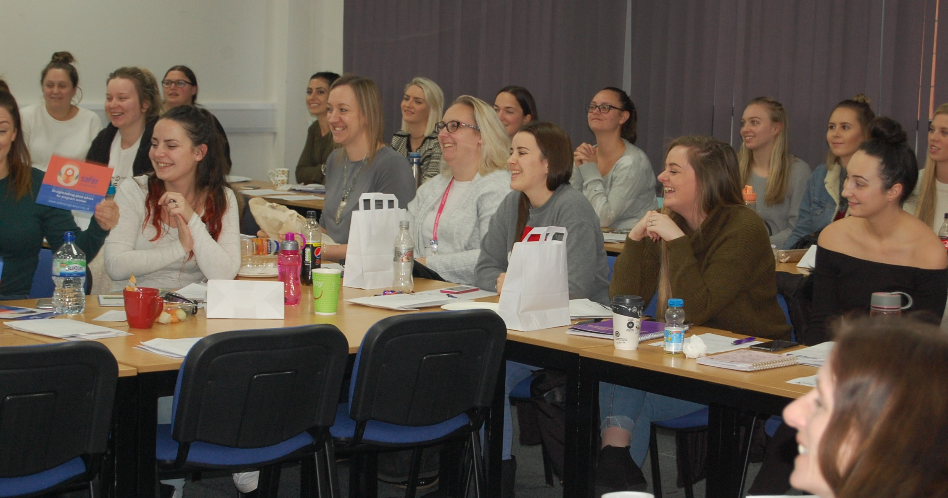
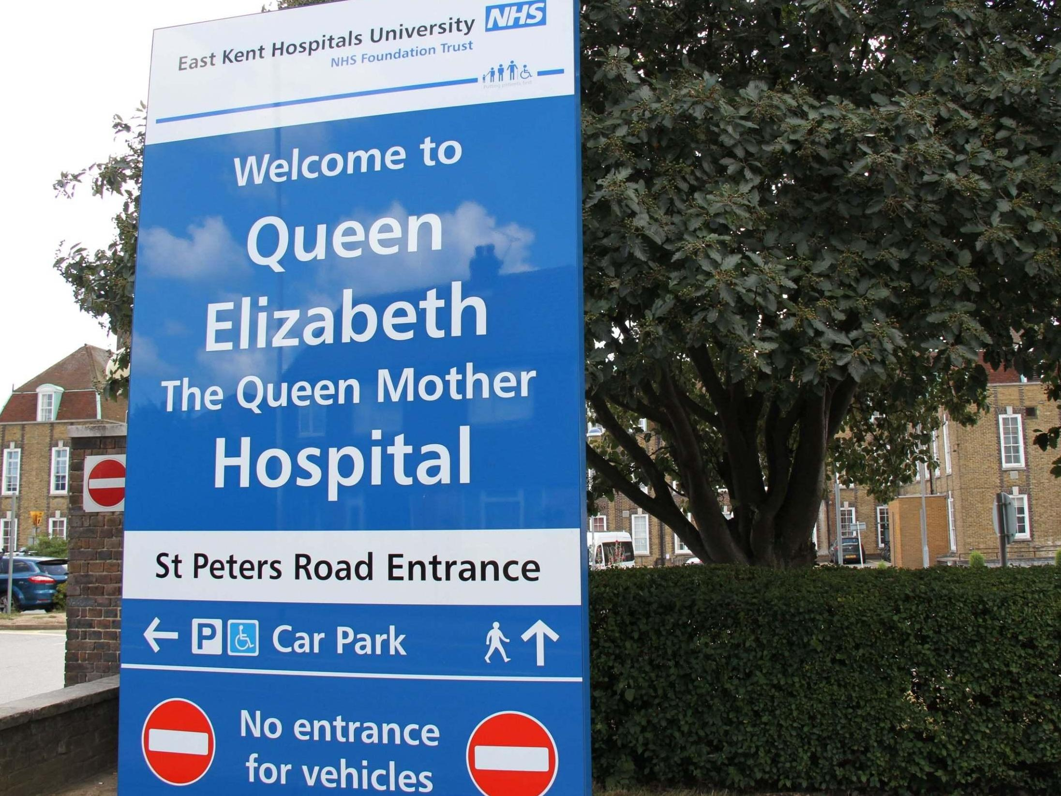
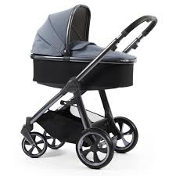
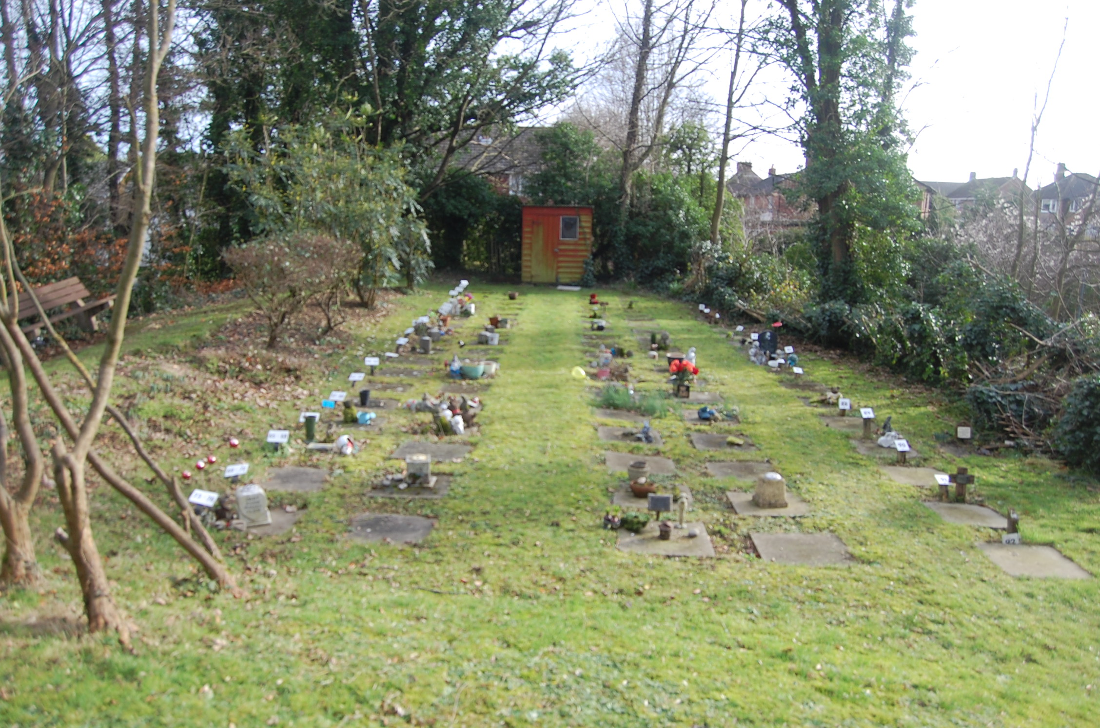
Support to the NHS

Slide 13
Claire’s sister was stillborn thirty years ago. The baby had been taken from the mum and placed in the coffin of an unknown woman who had recently died. The family were not allowed to attend the funeral because the vicar wanted to ‘protect’ the mum, to avoid her getting upset. Her precious baby, buried with a complete stranger. No focal point to mourn, nor to remember her baby.
Mary told us said she had waited over 40 years for somewhere to remember her baby. The Ashford Baby Memorial Garden gave her that somewhere special.
Rosemary had not spoken to a single person since her baby died almost fifty years before. Her husband would not talk and so she could not. We spent twenty minutes at a tombola talking about her baby, Jennifer, her blue eyes and curly hair, the first time in fifty years that anyone had spoken about the baby.
And more recently, a couple told us they lost their daughter Poppy in 2020 but waited until 2023 before they felt ready to order a nametile. But during those three years, the Garden helped greatly, by showing they were not alone.

Slide 15
Chris Twydell, Volunteer and Grandad to Liam

