Slide 1












  SUPPORTING THE COMMUNITY

Slide 2





WHO ARE WE?
  A community bank focused on financial inclusivity
  Not for profit savings and loans cooperative for anyone working or living in Kent and Medway
  Celebrating 25 years of business this year

Slide 3
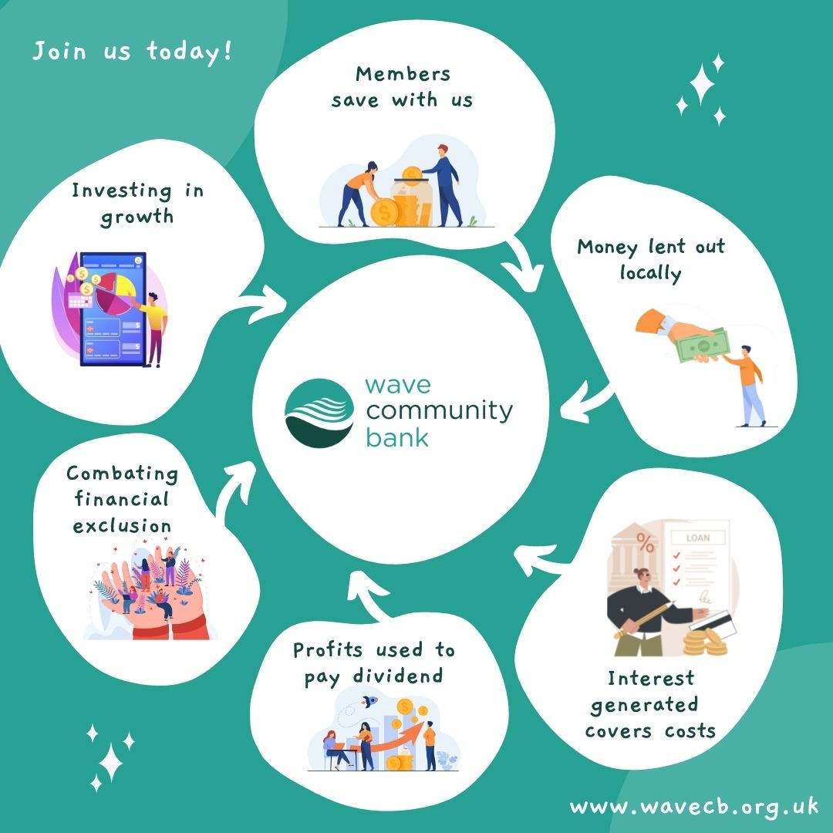
WHO ARE WE?
  14,600+ members ​
  £6.9m assets, savings £5.8m, loans £4.3m​
  Authorised and regulated by the PRA and the FCA

Slide 4







EMPLOYER PARTNERS

Slide 5



NATIONAL NUMERACY DAY
21st May 2025
FREE resources, fun activities, and celeb videos to boost your maths confidence!

Slide 6
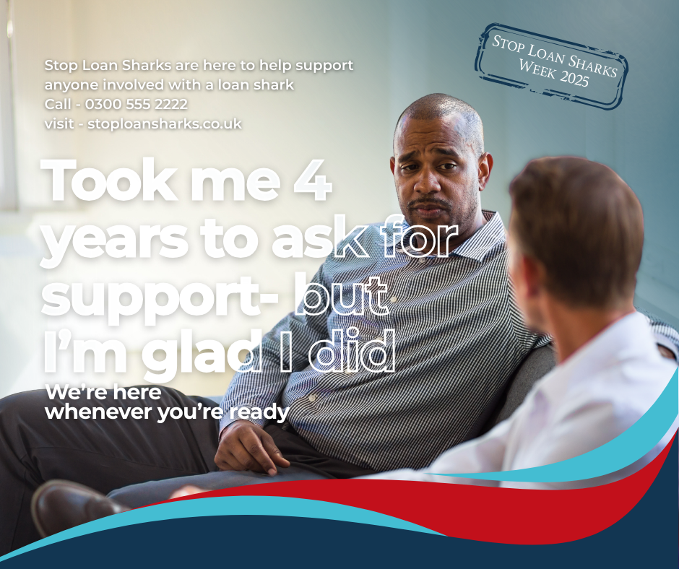
STOP LOAN SHARK WEEK 19TH - 25TH MAY
  Call the 24/7 free confidential helpline 0300 555 2222
  Text or WhatsApp on 07860 022116
  Email reportaloanshark@stoploansharks.gov.uk
Visit www.stoploansharks.co.uk, where you will find a reporting form and a Live Chat option, available 9am to 5pm, Monday to Friday.

Slide 7

BASIC BANK ACCOUNTS
Suits Me accounts can be opened in minutes, whatever your financial circumstances.
  Choice of account types
  No credit checks
  No verified proof of address*
  Alternative ID accepted
  No minimum balances
*subject to AML regulatory requirements.

Slide 8


SAVING MONEY -
SMALL STEPS BIG IMPACT
Start small - £1 a day = £365 a year

Slide 9

SAVING MONEY -
PRIZE SAVER
  Save into your PrizeSaver account and you could win a top prize of £5,000 or one of ten prizes of £50 and ten prizes of £20 in the monthly draws.
  £1 per entry up to £200

Slide 10

SAVING MONEY -
CHRISTMAS SAVING
  You can make unlimited withdrawals from this account between 1st November and 24th December each year.
  From 25th December you will not be able to make withdrawals until 1st November the following year.

Slide 11

SAVING MONEY -
YOUNG SAVERS
  Saving regularly can help you reach these goals and we offer 2% interest on all Young Savers accounts.
  Anyone under 16 years and living in Kent or Medway can open a Young Savers account with us and can save as little or as much as they need.

Slide 12


CREDIT SCORES
  What is a credit score?
  Why does it matter?
  How to improve it ?
    Pay bills on time
    Keep credit utilisation low
    Check your credit report regularly

Slide 13

SAVER LOANS
  Our Ethical Saver Loans are unique to credit unions and turn borrowers into savers.
  Each time you make a repayment, a portion of your money will be put into a savings account.

Slide 14

FAMILY SAVER LOANS
  Ethical Loans you can repay using your Child Benefit payments.
  Repayments can be made in line with how you receive your Child Benefit, weekly or 4 weekly.

Slide 15

DEBT CONSOLIDATION LOANS
  Our aim at Wave Community Bank is to help you reduce your monthly repayments and the overall interest you will repay, so you can clear your debts quicker.
  If you have any of the following kinds of credit, a debt consolidation loan with us should help you save on interest repayments:
    High interest loans – i.e. Peachy, Lending Stream, Loan Pig
    Credit cards
    Bank overdrafts

Slide 16


  To celebrate 25 years of Wave Community Bank we are giving away £500
  Easy form to nominate
  Head to the social media to find the link

Slide 17



THANK YOU
FOR LISTENING

