Slide 1
Wellbeing at the Centre of everything we do…. Plan for survival & growth 2025/26 and beyond ….
Registered Charity 1153745
Social café - Activities
Groups - Support
Friendship
Room Hire
David Milham
Hon. Treasurer

Slide 2
Brief history
Established 40 years ago following closure of St Augustine’s hospital
Day centre for people needing mental health support
30 years ago purpose built centre opened at St Peter’s Place
Funded by voluntary donations on land leased from Canterbury City Council (110 yr Lease)
Grant funded by Kent County Council and NHS (Mental Health)
With some additional community support.
Official funding has reduced and from April 2024 was £Nil
Centre is entirely dependent upon voluntary grants and donations.
April 2024 – Trustees agreed to merge with MIND in Bexley and East Kent
MIND planned to extend the Café area:-
Create a Revival café; Create a Wellbeing area in lounge to the rear and let the upstairs. Application submitted for a Levelling–up Fund £250K grant.
All applications were frozen when the General Election was called and MIND withdrew from the merger.
Umbrella was spending £120K more pa than income
Funded from diminishing reserves (sale of next door property in 2022)

Slide 3
Survival – July 2024
Reduce costs – 2 staff redundant
Review contracts
Utilities, insurance, waste removal, telephone, internet, security, website, photocopier, subscriptions, bookkeeping….
Two Trustees attended Funding4All conference
Introduced to Stronger Kent Communities
Funded consultancy with Sue Carter to develop a Strategic Financial Plan
Two volunteer Bid Writers – Modest Success
J Swire Trust, Kent Com. Foundation, Kobler Trust, Friends of Mental Health East Kent
Registered with “Warm Welcome Spaces”
December – Plan identifies survival through to December 2025

Slide 4
Strategic Financial Plan
Current operation Mon – Friday 9am – 3 pm
Requires income of £125K pa
Recruitment – volunteers in
Kitchen, serving in café, supporting members – now circa 30 regular volunteers
Some specialist help still needed with social media, bookkeeping, activities
Two new Trustees
One with business skills, the other from senior NHS position
Social café - Food Donations from:-
Booker, TWWholesale (fruit & veg), Nandos, Fairshare, Sainsbury’s, M&S, Waitrose – also run a weekly Food Pantry
Increase regular users – membership £12pa re-introduced
Member’s meal deal two course lunch £5 – activity sessions – yoga, art group, board games, crafts, music, philosophy….
Letting income
Upstairs Rotary Room for up to 40, Smaller room 8-10 Café (evenings and weekends) up to 90.

Slide 5
Strategic Financial Plan
Fundraising:
Friends of Canterbury Umbrella:-
Regular donations through Enthuse.com
Local business sponsorship for events / activity days
Bid-writing:-
Two volunteers having some success with local Trusts
Bid Process Enhancement in progress
Events – quizzes, gourmet meal – support from Canterbury Rotary Clubs
Canterbury Rugby Club – match day Charity Saturday 8th March 2025
Contracts – DWP, NHS, KCC Social Services – new trustee recruited will be developing funded support programmes

Slide 6
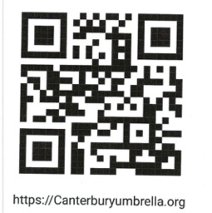
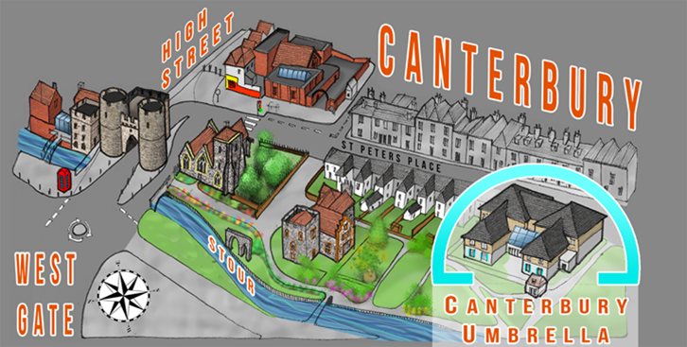
Registered Charity 1153745
Wellbeing at the Centre of everything we do
Social café - Activities - Groups - Support – Friendship
Room Hire

