Slide 2
Katie McDaniel Where to start with corporate partnerships?

Slide 3
Why a business might give:
To fulfil their Corporate Social Responsibility (CSR)
To offset tax
For positive publicity
To offset a negative public image

Slide 4
The difference is the difference between corporate approaches and grant applications.

Slide 5
Preparation, preparation, preparation
1. Your values, your mission statement, your reasons for being…..
YOUR SYNERGIES

Slide 6
Preparation, preparation, preparation
2. Your services, your role in the community, the work you do…..
YOUR DELIVERY

Slide 7
Preparation, preparation, preparation
3. What would be missing if you weren’t delivering…..
YOUR PR PITCH

Slide 8
Preparation, preparation, preparation
4. What do you need money for…..
YOUR ASK

Slide 9
Change your mindset!
This is not a grant application!

Slide 10
Preparation, preparation, preparation
5. What can you offer in return?
YOUR PROPOSAL

Slide 11
Research, research, research
1. Synergetic matches

Slide 12
Research, research, research
2. Giving history, stories, About Us

Slide 13
Research, research, research
3. Two lists:
Go for it!
Long shot

Slide 14
Research, research, research
4. Contact details online
Head of CSR >
Head of marketing >
CEO
5. Verify contact details by phone

Slide 15
Research, research, research
6. Look to your own community -
users
volunteers
friends
families
supporters
suppliers…..consider a direct reach

Slide 16
Your approach
A menu approach…..

Slide 17
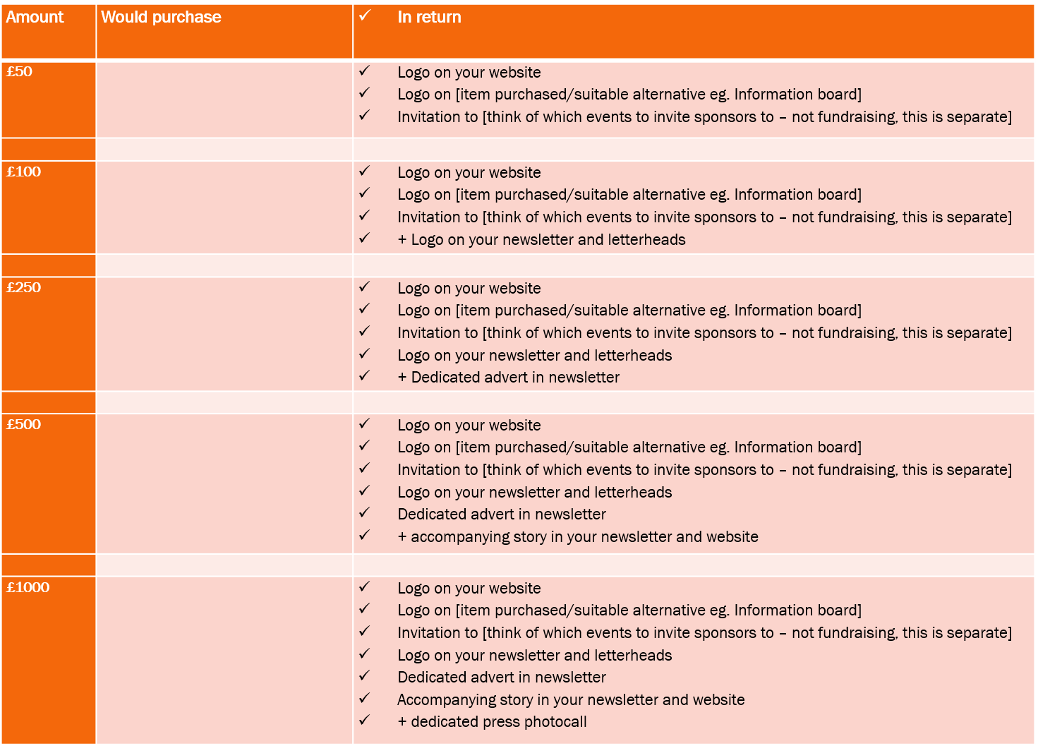

Slide 18
Your approach
Letter
Email
Call
(Email again)

Slide 19
Your approach
Start with your reason for contacting – your synergy
Be direct in your ask in first paragraph – please help us to make this difference by
Include a figure – pick a middle menu item
Try and keep to one page
Don’t forget a call to action

Slide 20
Be a good partner
Detail in a follow up email exactly what has been agreed on both sides.
Deliver! Keep them on guest lists for events and new initiative launches, add them to newsletters and mailing lists and check in periodically.

Slide 21
Be a good partner
Then you can go back to them again and begin to secure their giving. Never underestimate how a £50 donation can turn into a £10,000 a year sponsor by being good partners and giving the business what they want and what you promised…!

Slide 22
Other forms of corporate support
In kind support
ESV
Payroll giving

Slide 23
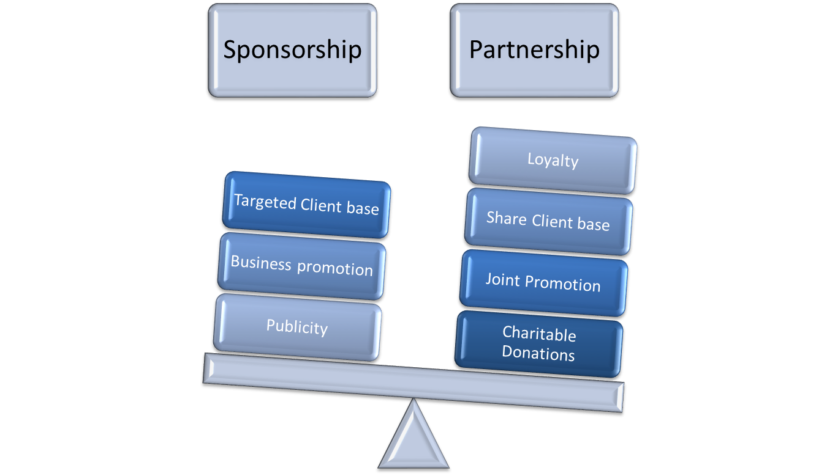

Slide 24
Any questions?

